Slide 2
Meet Number Two
Hello, I am Number Two and I’m off to the zoo! Can you come with me and see where we can find two at the zoo?
Can you see Number Two? What do you notice about him?
What does he have two of?

Slide 3
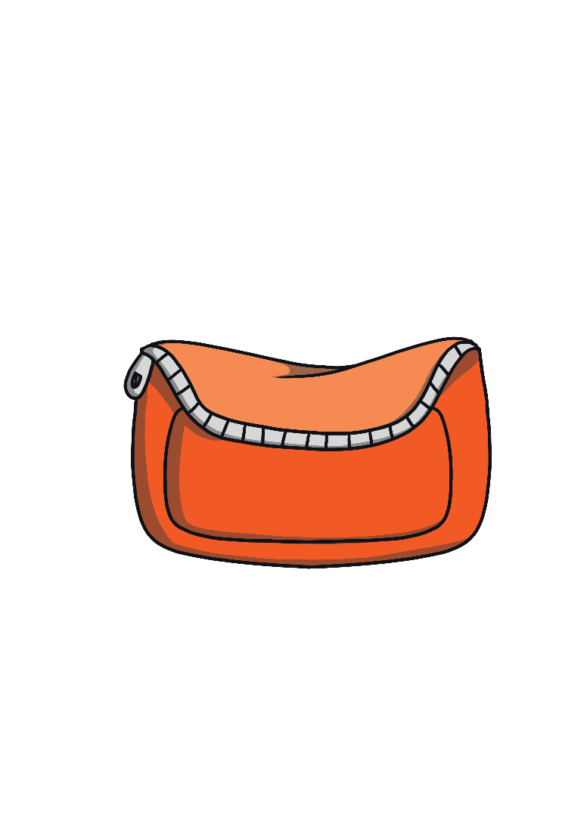
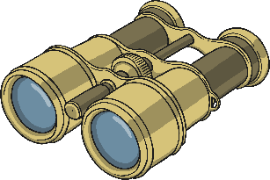
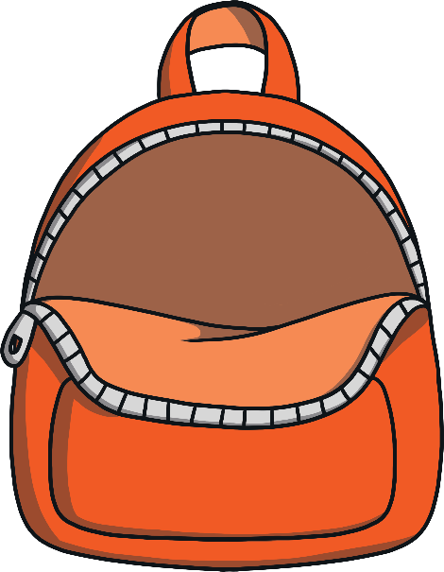
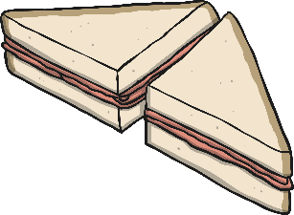
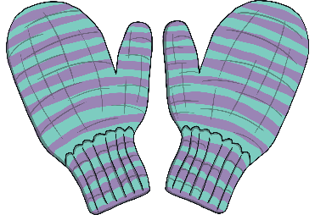
Number Two needs to take some things with him to the zoo. He has begun to pack his bag. Look at all of the objects below. Help Number Two to pack his bag by clicking on the objects that he needs for his day at the zoo. What do you notice about all the objects he packs in his bag?

Slide 4
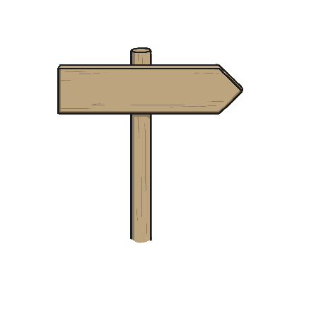
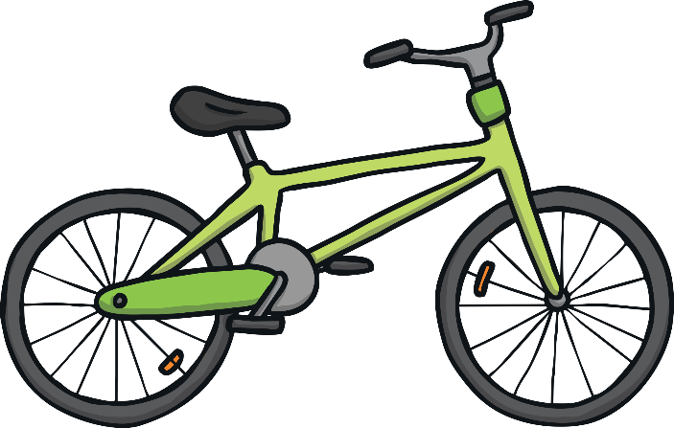
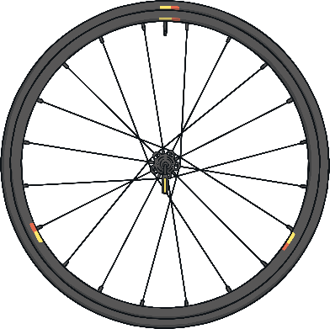
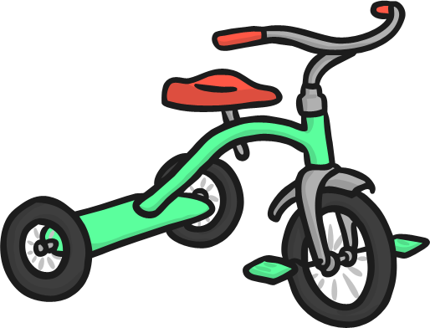
Number Two thought about how to get to the zoo. Which type of transport do you think Number Two chose? Why?
Try again
2 wheels
1 wheel
Try again
Try again
4 wheels
3 wheels

Slide 5
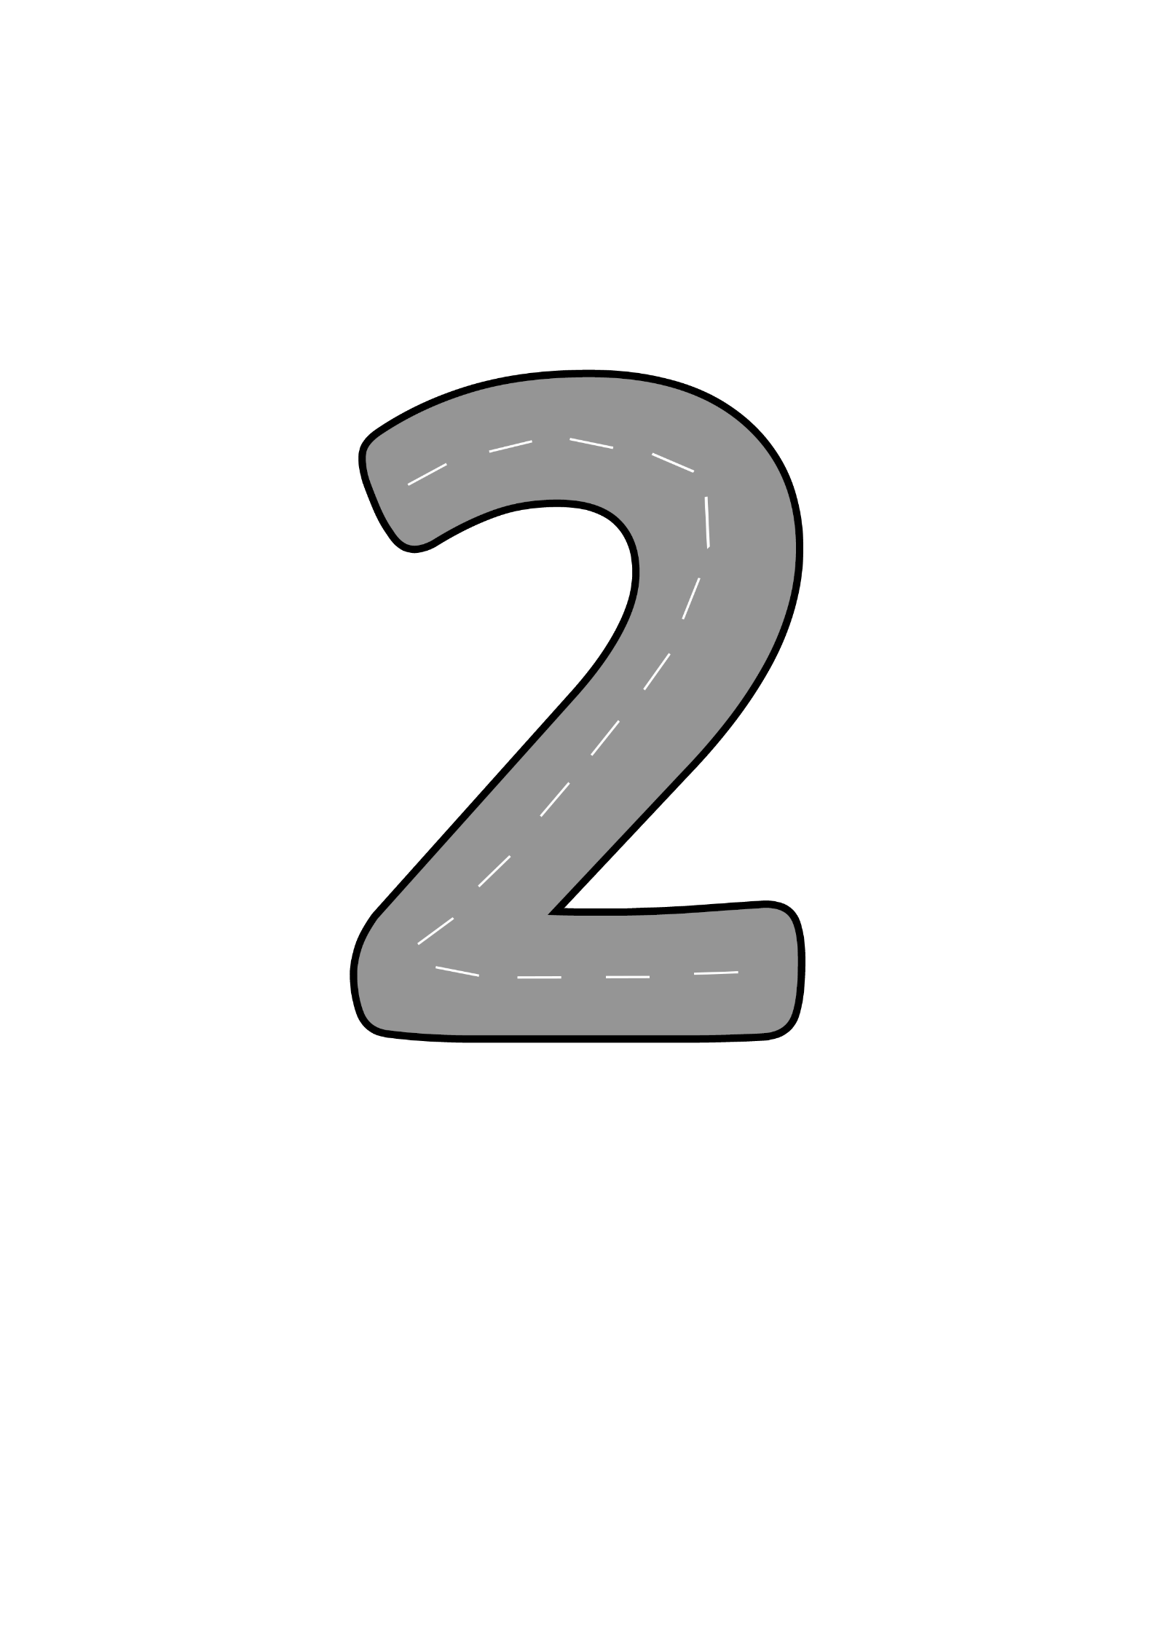
Number Two set off on his bike. Look at the road that he followed.
As he rode along, he sang a song.
Half a heart says, ‘I love you.’ Add a line. Now I’ve made the number two.

Slide 6
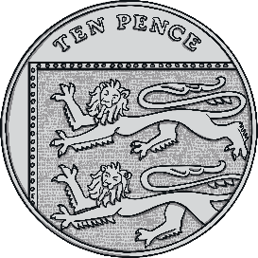
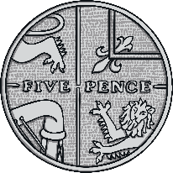
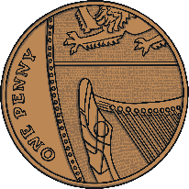
Number Two arrived at the zoo. He looked at the sign at the entrance.
It costs 2p to enter the zoo. Can you help Number Two choose the coin he needs to pay?
Let’s have fun at the zoo!
Entry 2p
Try again
Try again
Try again

Slide 7
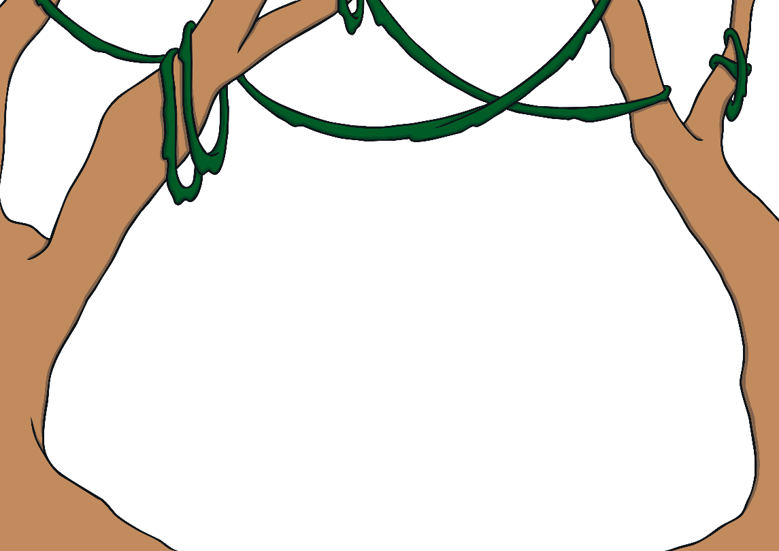
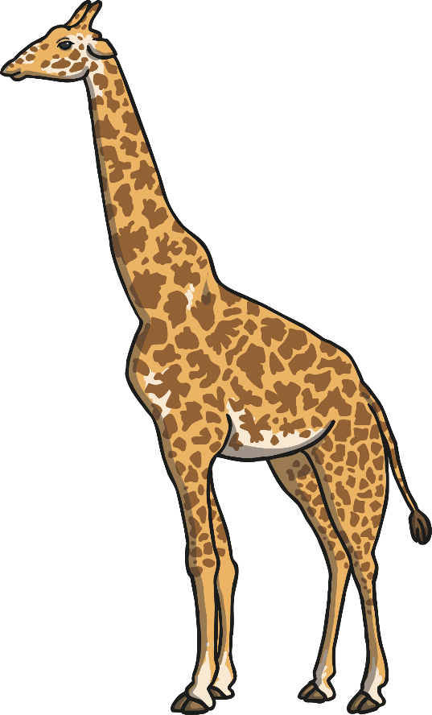
Number Two reached the first enclosure. He looked inside.
How many giraffes can you see? How do you know?

Slide 8
Number Two walked through the butterfly house looking on the leaves for butterflies. Can you spot the leaf with two butterflies on?
Try again
Try again
That’s right,
there are 2 butterflies on that leaf.
Choose the leaf with 2 butterflies on. How do you know it is 2?

Slide 9
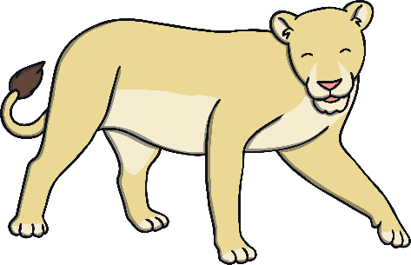
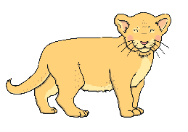
Number Two loved looking at the lions. One of the lionesses has 2 cubs. Can you choose the lioness that has 2 cubs?
I only have 1 cub. Try again.
Well done.
Which lioness has 2 cubs? Can you count them and choose the correct one?

Slide 10
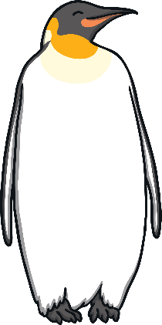
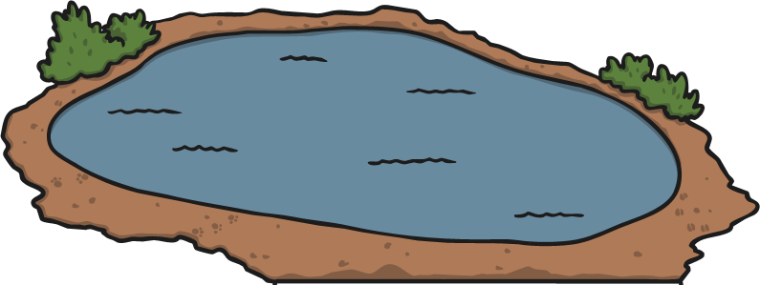
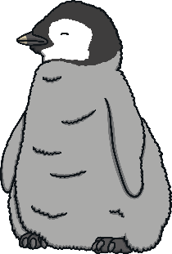
Number Two went to see the penguins being fed. Number Two wanted to throw 2 fish to the penguins. Which bucket has 2 fish in?
Try again
Try again
Well done. The penguin can have 2 fish.
Can you find the bucket that has 2 fish in? How do you know there are 2?

Slide 11
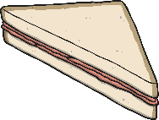
Number Two was tired after walking around the zoo. He sat down for a picnic. Which plate has 2 sandwiches?
Yes, I like to eat 2 sandwiches.
That’s not my plate, try again!
That’s not my plate, try again!

Slide 12
Before going home, Number Two had to find his bike outside the entrance. What number bay is the bike parked in?
No, that is not bay 2.
Thank you, that is my bike!
No, that is not bay 2.
1
2
3
Can you find the bay I
parked my bike in?
What number comes before 2? What number comes after 2?

Slide 13
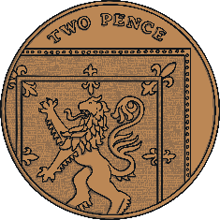
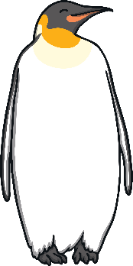
I have seen lots of great things on my trip to the zoo. Can you remember all the things that I saw?
2 giraffes
2 butterflies
2 pence
2 cubs
2 fish
2 sandwiches
2 penguins

Slide 14
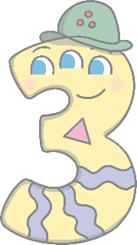
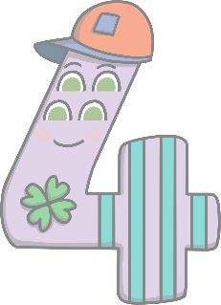
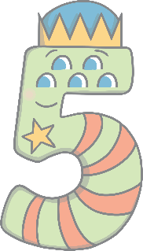
Can you find number 2 on the number track?
1
2
3
4
5
Which number comes before number 2? Which number comes after number 2? Can you count along the number line from 1 to 5?
Click on Number Two to move him onto the number track.

