Slide 2
Meet Number Seven
Hello, I am Number Seven. Would you like to hear about my holiday to Devon?
Can you see Number Seven? What do you notice about her? What does she have seven of?

Slide 3
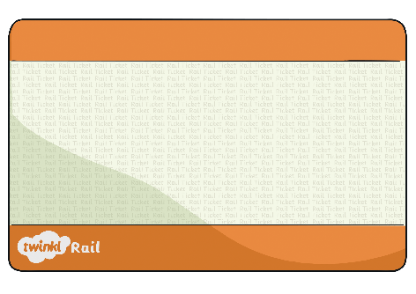
Number Seven went on holiday to Devon. She took the train. Number Seven needed a ticket for the train. Her ticket had a number 7 on it.
Can you help me choose the correct ticket for my journey?
That’s my ticket!
Try again!
Try again!
5
7
4

Slide 4
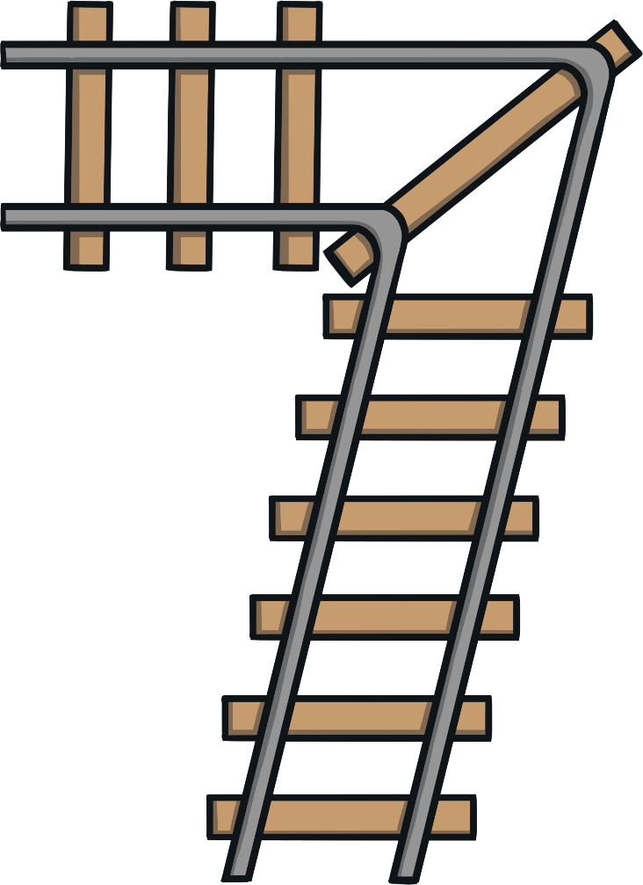
Number Seven set off. As the train sped along, she sang a song...
Across the sky and down from heaven. Now I’ve made a number seven.

Slide 5
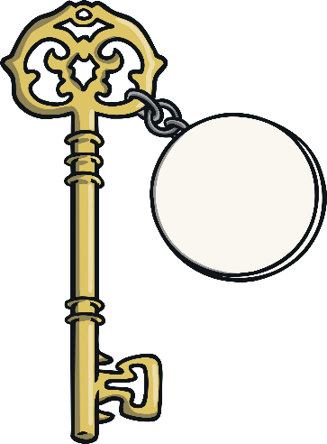
When Number Seven arrived at her hotel, she was told she would be staying in room number 7.
Which key belongs to me? How do you know?
Well done, you’ve found the right key! Can you count the spots to check?
Try again!
Try again!

Slide 6
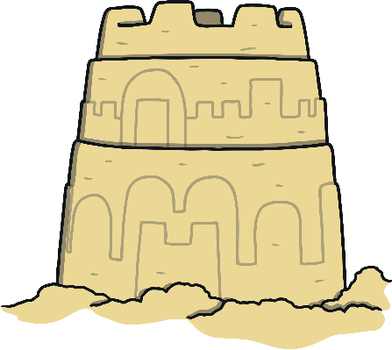
Number Seven decided to go the beach, where she took part in a
sandcastle building competition.
Which sandcastle do you think is mine? Why do you think that?
Well done! That’s my sandcastle!
Try again!
Try again!

Slide 7
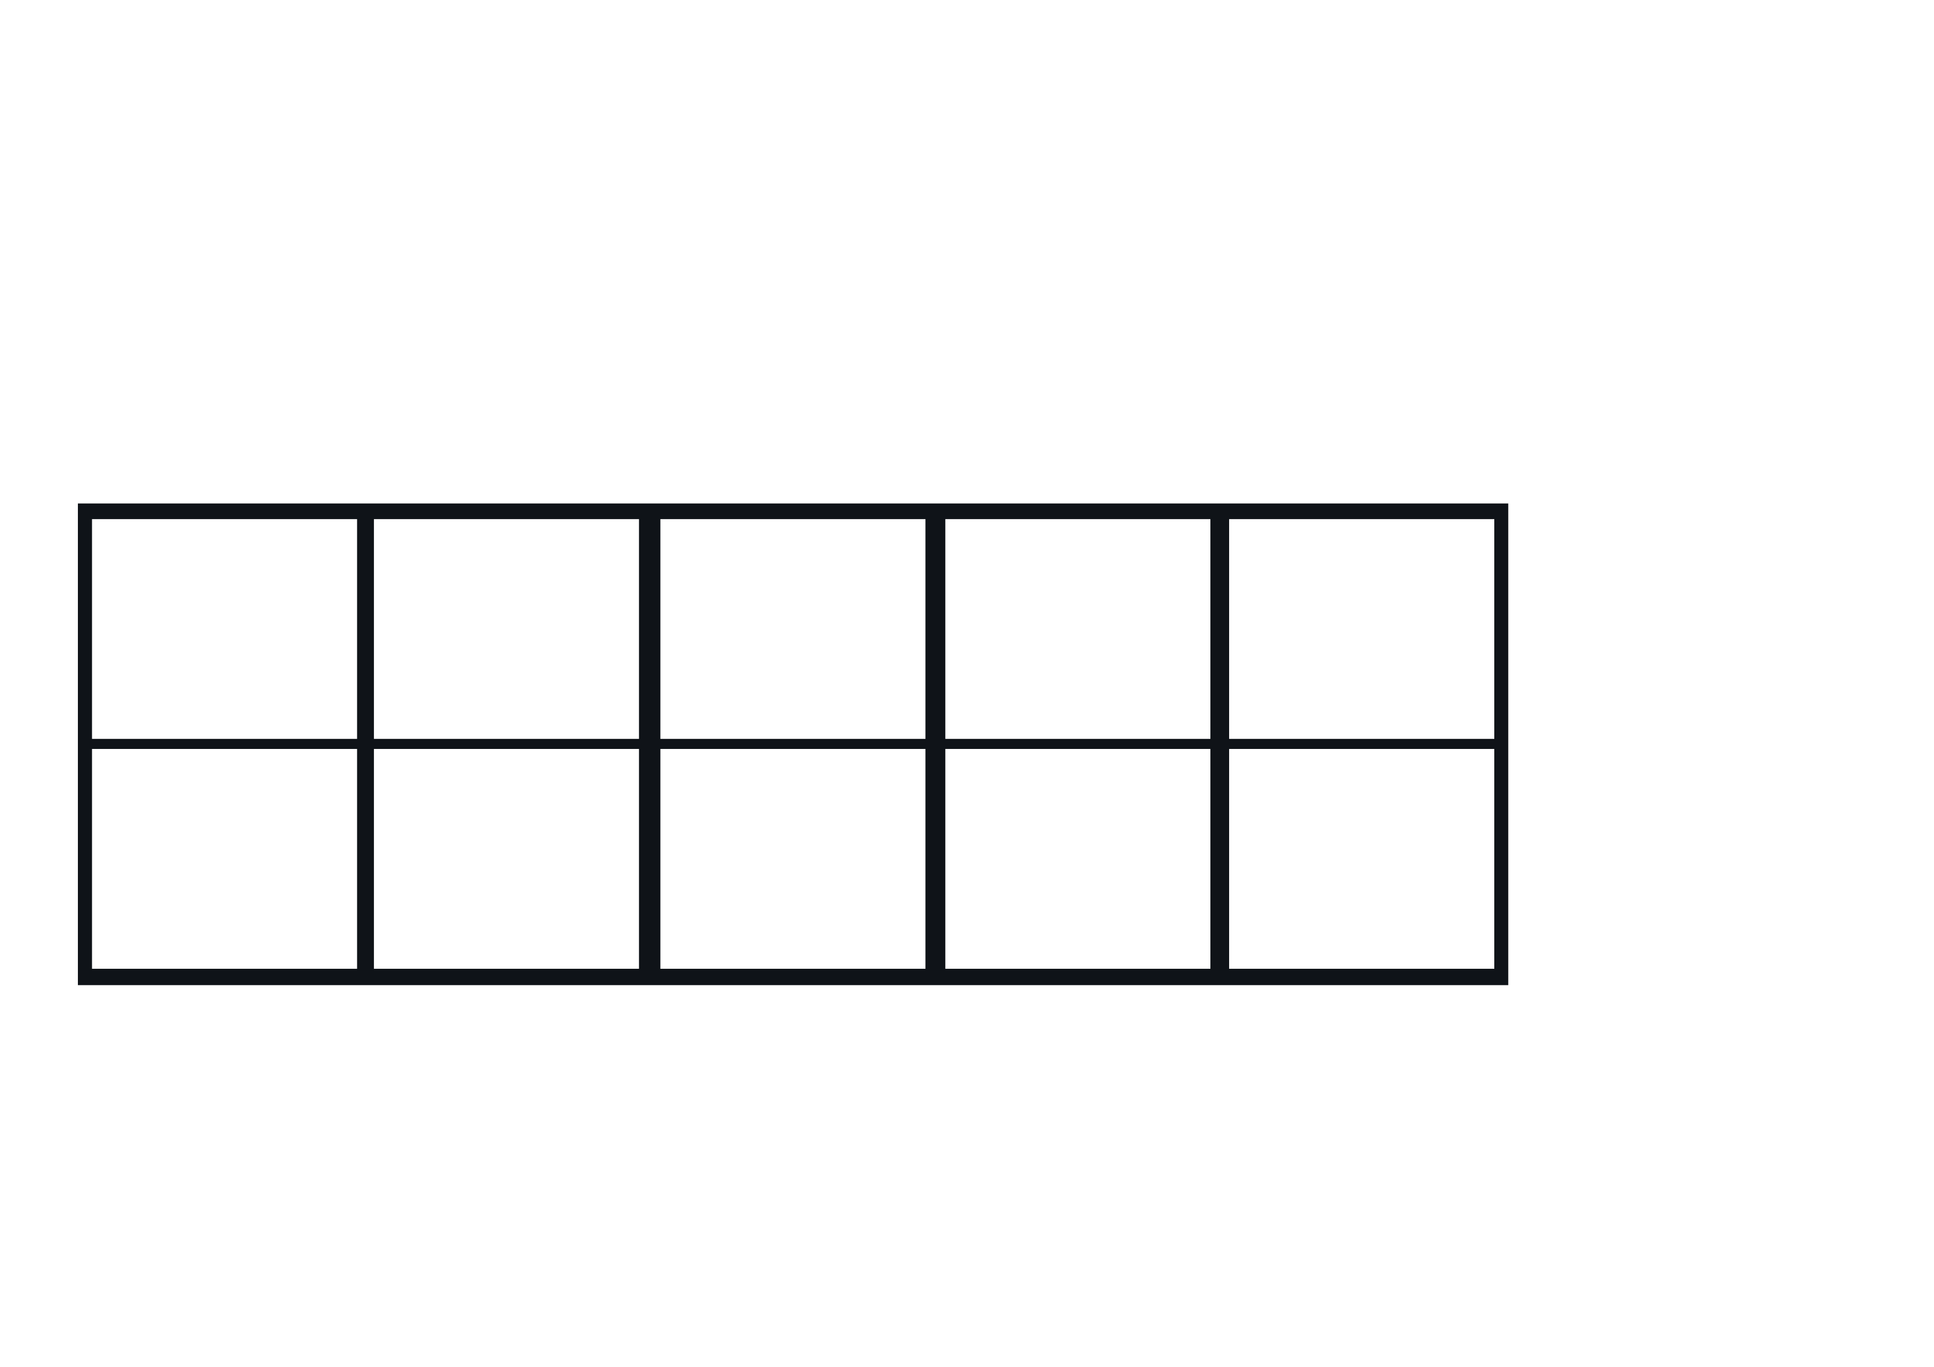
While she was at the beach, Number Seven found some pretty shells to collect.
Which bucket do you think is mine? How can you check?
You chose the right bucket! How did you know it was 7?
Try again!
Try again!

Slide 8
Then, Number Seven bought herself an ice cream. It cost 7p.
7p
Which purse shows the coins I used to pay for my ice cream?
Well done. That’s 7p! How did you check?
Try again!
Try again!

Slide 9
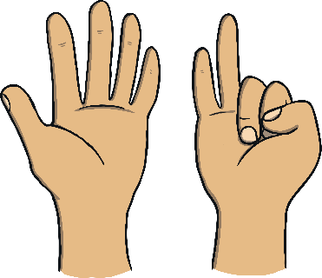
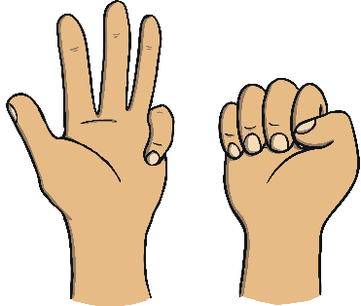
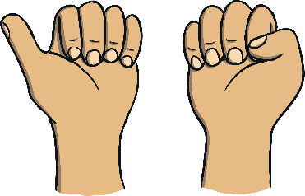
Number 7 used her binoculars to look around the beach.
I think there are 7 seagulls. Am I right?
Which set of fingers show 7?
You’re right! That’s 7. Can you show me 7 on your fingers?
Try again!
Try again!

Slide 10
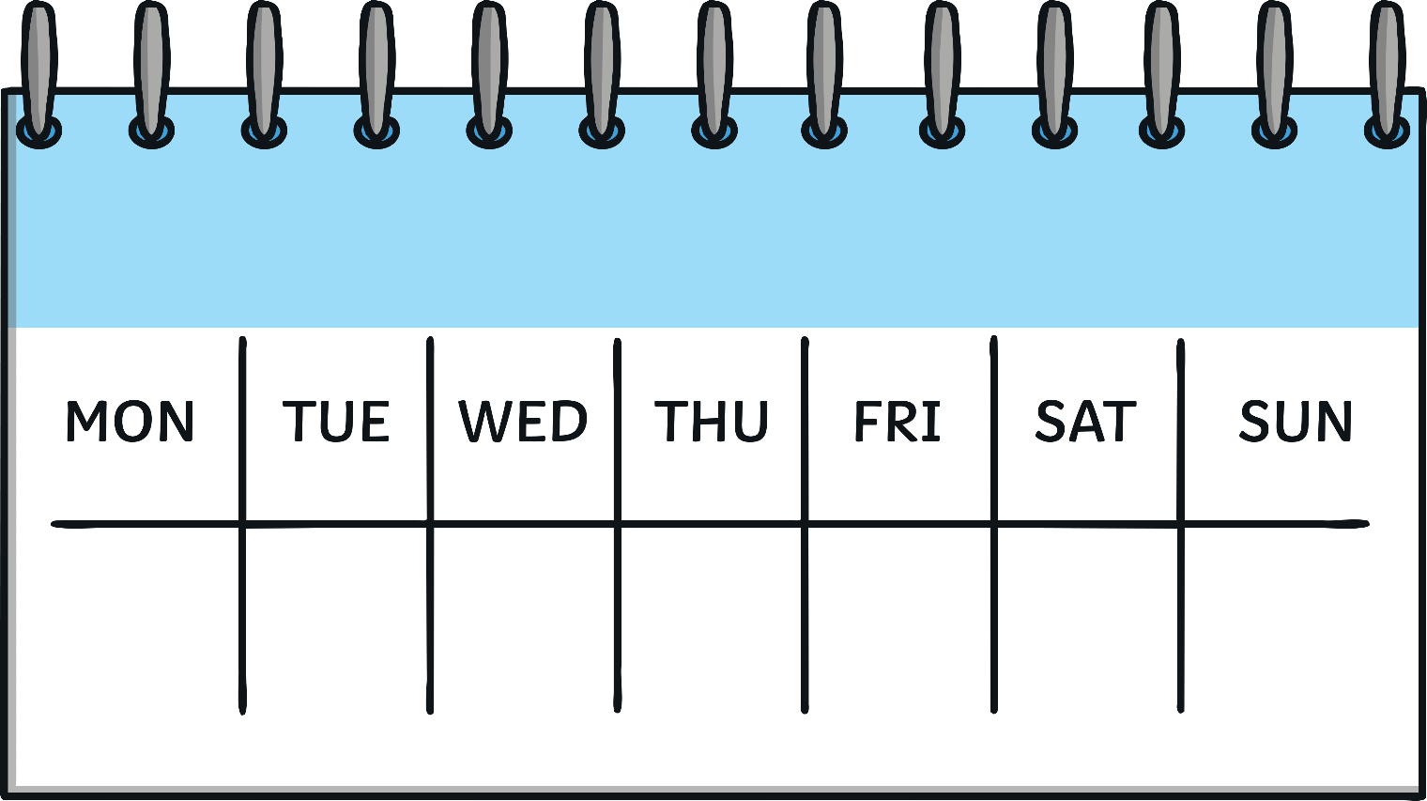
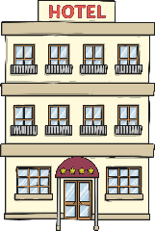
Number Seven had such a busy week on her holiday! Look at all the things she did.
How many days are in a week? Can you say them?

Slide 11
Can you remember all of the ways that we saw 7 on my holiday?
7
ticket number 7
room number 7
7 flags
7 shells
7 pennies
7 seagulls

Slide 12
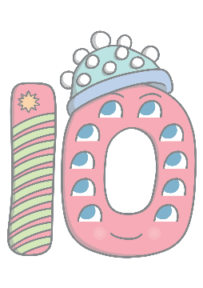
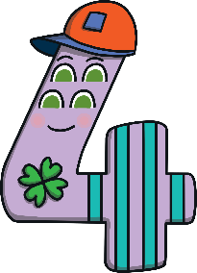
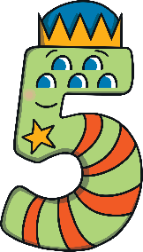
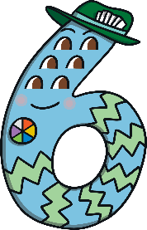
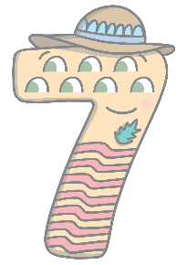
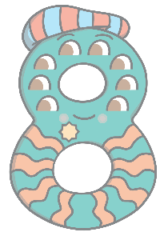
Can you find 7 on the number track? Click on Number Seven to move her onto the number track.
1
2
3
4
5
6
7
8
9
10
Which number comes before 7? Which number comes after? Can you count along the number track from 1 to 10?

