Slide 2
Meet Number One
Hello, my name is Number One. I love the number 1. Will you come on an adventure with me and see how many 1s you can see?
What do you notice about Number One? What does he have one of?

Slide 3
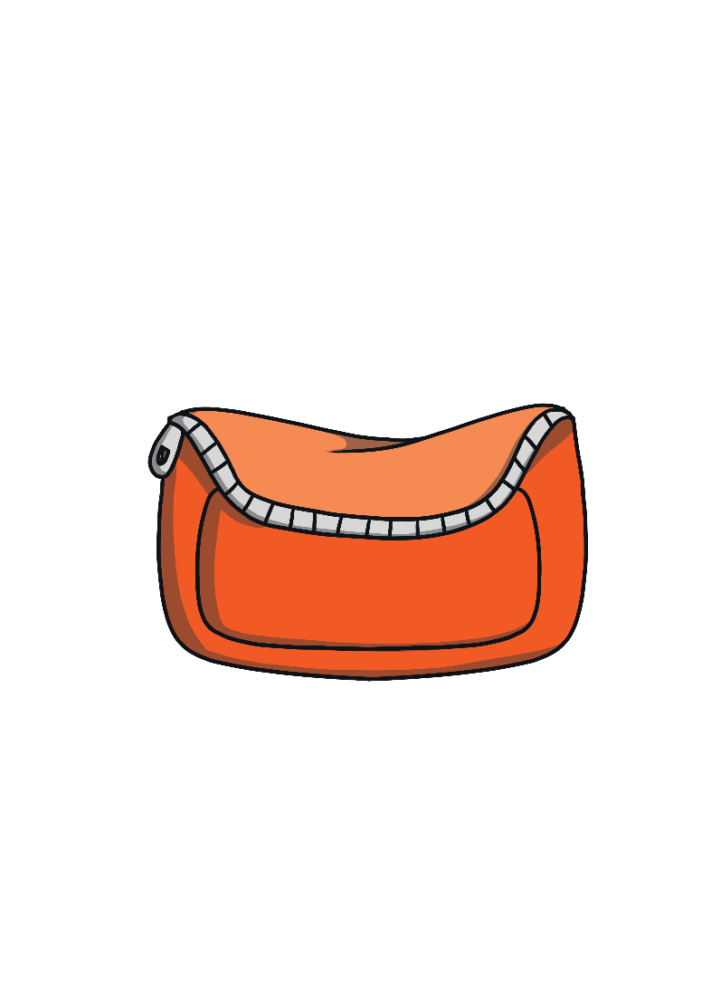
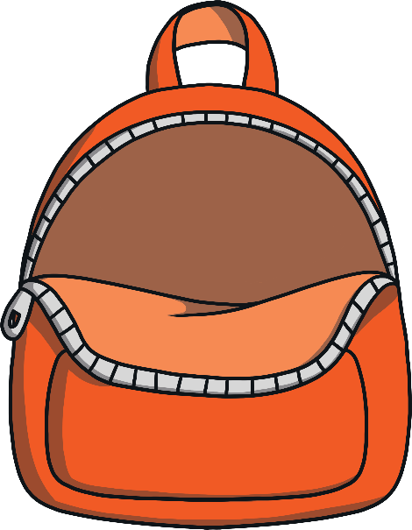
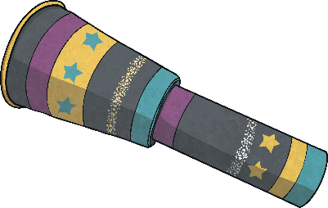
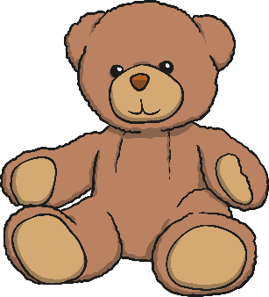
Number One wanted to go on an adventure! Can you help to pack Number One’s bag by clicking on each item?
1 telescope
1 apple
1 purse
1 teddy

Slide 4
Number One set off along the road. He hopped along on his one leg.
What do you notice about the road?
As he hopped along, he sang a song…
A downward stroke, that was fun.
Now I’ve made the number 1!

Slide 5
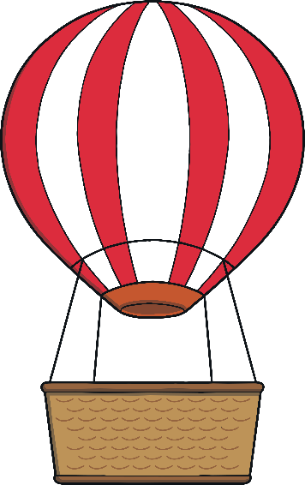
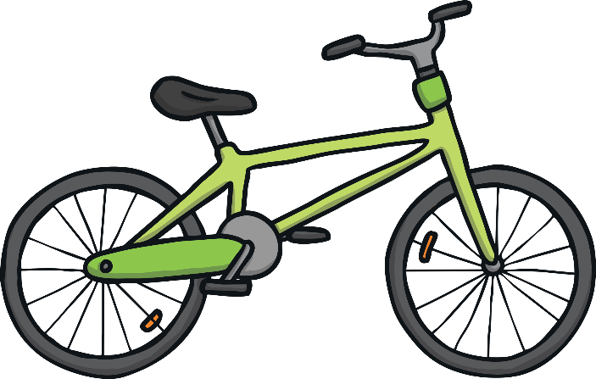
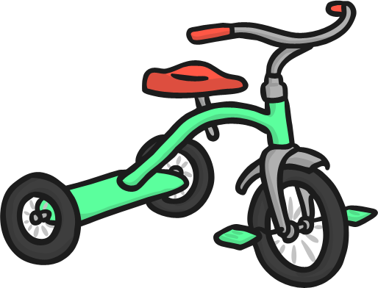
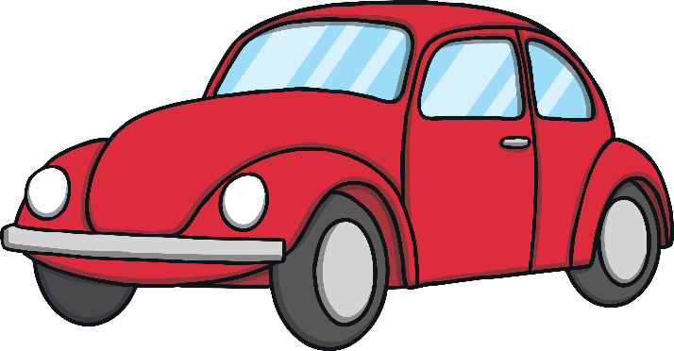
It was taking poor Number One a very long time to hop along the road and soon he felt tired. Suddenly, Number One saw a transport shop. Which type of transport do you think Number One should choose? Why?
1
2 wheels
1 balloon
4 wheels
3 wheels

Slide 6
It costs £1 to ride in the hot-air balloon. Which purse does Number One need?
Well done! This purse has £1.

Slide 7
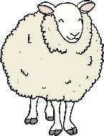
Up and up went the hot-air balloon. Number One looked down on all the sheep in the fields. I wonder which field has only 1 sheep. Can you help?
Well done! This field has 1 sheep. Did you need to count the sheep?

Slide 8
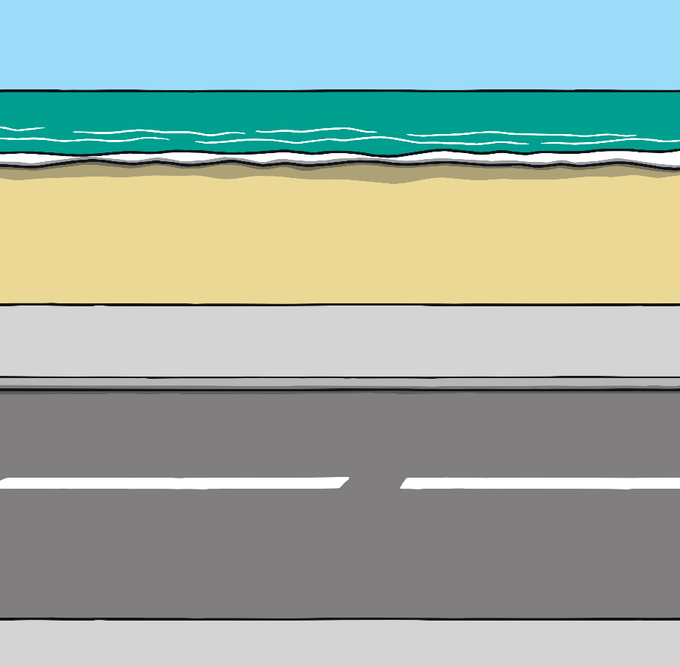
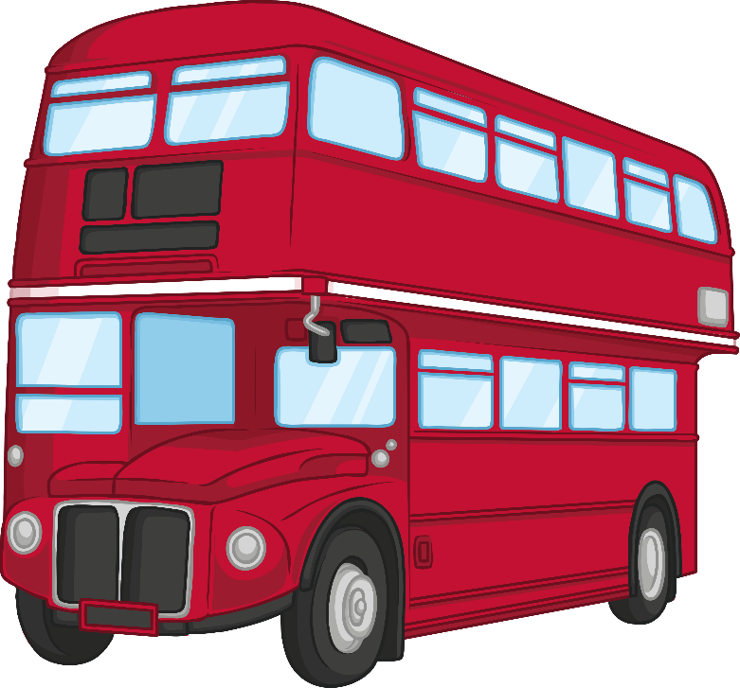
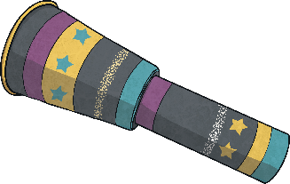
The sheep were getting smaller and smaller as Number One floated up and up. Number One looked through a telescope with his one eye. Down below, he could see a bus driving along the road. What do you notice about the bus?
one
1
How did you know it was the number 1? How many different ways to show 1 can you see?

Slide 9
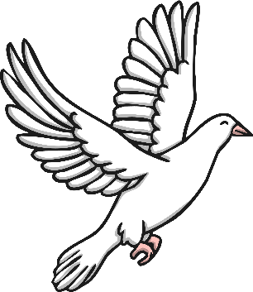
Up and up he floated in the balloon. Number One went past 1
cloud, 1 bird and 1 sun. Which picture is the right one? How do you know?
Yes! This picture shows 1 sun, 1 bird and 1 cloud. How many things are there altogether? What is 1 + 1 + 1?

Slide 10
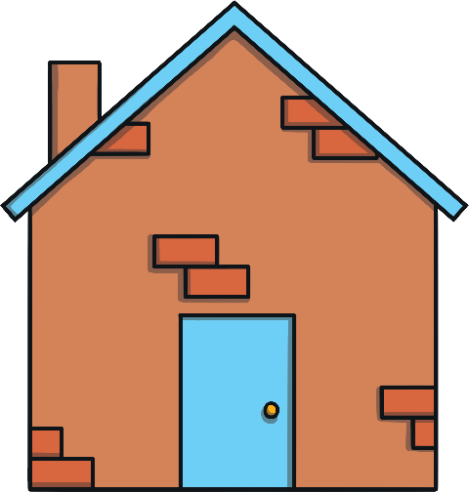
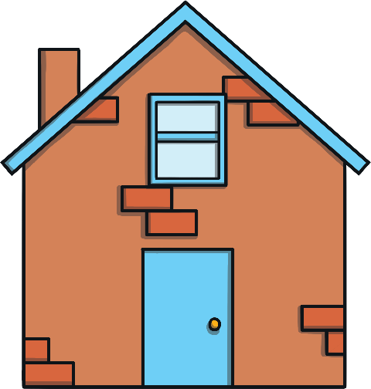
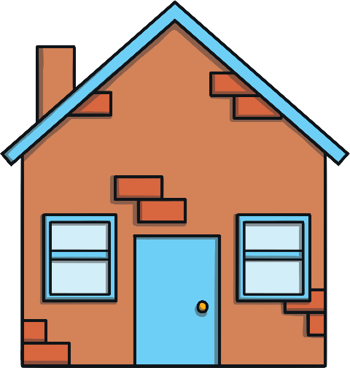
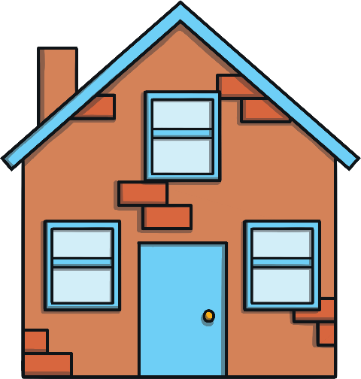
Feeling very hot and tired, Number One decided to land the hot-air balloon and go home. This is Number One’s street. Which house do you think belongs to Number One? Why?
0
1
2
3
Which numbers live next to Number One?

Slide 11
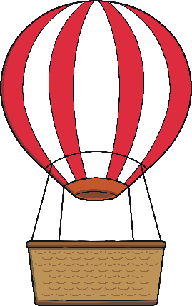
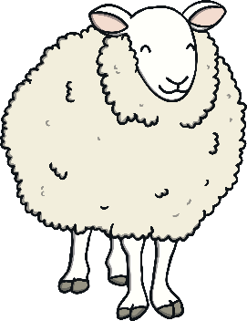
What an adventure Number One had! Let’s look at all the things
he saw today.
hot-air balloon
£1
1 sheep
1 bus
1 cloud
1 bird
1 sun

Slide 12
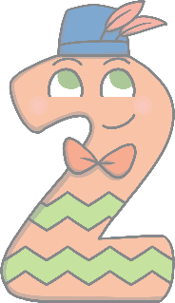
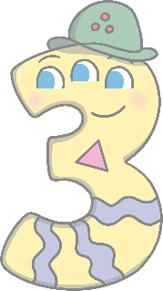
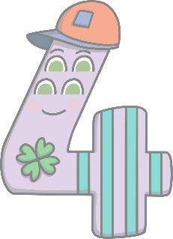
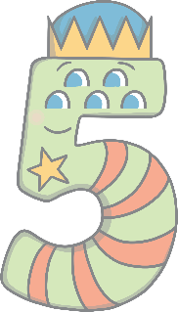
Can you spot 1 on the number track? Can you count along the
line from 1 to 5?
1
2
3
4
5
Number One has some friends. They are called Number Two, Number Three, Number Four and Number Five. Perhaps you will meet them soon!

