Slide 2
All about the Number…
2

Slide 3
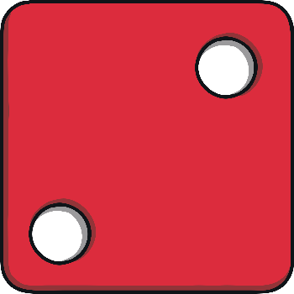
All about the Number 2
The number 2 can be shown in lots of different ways.
two
Next

Slide 4
Number Fingers
How many fingers are being shown?
Can you hold up 2 fingers?
back

Slide 5
Number Words
Do you know what this word says?
two
This is the number 2, written as a word.
back

Slide 6
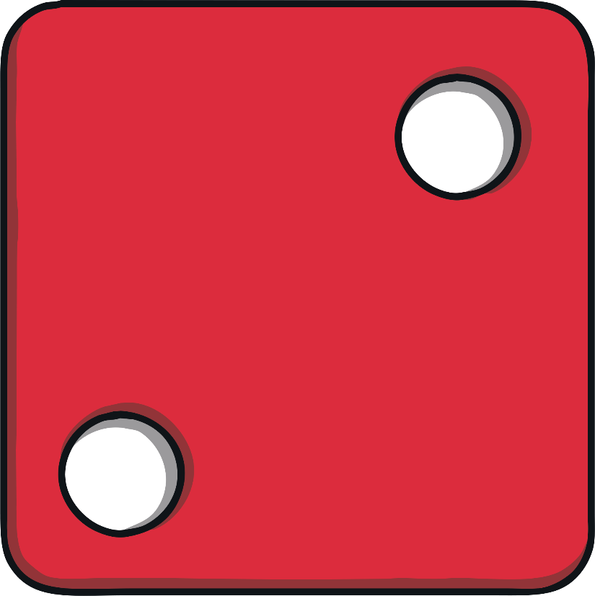
Dotty Dice Numbers
Dice sometimes have numbers on them written as a pattern of dots. This is the number 2.
back

Slide 7
Number Shapes
This is a number shape for the number 2. The number shape has 2 holes or circles.
back

Slide 8
Number Lines
Can you spot the number 2 on the number line? Which numbers are next to the number 2?
Click the hand to reveal the answer!
0
1
2
3
4
5
6
7
8
9

Slide 9
Number Lines
10
How about this number line?
Can you spot the number 2?
Is it in the same place?
9
8
7
6
5
4
3
2
1
Click the hand to reveal the answer!

Slide 10
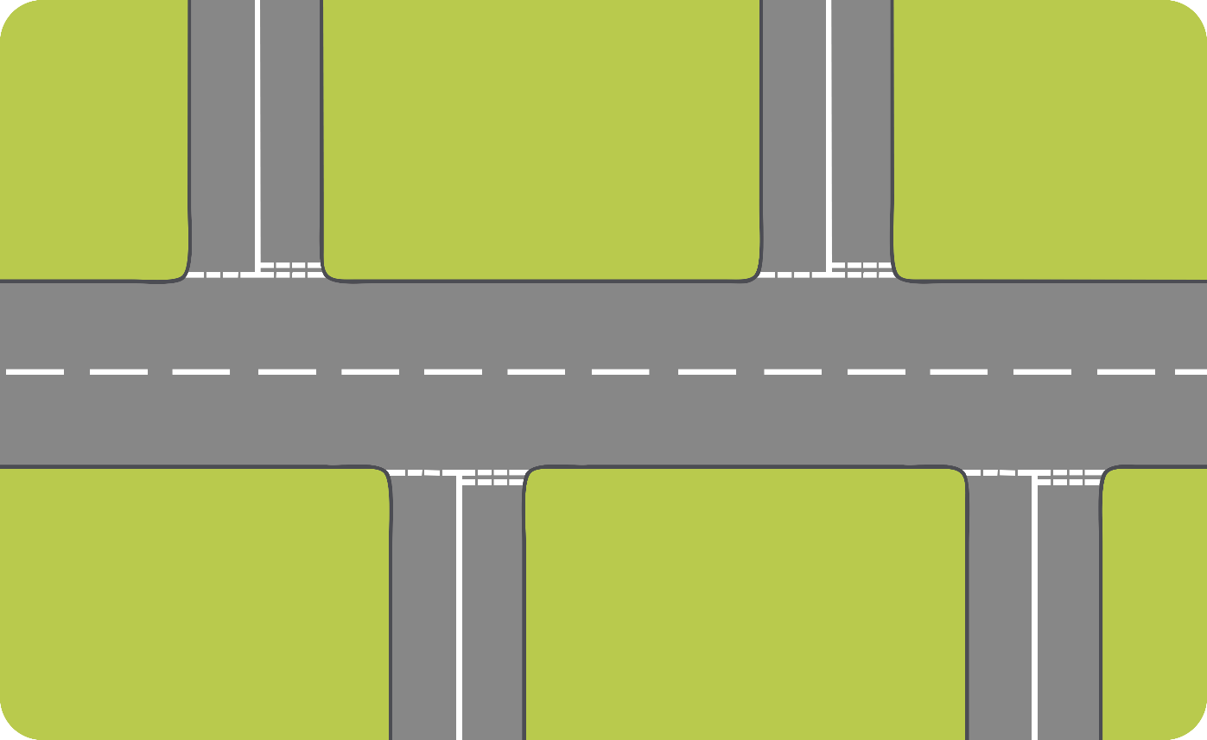
Let’s Try Together!
Sam wants to put 2 cars on her road. Can you help her? Click on 2 cars to add them to the road.

Slide 11
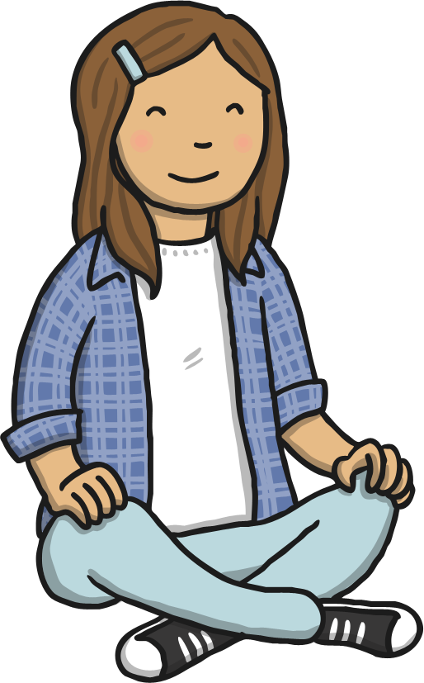
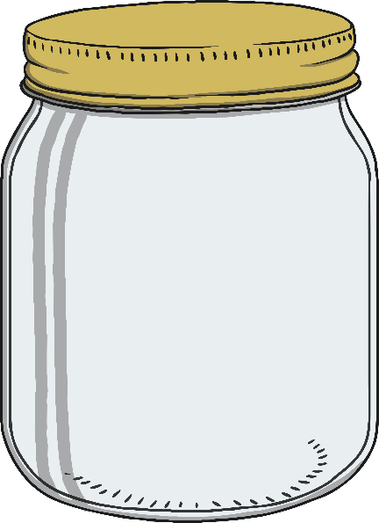
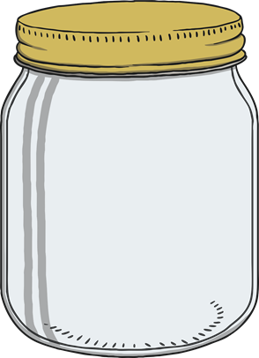
Hope needs to find the jar of sweets with 2 sweets. Can you help her?

Slide 12
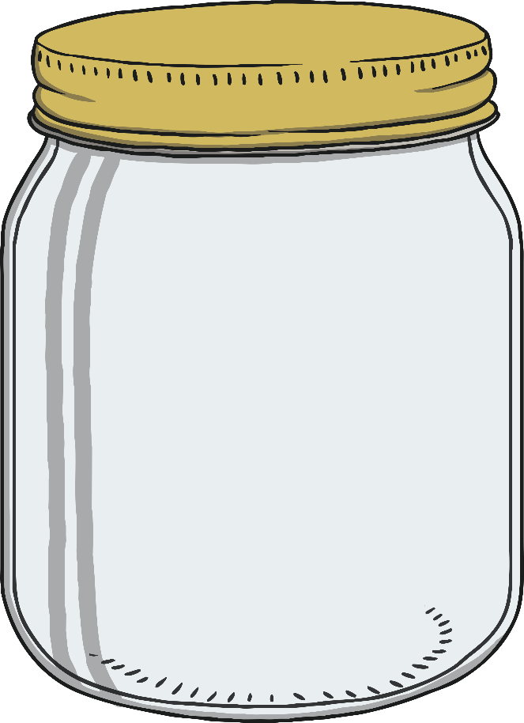
Well done!
Next

Slide 13
Try Again!
back

Slide 14
Try Again!
back

Slide 15
Numbers as Labels
Have you noticed how numbers can be used for labels too? For example, a number on a bus or the number on a door.
Have you ever seen a house with a number 2 on the door?
2

Slide 16
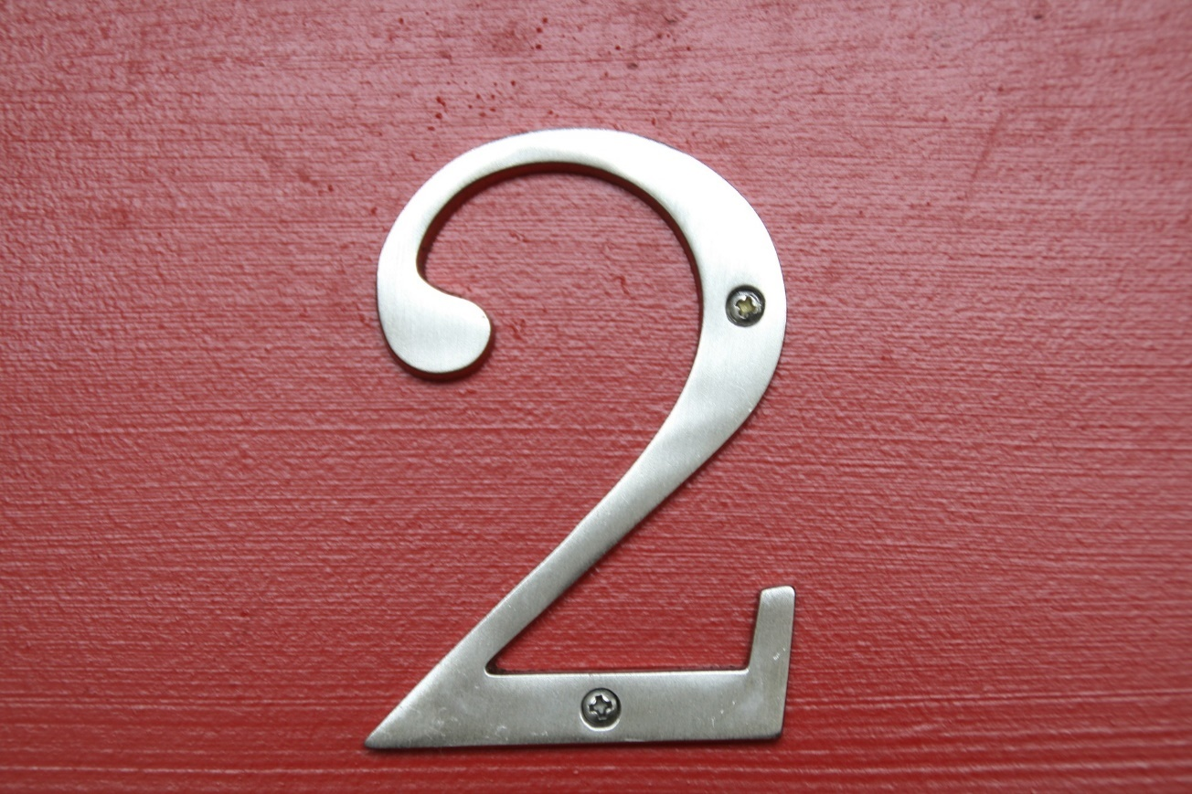
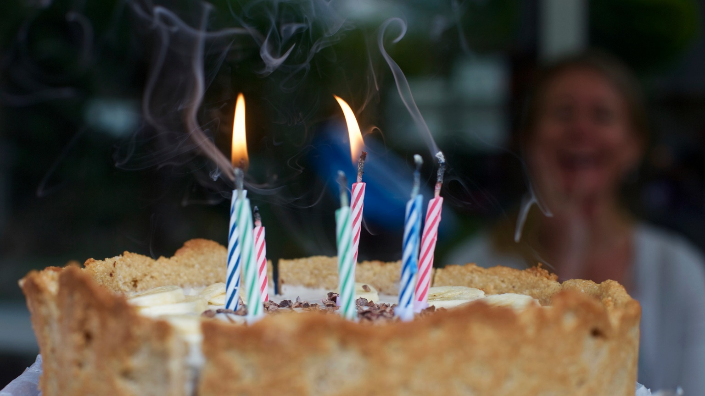
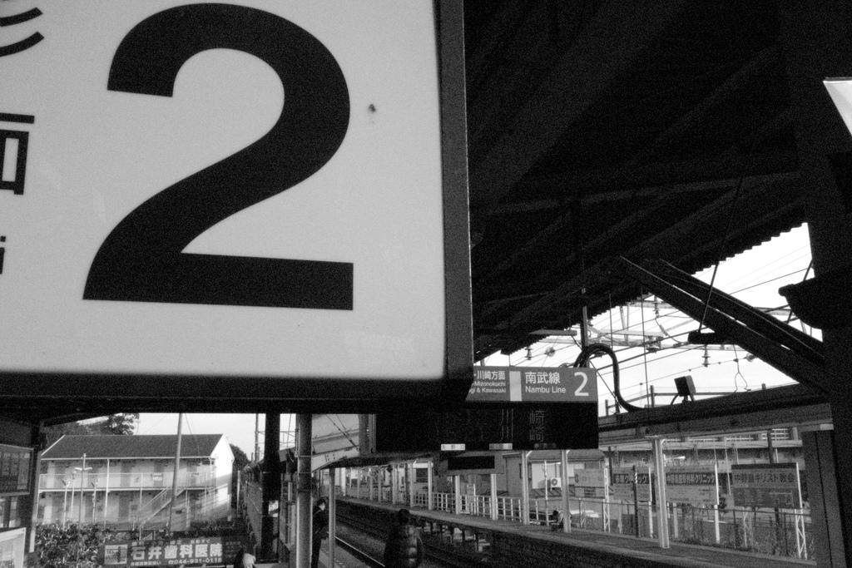
Numbers Everywhere!
Have you ever looked for numbers in your classroom or on your walk to school? Numbers are everywhere! Can you spot the number 2 in your classroom?
“Number 2” by yoppy is licensed under CC BY 2.0

Slide 17
Number 2 Challenges
Are you ready for a challenge? Click on the stars to make a challenge appear.
Finished

Slide 18
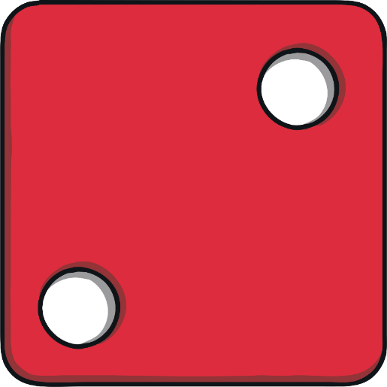
Challenge
2
Quickly, find something in the classroom that shows the number 2.
two
back

Slide 19
Challenge
Quickly, find something in the classroom that shows the number 2.
2
back

Slide 20
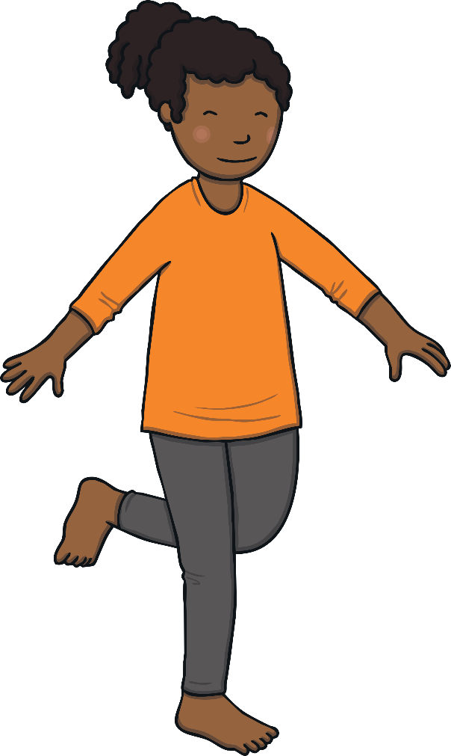
Challenge
Can you do 2 hops?
back

Slide 21
Challenge
Can you show me 2 fingers?
back

Slide 22
Congratulations!
You are now an expert on the number 2.
Can you give yourself 2 pats on the back?
Can you give yourself 2 claps?
two

