Slide 2
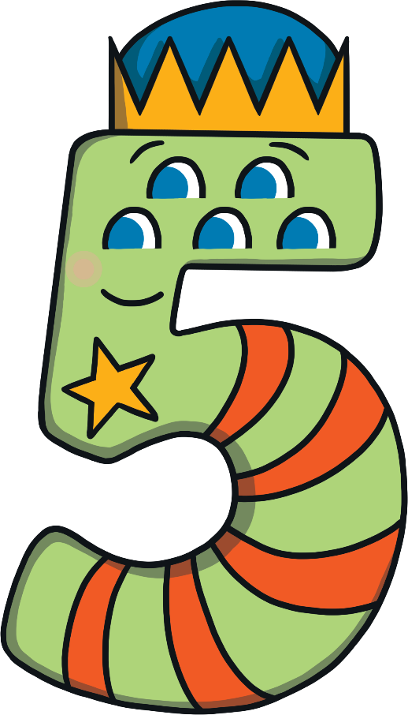
Meet Number Five
Hello, my name is Number Five. I really love the number 5. Today, I am off on an adventure – would you like to come with me? I wonder how many number 5s we will see.
What do you notice about Number Five? What does she have five of?

Slide 3
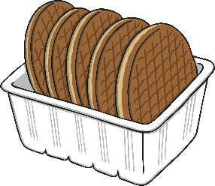
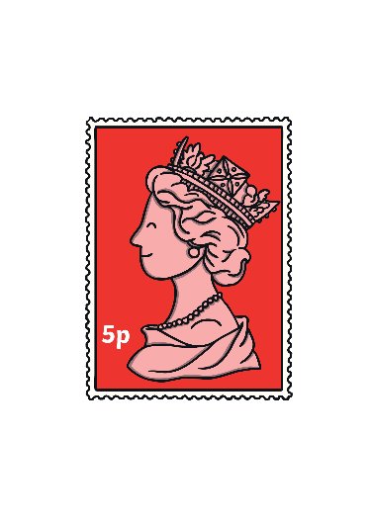
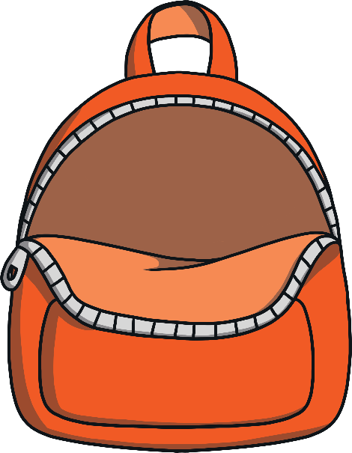
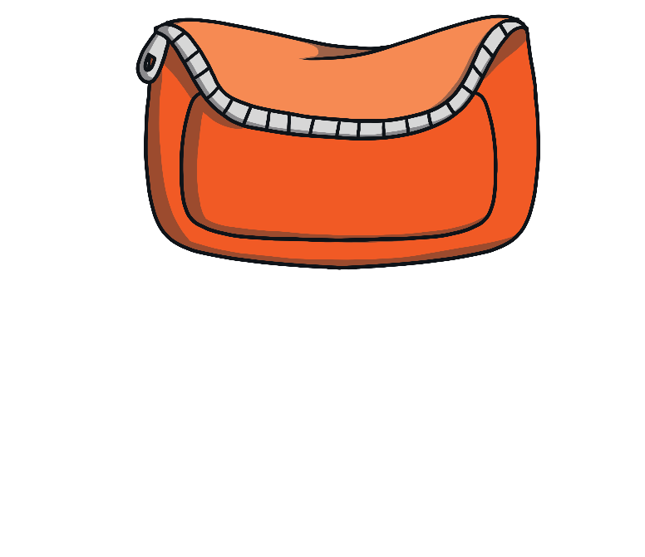
Number Five wanted to have some fun. She decided to pack her bag and set off. Help Number Five pack her bag by clicking on all the items that show 5.
There are 5 flowers. I
need these.
This is just 1 apple. I won’t pack this.
I might need these 5 biscuits.
Yes, this star has 5 points.
This stamp costs 5p.

Slide 4
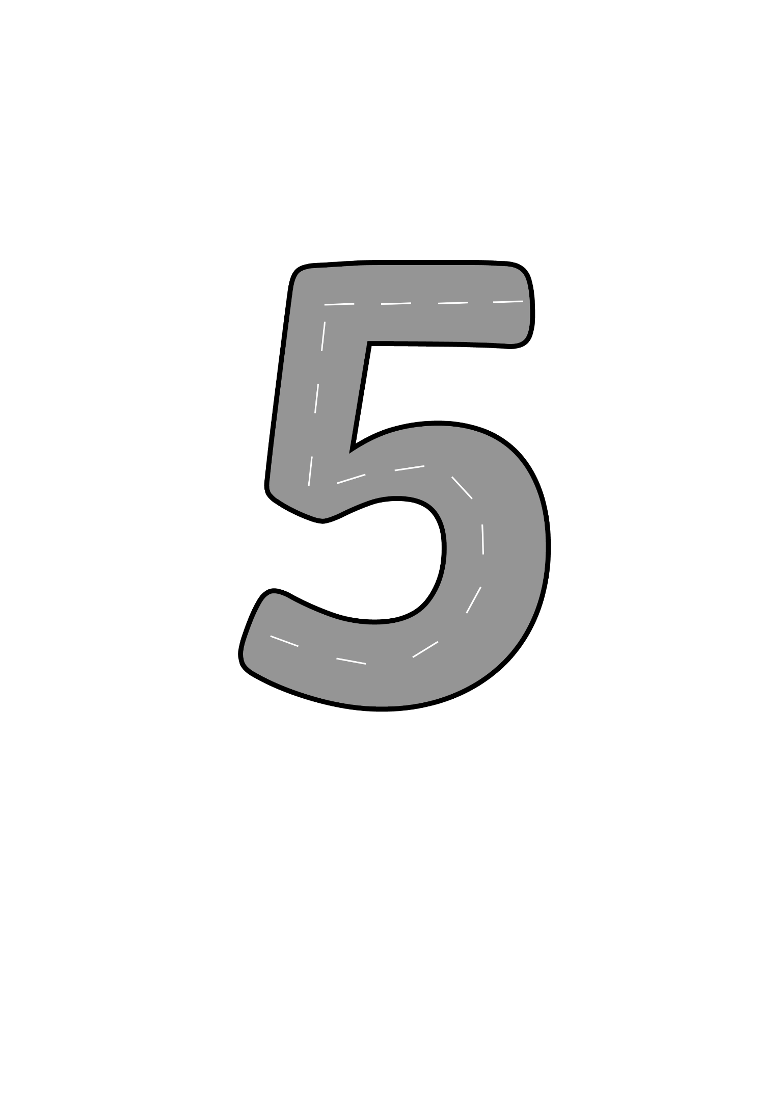
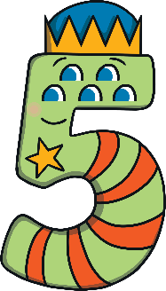
Number Five set off on her adventure. First, she needed to walk along the road. What do you notice about the road?
As Number Five hopped along, she sang a song!
Draw the hat, the back, and tum, now my number 5 is done.

Slide 5
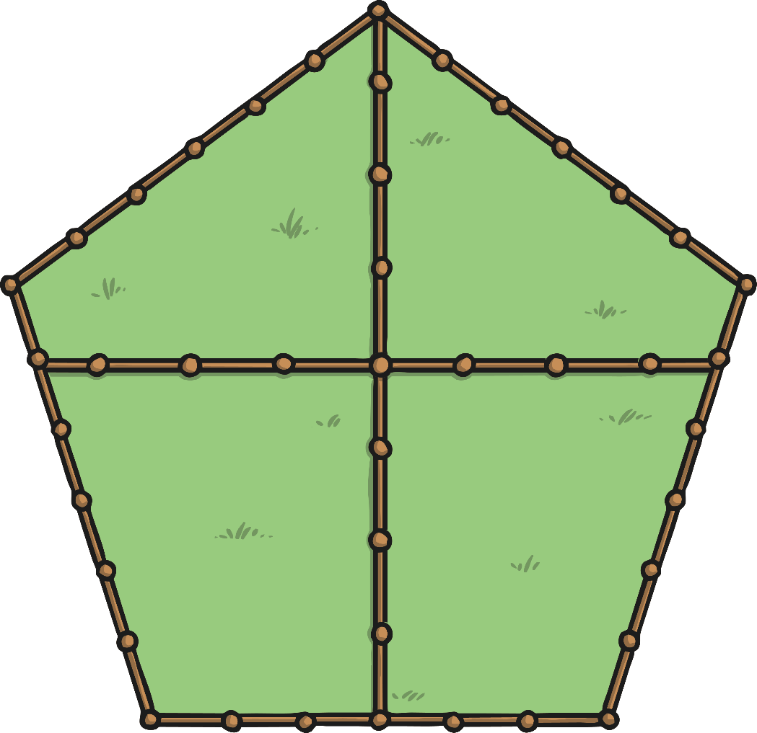
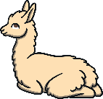
Number Five walked past some fields. In one of the fields, there were 5 llamas.
Which field shows 5 llamas?
Try Again
Try Again
Well done! There are 5 llamas in this field. What do you notice about the shape that surrounds the fields?
Try Again

Slide 6
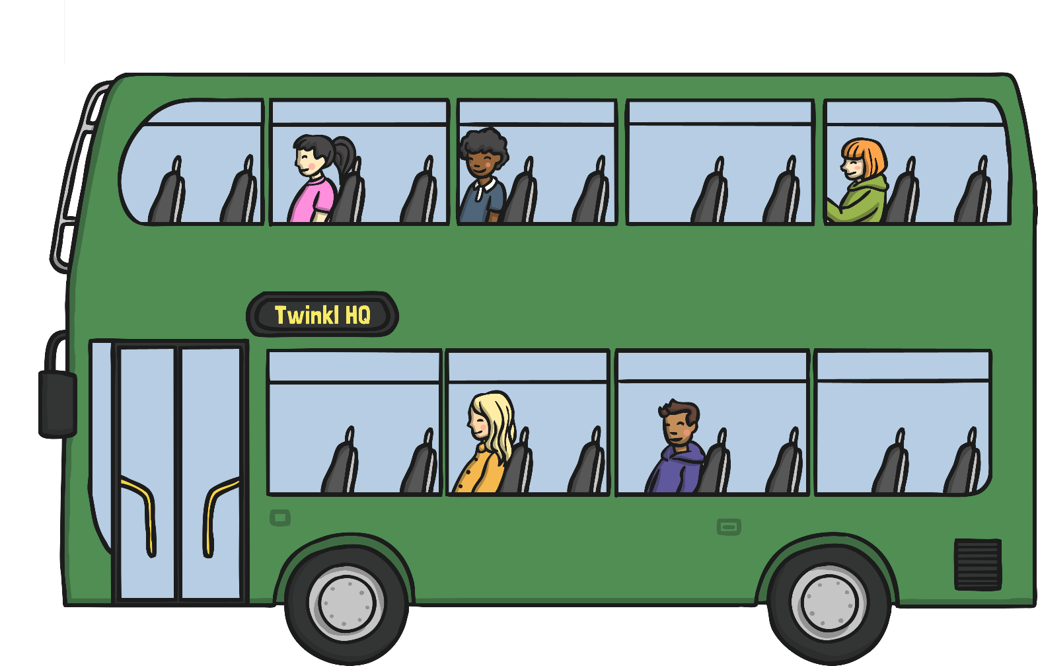
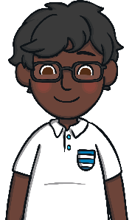
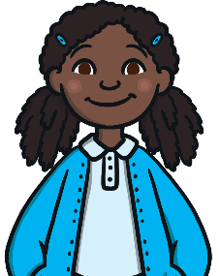
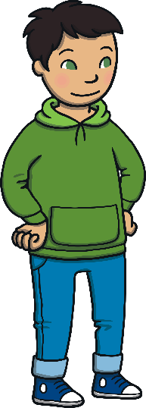
Number Five stopped at the bus stop and waited for the bus to come.
What do you notice about the bus? How many different ways is number 5 shown on the bus?
5
five

Slide 7
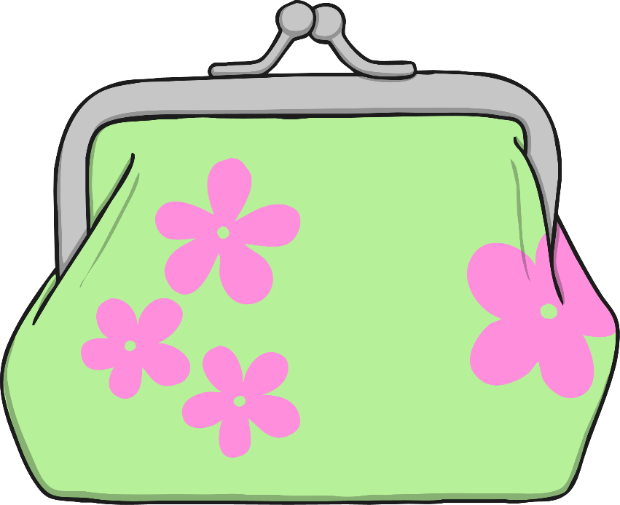
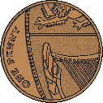
Number Five needed 5p to travel on the bus. Which purse shows 5 pennies?
Try Again
Well done! How did you know this purse had 5 pennies?

Slide 8
Number Five got off the bus and hopped across a field. Soon, she noticed a hive. How many bees can you count going into the hive?
Click the hive and count how many bees go into the hive.

Slide 9
Number Five enjoyed watching the bees so much, she wanted to give them a gift. She looked in her bag to find her flowers.
How many bees are there? How many flowers are there? Is there a flower for each bee?

Slide 10
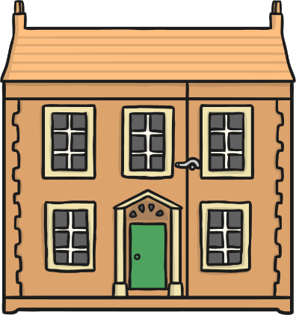
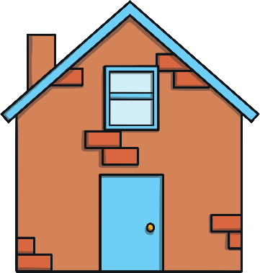
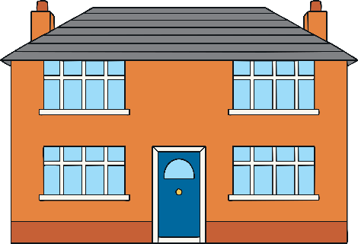
After a long and busy day, Number Five decided it was time to go home.
What do you notice about the houses? Which house do you think Number Five lives in?
1
2
3
4
5
My house has 5 windows.

Slide 11
What an adventure Number Five had! Let’s look at all the things
she saw today.
5 flowers
5 bees
5 coins
5 llamas
5 passengers

Slide 12
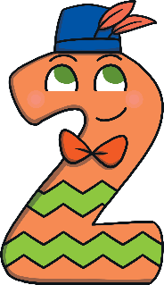
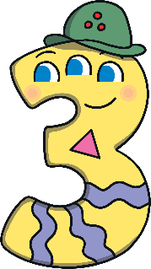
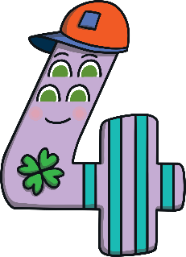
Can you spot the number 5 on the number track? Can you count along the line from 1 to 5? Click Number Five to put her on the line.
1
2
3
4
5
Number Five has some friends. They are called Number One, Number Two, Number Three and Number Four.

