Slide 1
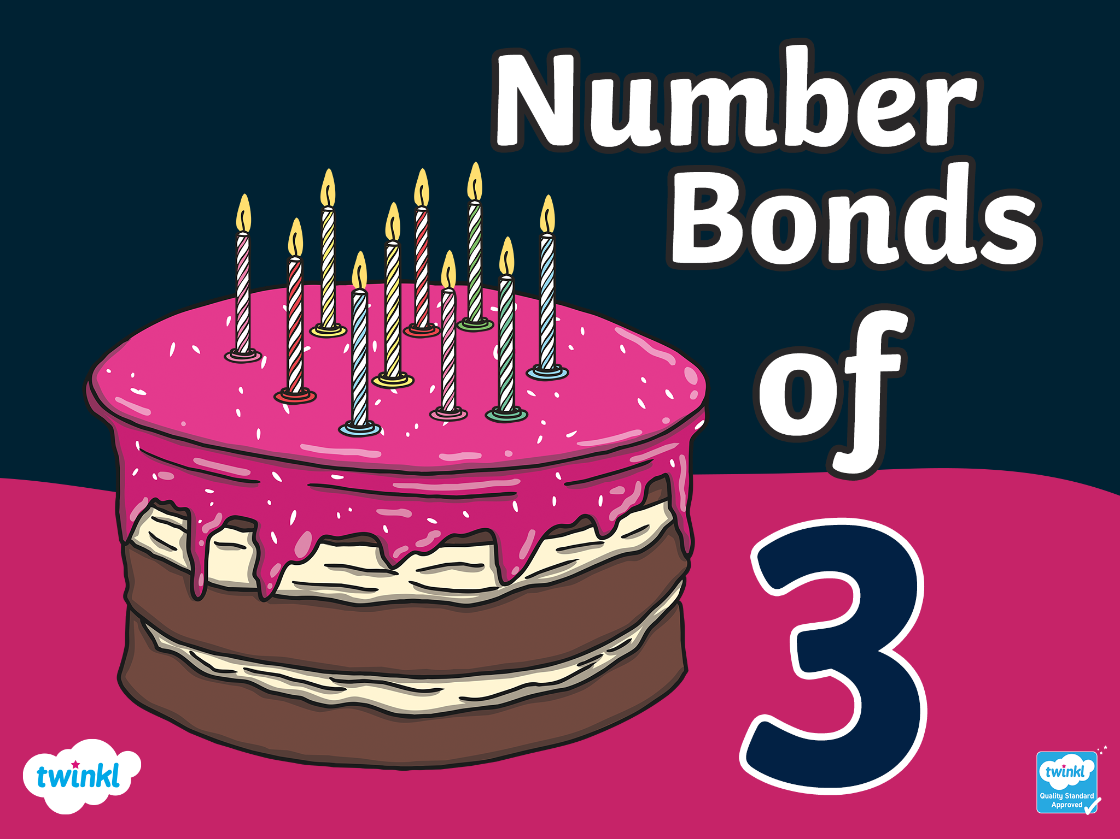

Slide 2
There are 4 ways to make 3!

Slide 3

3+0=3
There are 4 ways to make 3!

Slide 4
0+3=3
There are 4 ways to make 3!

Slide 5
2+1=3
There are 4 ways to make 3!

Slide 6
1+2=3
There are 4 ways to make 3!

Slide 7
Challenge
With a partner, write down the ways of making 3. Remember there are 4 ways of making 3!
3 + 0 = 3
0 + 3 = 3
2 + 1 = 3
1 + 2 = 3
Click to reveal the answers

Slide 8


