Slide 2
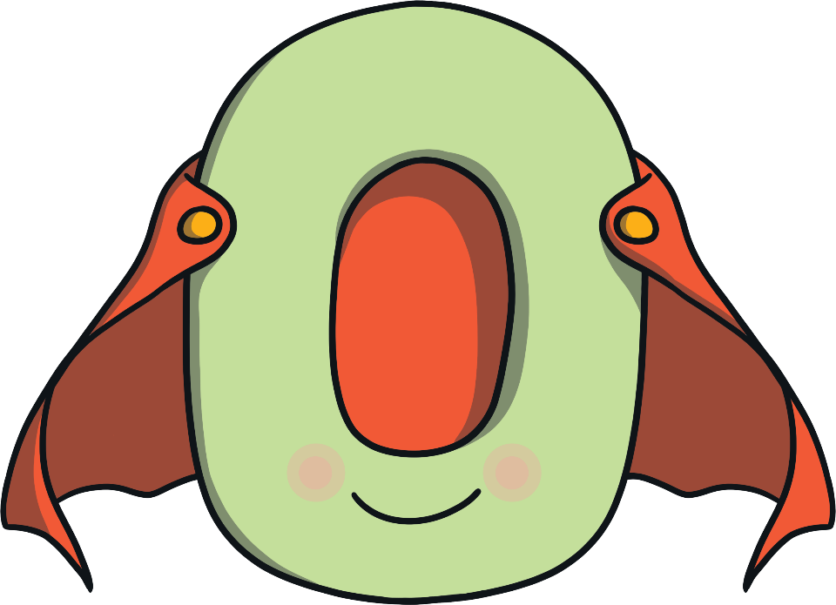
Meet Zero
Hello, I am Zero and I am a hero!

Slide 3
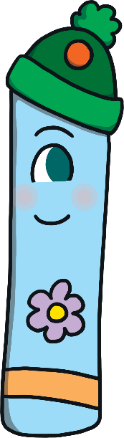
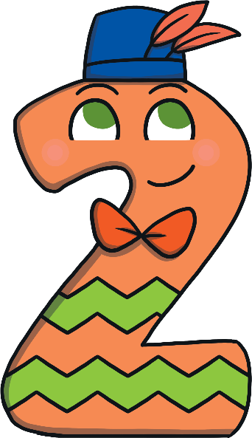
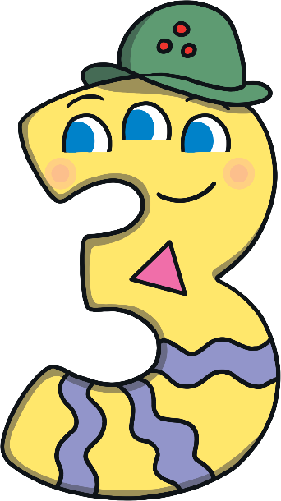
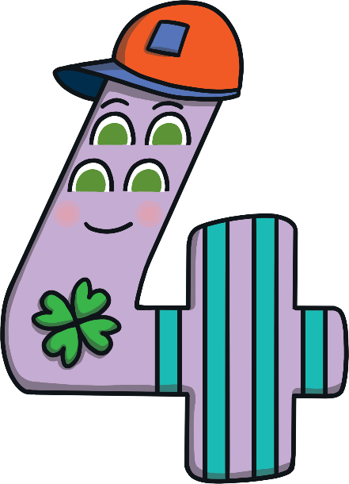
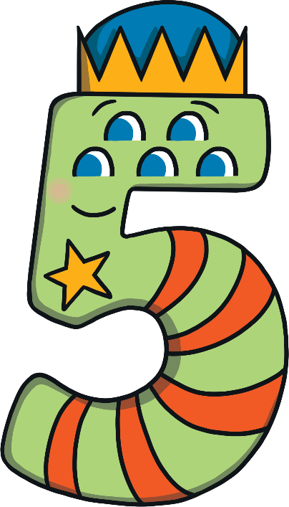
Zero is the hero of Numberland. Whenever other numbers are in trouble, they always call on Zero to help!
Zero is our hero! Whenever we need him, we press the button that shows 0 on our hero phone.

Slide 4
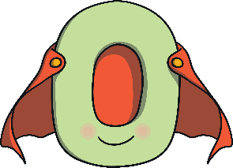

When Zero gets his call, he makes a 0 in the air. Can you make a 0 in the air with your finger? As he flies through the sky, he sings a song...
Around to the left to find my hero, back to the top, I’ve made a zero.

Slide 5

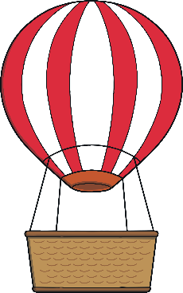
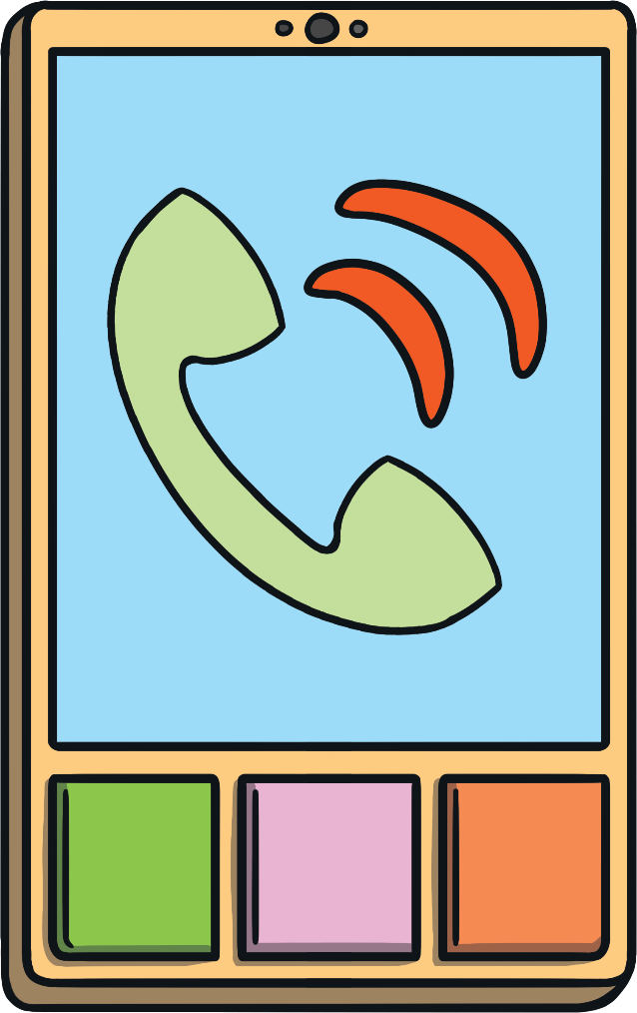
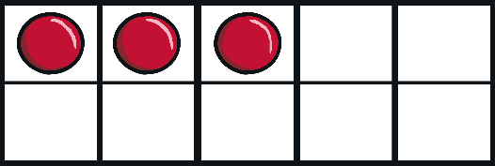
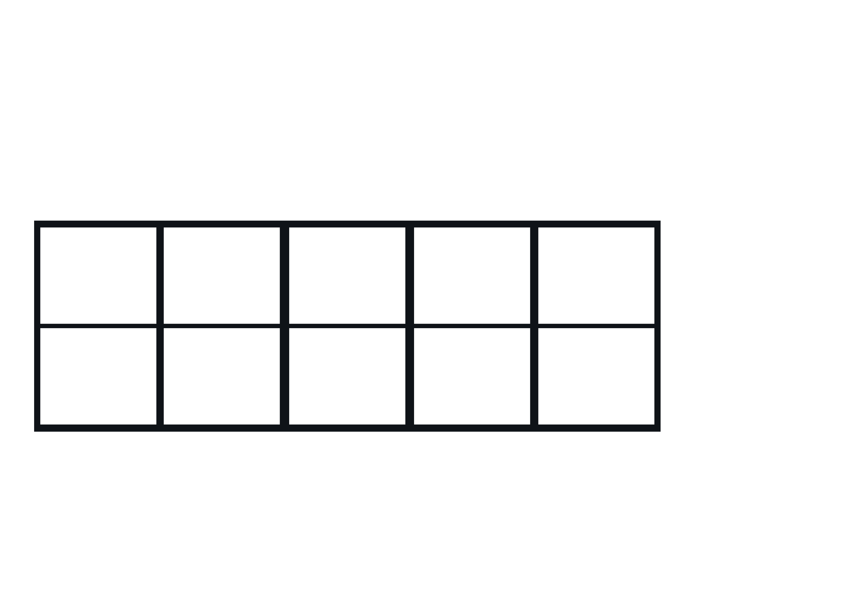

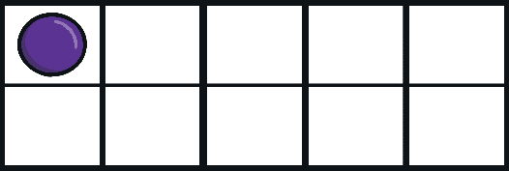
Number One was in trouble. His balloon had crashed into a tree. There was only one thing for it, he needed to call Zero, the hero!
Oops, not that button!
Oops, not that button!
I need to call Zero! Which button do I need to press? Which button shows 0?

Slide 6


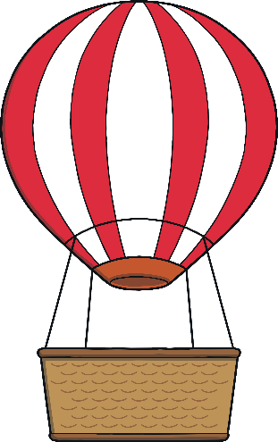
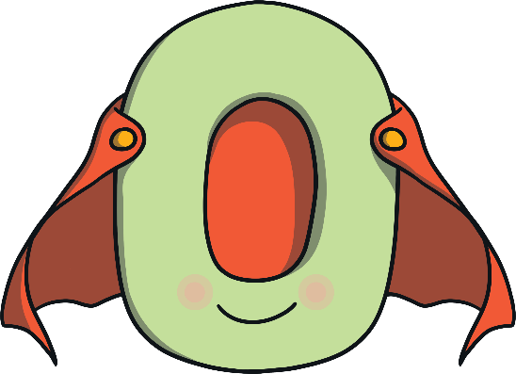

Zero the hero to the rescue!
Thank you for rescuing me Zero!
You pressed the right button on the hero phone! This ten-frame shows 0. How did you know it is 0?

Slide 7

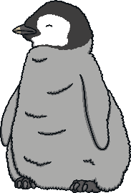
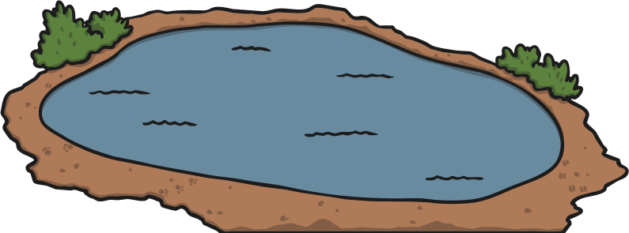






Number Two had a problem. He had fallen into the penguin enclosure when feeding them some fish. There was only one thing for it, he needed to call Zero, the hero!
Oops, not that button!
Oops, not that button!
I need to call Zero! Which button do I need to press? Which button shows 0?

Slide 8

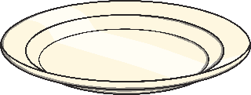
Zero the hero to the rescue!
Thank you for rescuing me Zero!
You pressed the right button on the hero phone! This plate shows 0. When do you have nothing on your plate?

Slide 9
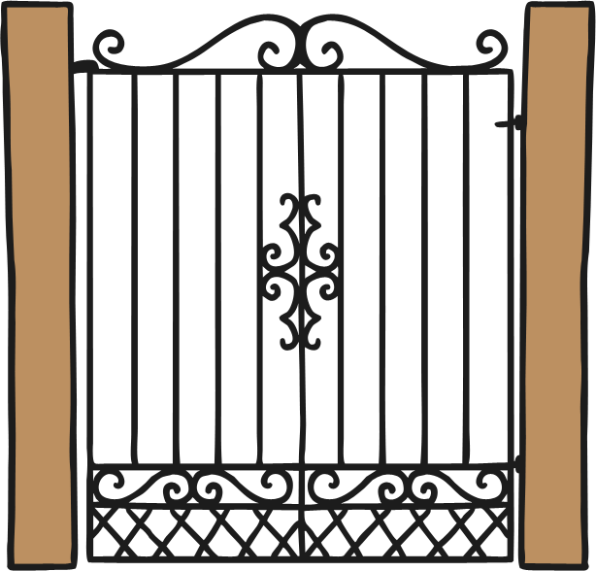

Number Three was stuck. The gates closed in the park and she was locked in. There was only one thing for it, she needed to call Zero, the hero!
Oops, not that button!
Oops, not that button!
0
3
5
I need to call Zero! Which button do I need to press? Which button shows 0?

Slide 10

Zero the hero to the rescue!
Thank you for rescuing me Zero!
0
You pressed the right button on the hero phone! This is 0. Can you draw a 0 in the air with your finger?

Slide 11
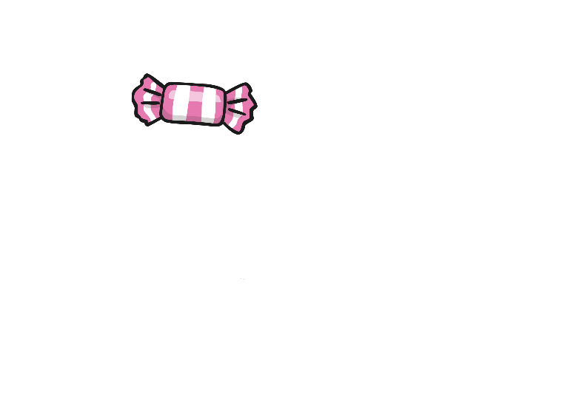
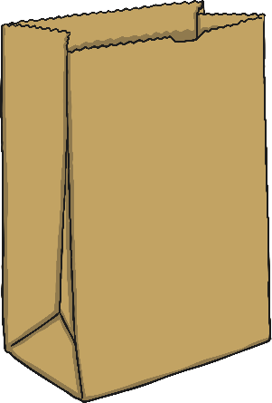
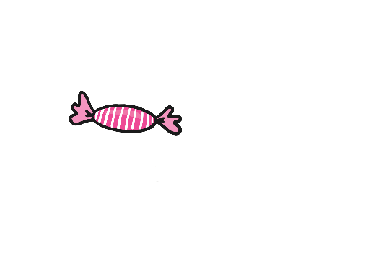
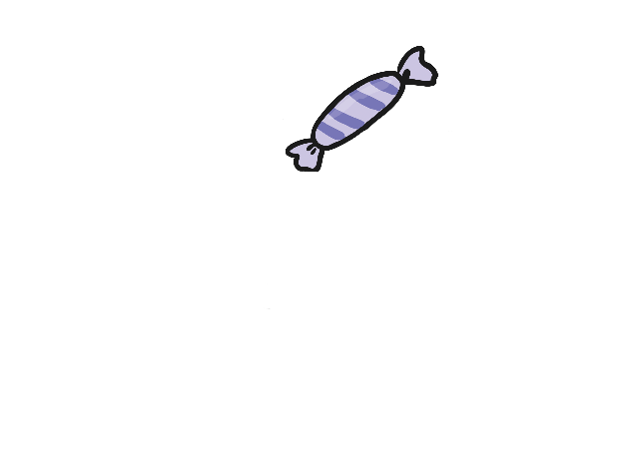
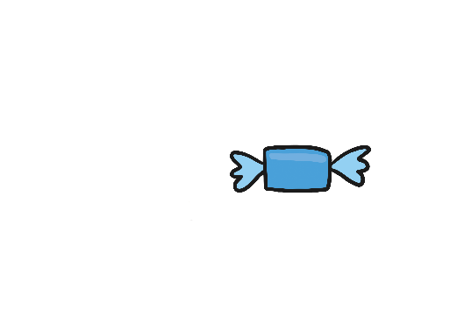

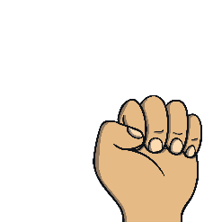
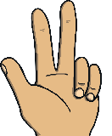
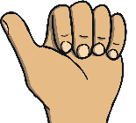
Uhoh! Number Four’s bag broke and all his shopping landed on the floor. There was only one thing for it, he needed to call Zero, the hero!
Oops, not that button!
Oops, not that button!
I need to call Zero! Which button do I need to press? Which button shows 0?

Slide 12



Zero the hero to the rescue!
Thank you for rescuing me Zero!
You pressed the right button on the hero phone! This is 0. Can you show me 0 with your fingers?

Slide 13
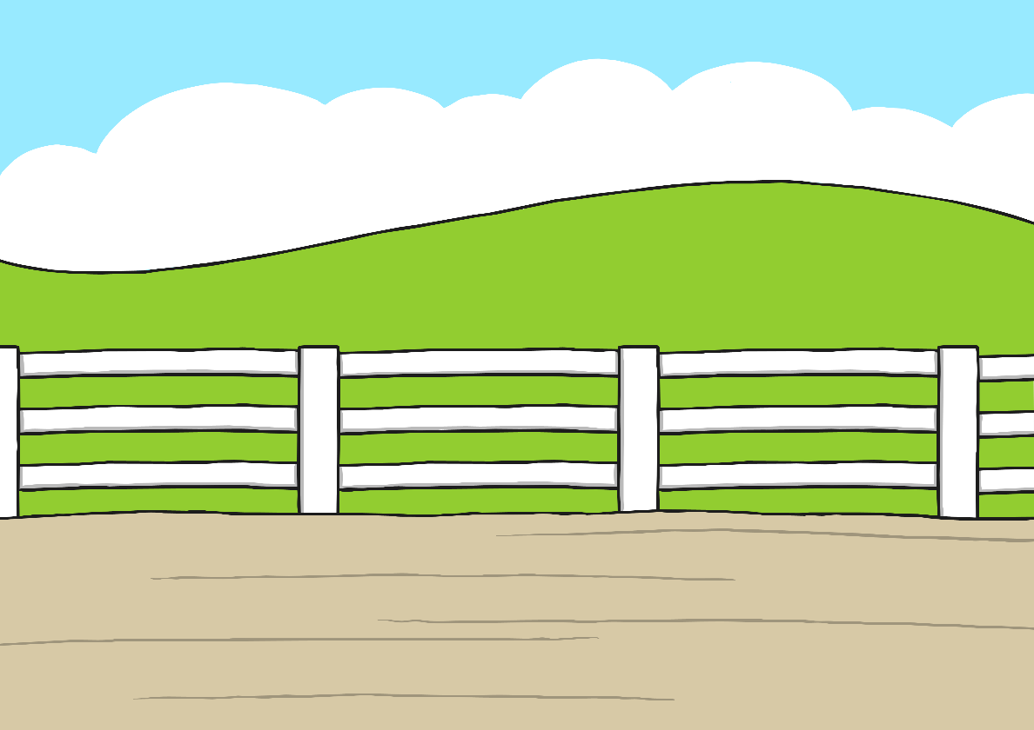
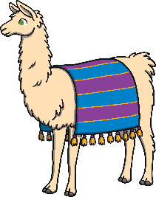
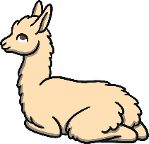

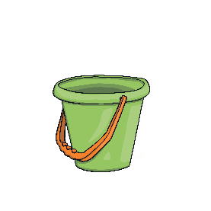

Poor Number Five. One of her llamas escaped over the fence. There was only one thing for it, she needed to call Zero, the hero!
Oops, not that button!
Oops, not that button!
I need to call Zero! Which button do I need to press? Which button shows 0?

Slide 14

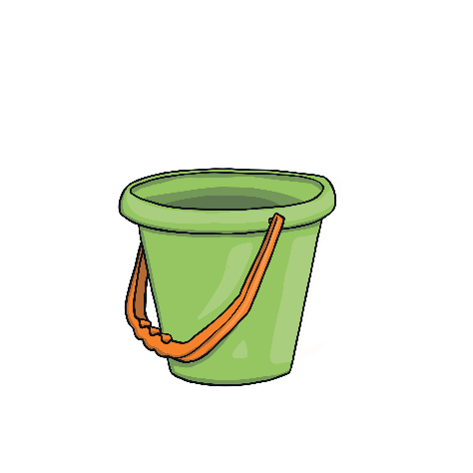
Zero the hero to the rescue!
Thank you for rescuing me Zero!
You pressed the right button on the hero phone! This bucket has no shells. It shows 0. Can you think of any other times that you might have 0 of something?

Slide 15

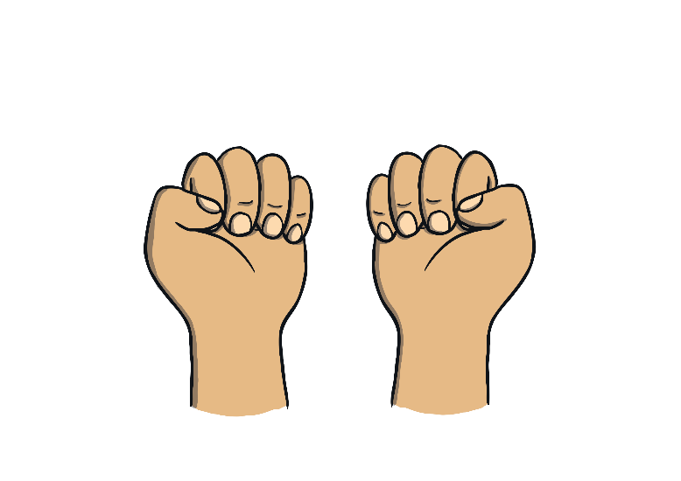


Let’s look at the all the buttons that the numbers pressed to call me. What do you notice? What number do they show?
0
0 counters
0 cupcakes
number 0
0 fingers
0 shells

Slide 16
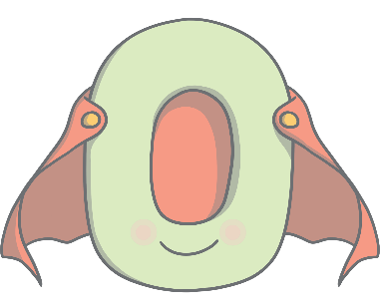




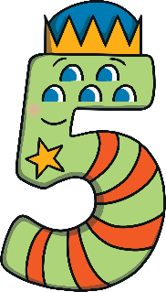

Can you spot the number 0 on the number track?
Click on Zero to move him onto the number track.
0
1
2
3
4
5
Can you see me on the number track? What do you notice? What number comes after 0? Can you count along the number track from 0 to 5?

