Slide 2
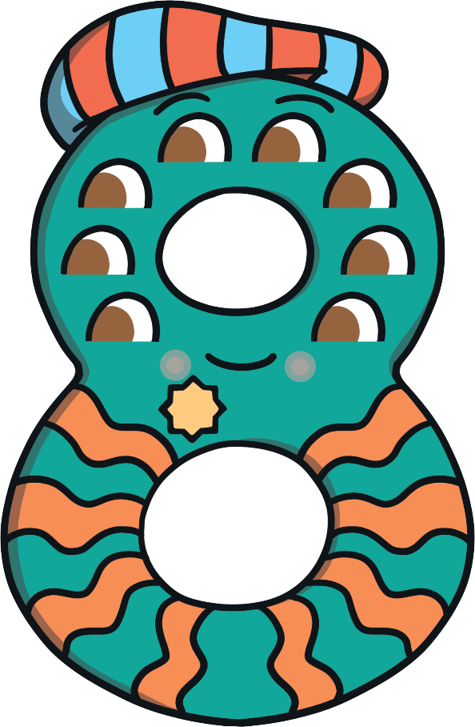
Meet Number Eight
Hello, my name is Number Eight and I love the number 8. Can you tell? Do you want to hear about my adventure to the farm?
What do you notice about Number Eight? Talk to a friend about what you can see.

Slide 3
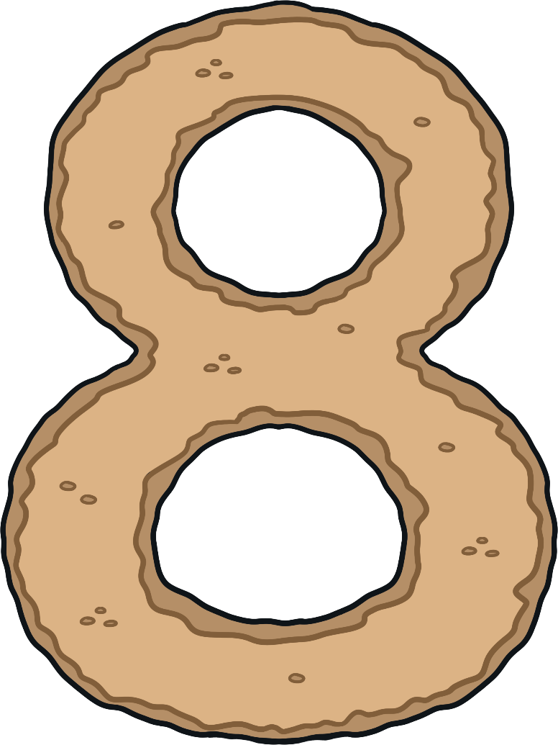
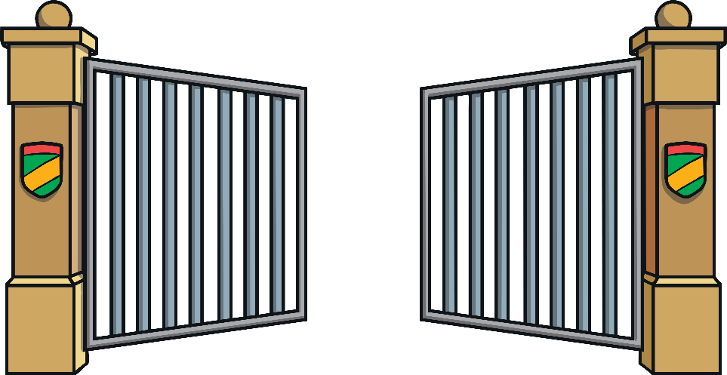
One day, Number Eight decided to go and visit his friend, Farmer Flo, and see all the animals on her farm. As he walked down the path to his garden gate, he was so excited that he did a little dance and sang a song.
Make an ‘s’ and close the gate, now I’ve made the number 8!

Slide 4
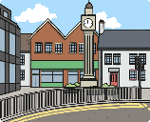
Number Eight walked down the road to the road sign and stopped to decide which way to go. Which is the way to Farmer Flo’s farm? How do you know? Click on the sign that Number Eight followed.
Railway Station
That’s right. This sign says ‘Farmer Flo’s Farm – 8 miles’.
Farmer Flo’s Farm
5 miles
8 miles
Try again!
Try again!
Try again!
Town Centre
Seaside
10 miles
2 miles

Slide 5
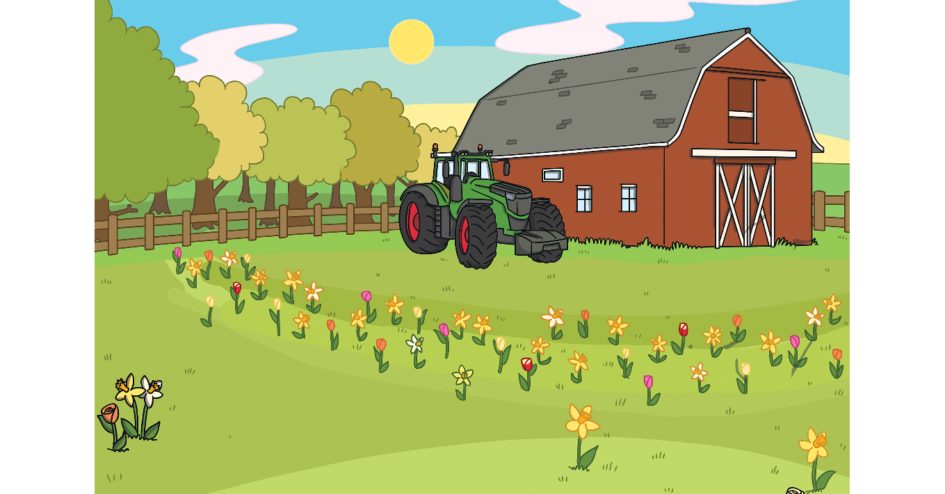
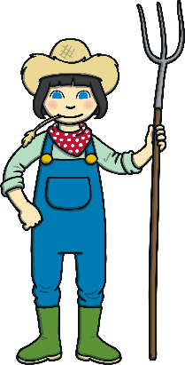
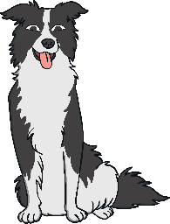
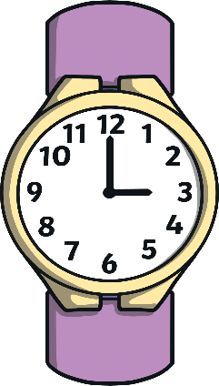
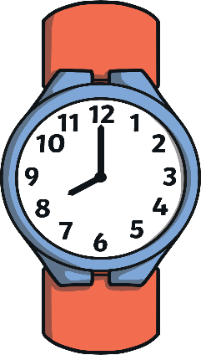
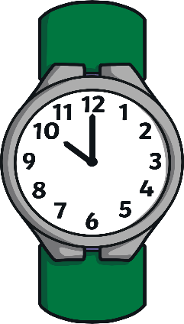
It was 8 o’clock by the time Number Eight got to Farmer Flo’s farm. What did he see on his watch?
Yes! This watch says 8 o’clock. How did you know?
Try again!
Try again!

Slide 6
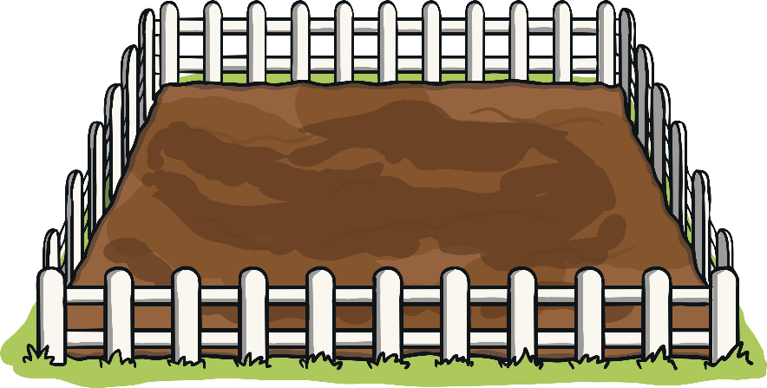
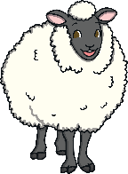
First, it was time to round up the sheep with the help of Sheepdog Shep. Which pen has 8 sheep in it?
Yes! There are 8 sheep in this pen. Can you count how many sheep are in the other two pens?
Try again!
Try again!

Slide 7
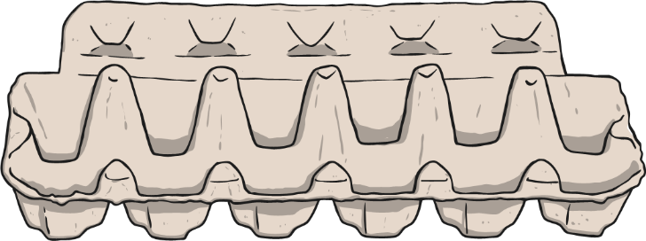
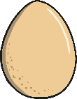
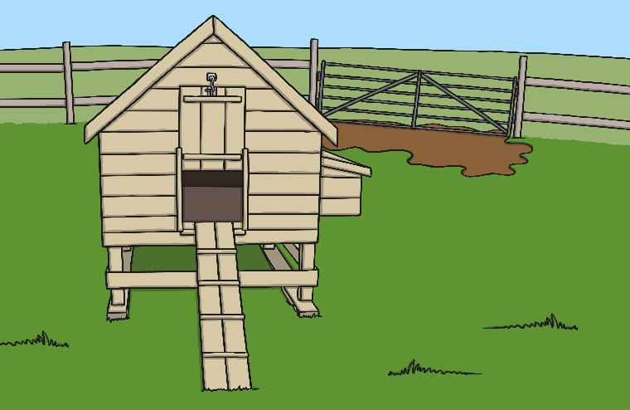
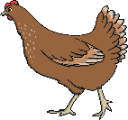
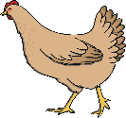
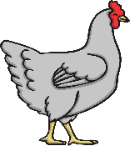
Next, Number Eight and Farmer Flo went to collect some eggs from the hens. Number Eight found 8 eggs. Which egg box do you think is his?
Yes! There are 8 eggs in this box.
Try again!
Try again!

Slide 8
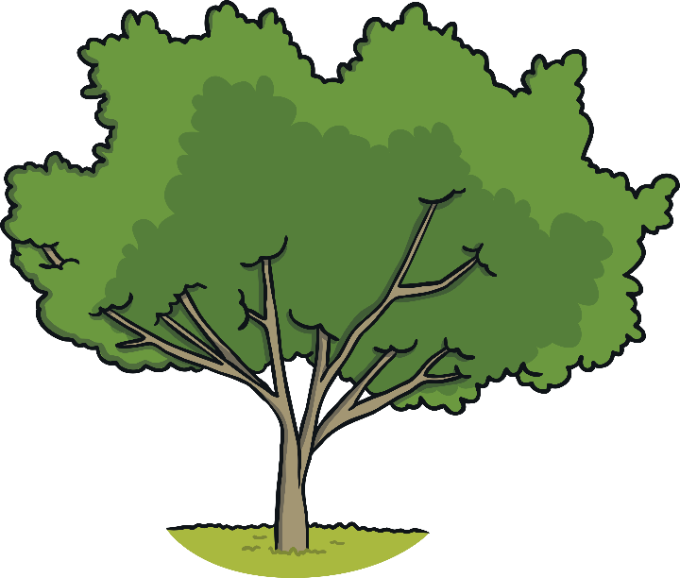
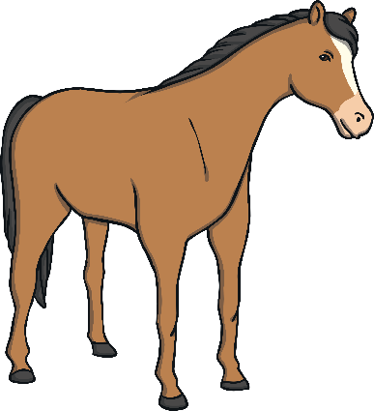
Finally, it was time to feed the horses with some yummy apples. Which tree has 8 apples on it?
Try again!
Try again!
Well done! This tree has 8 apples.

Slide 9
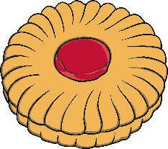
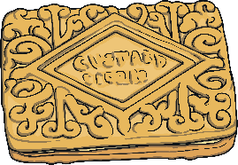
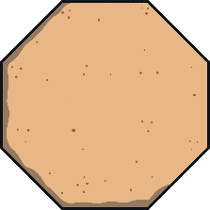
Before Number Eight went home, he and Farmer Flo had a lovely cup of tea and a biscuit. Which biscuit do you think Number Eight chose? Why?
That’s right! I picked the biscuit that has 8 sides because I love the number 8! My biscuit is an octagon.
Try again!
Try again!

Slide 10
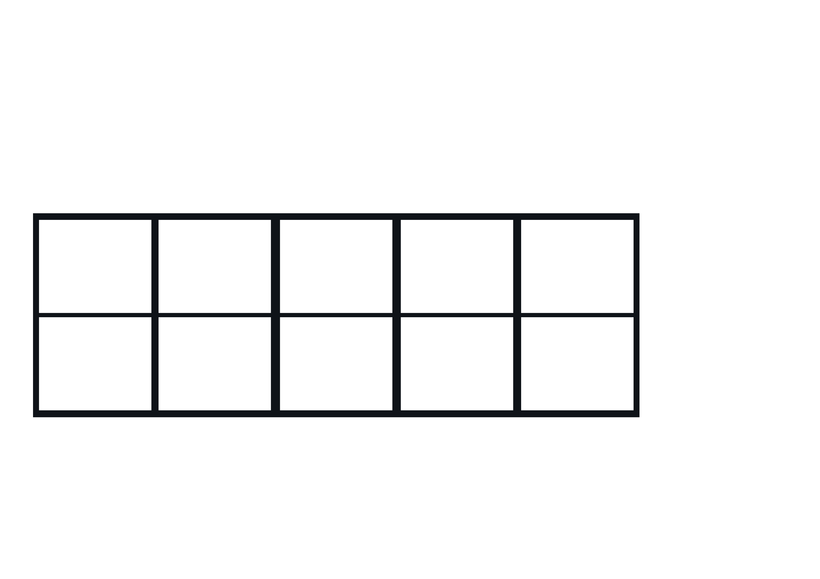
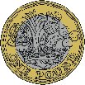
Number Eight was very tired after his busy day at the farm, so he decided to get the train home. His ticket cost £8. Which purse does he need?
Well done! This purse has £8.
Try again!

Slide 11
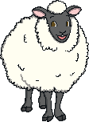
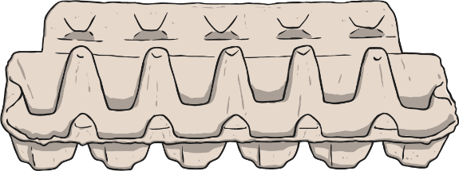
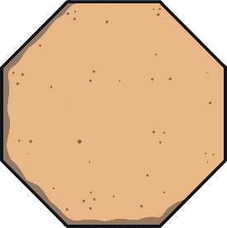
Let’s look at all the things Number Eight saw on his adventure to the farm.
Farmer Flo’s Farm
8 miles
8 miles
8 o’clock
8 sheep
8 eggs
8 apples
8 sides

Slide 12
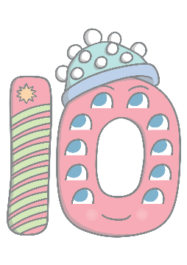
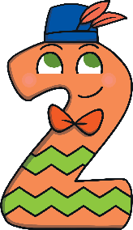
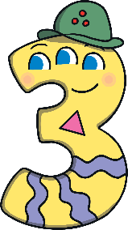
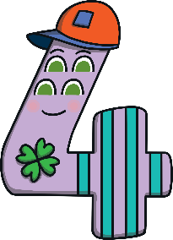
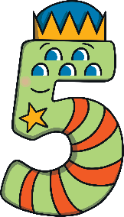
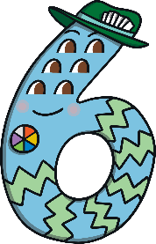
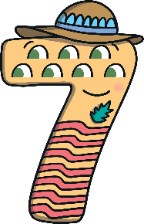
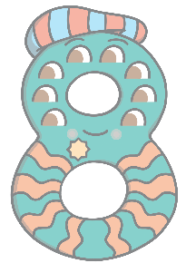
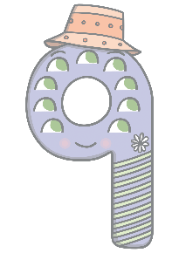
Can you find 8 on the number track? Click on Number Eight to move him onto the number track.
1
2
3
4
5
6
7
8
9
10
Which number comes before 8? Which number comes after number 8? Can you count along the number line from 1 to 8?

