Slide 1
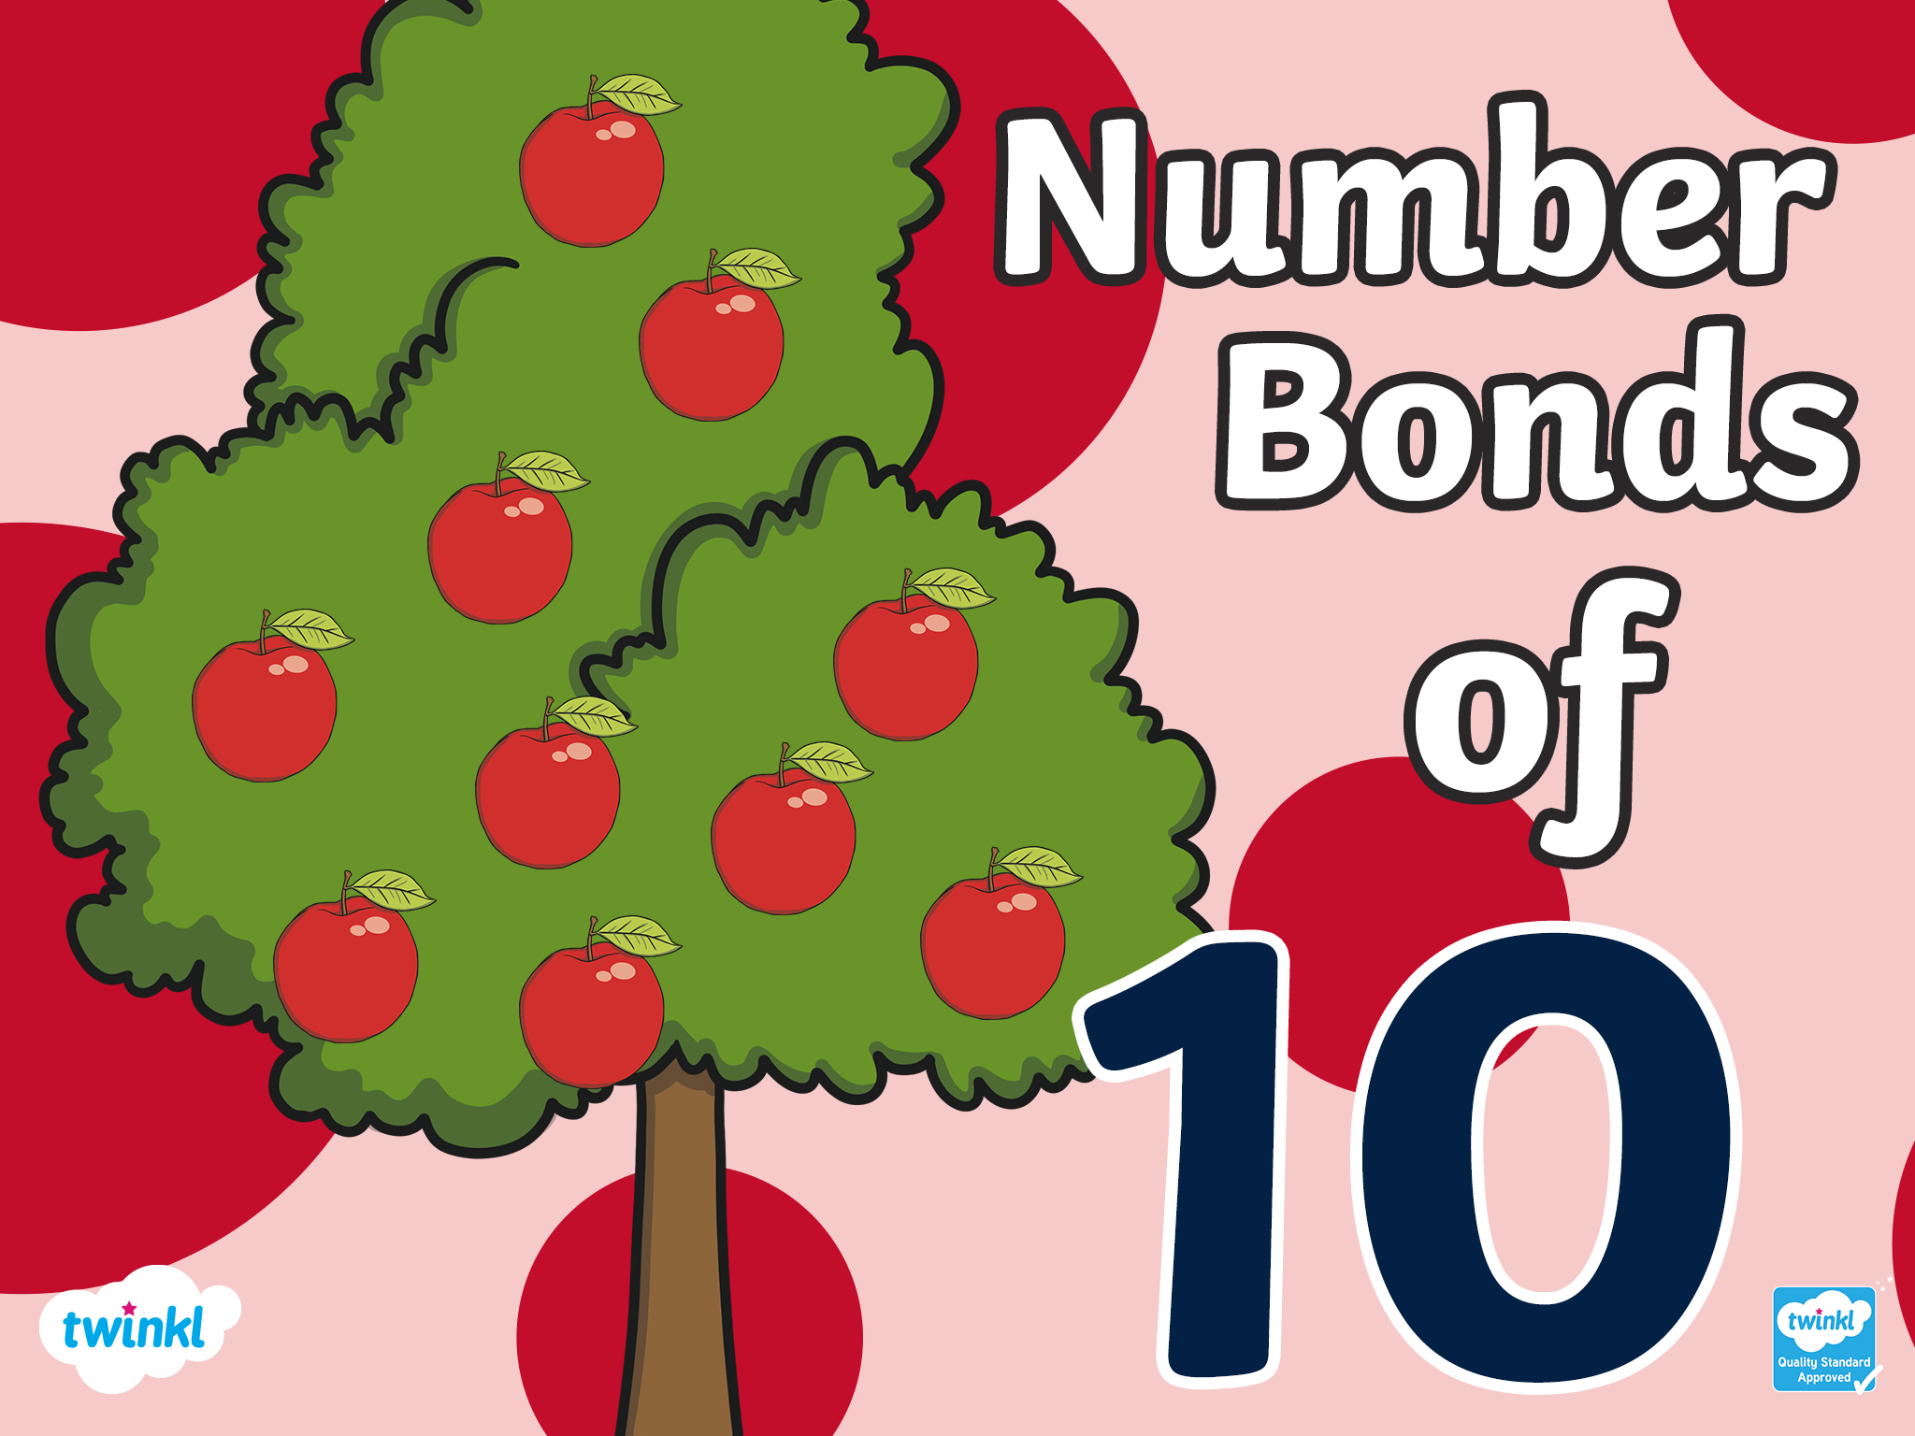

Slide 2

Number bonds of 10 are two numbers that make 10 when they are added together!
There are 11 ways to make 10.

Slide 3
10+0=10
There are 11 ways to make 10!

Slide 4
0+10=10
There are 11 ways to make 10!

Slide 5
9+1=10
There are 11 ways to make 10!

Slide 6
1+9=10
There are 11 ways to make 10!

Slide 7
8+2=10
There are 11 ways to make 10!

Slide 8
2+8=10
There are 11 ways to make 10!

Slide 9
7+3=10
There are 11 ways to make 10!

Slide 10
3+7=10
There are 11 ways to make 10!

Slide 11
6+4=10
There are 11 ways to make 10!

Slide 12
4+6=10
There are 11 ways to make 10!

Slide 13
5+5=10
There are 11 ways to make 10!

Slide 14
Challenge
Can you remember all 11 ways of making 10?
Using a whiteboard and pen, write down as many ways to make 10 as you can remember. You can do this independently or with a group or partner!

Slide 15
