Slide 2

Meet Number Six
Hello, my name is Number Six and I’m in a fix! Can you help me to solve my problems?
What do you notice about Number Six? What does he have six of?

Slide 3



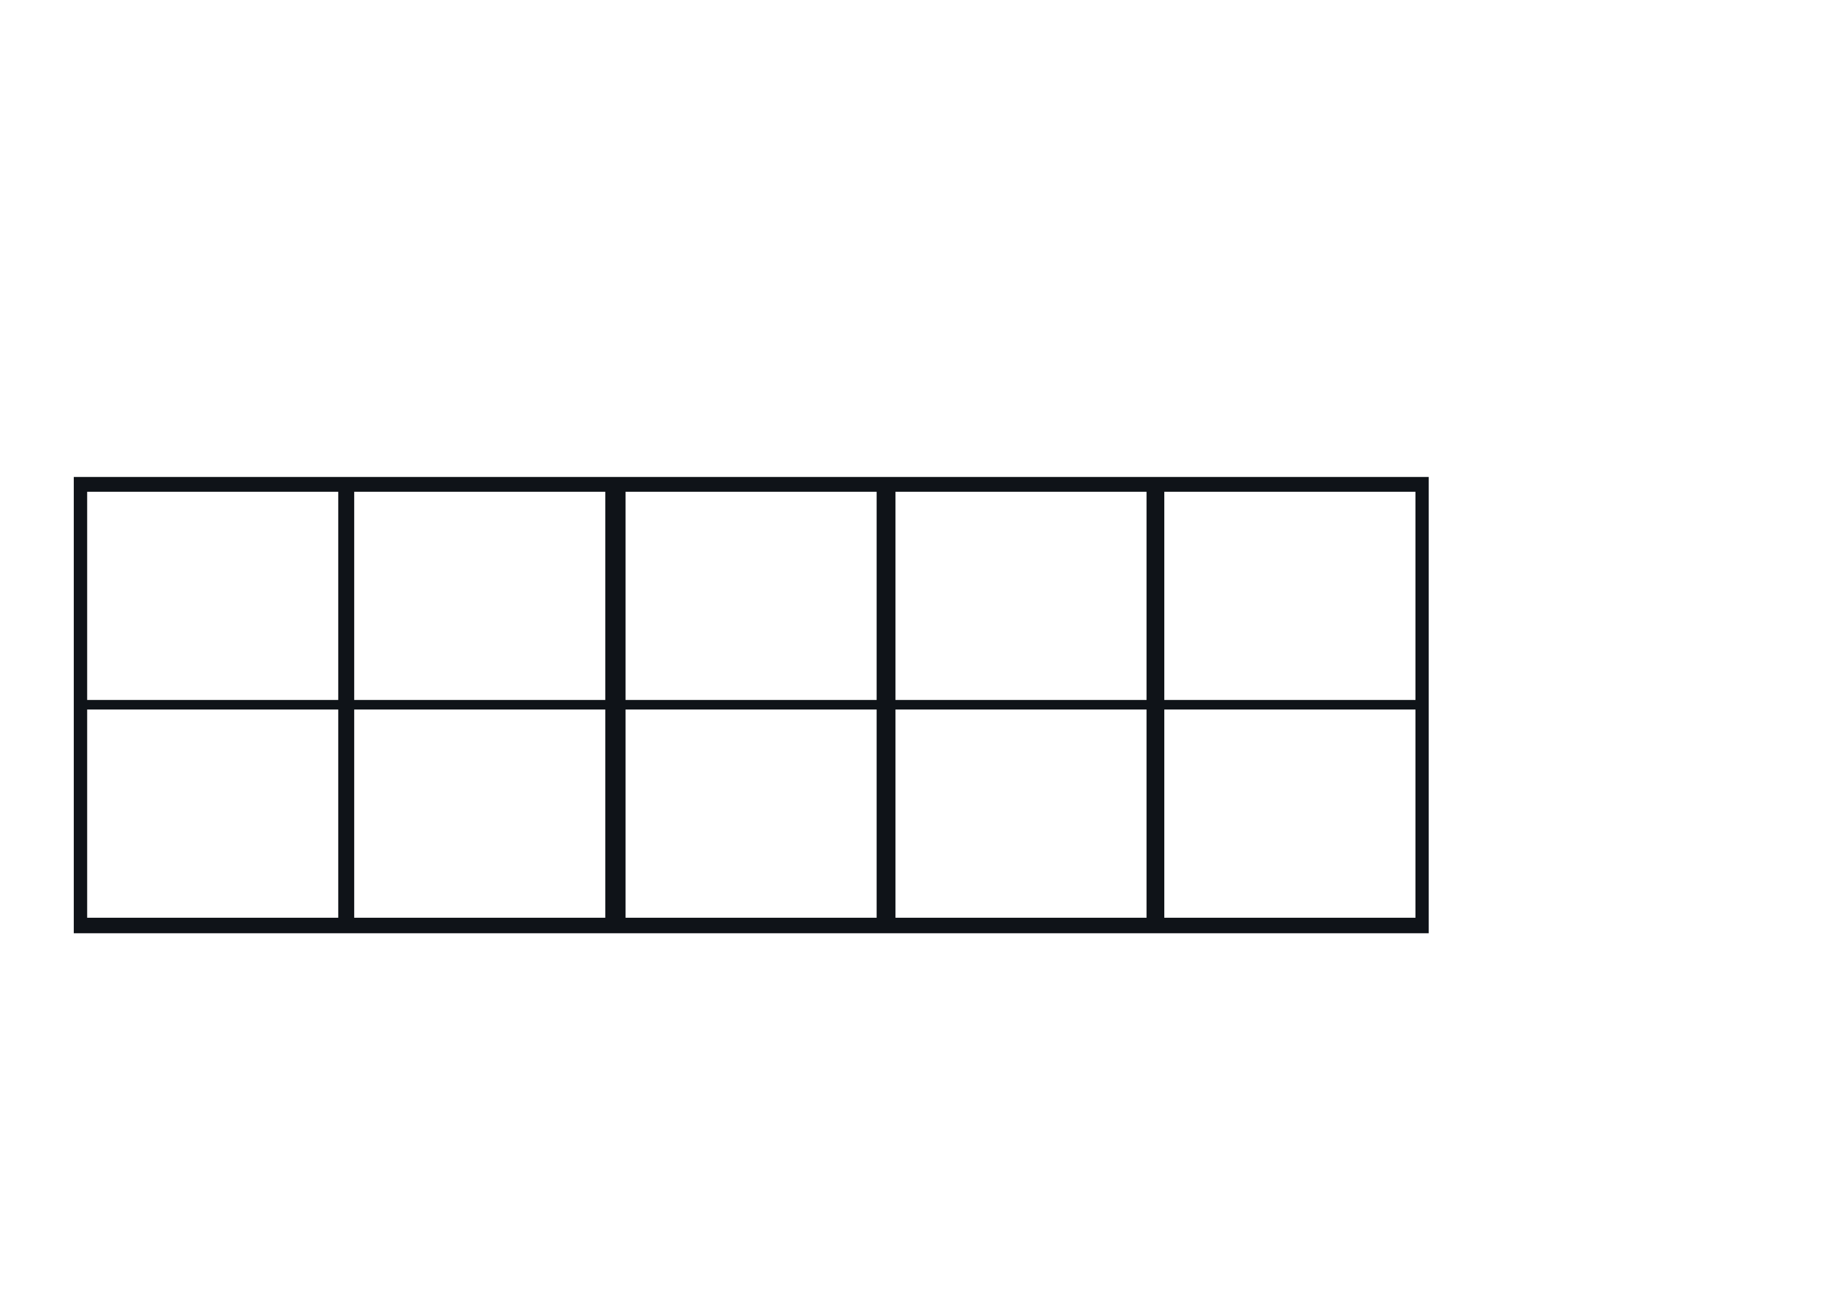

Number Six wanted to go out for the day. He needed to get a taxi.
It was 6p for the taxi journey. Number Six was in a such a fix, he didn’t know which coins to give the driver! Can you help him?
I’m in such a fix! Which purse has 6p in it? Can you click it for me?
Try again!
Try again!

Slide 4

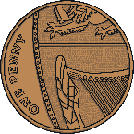
Thank you for helping me find the right purse. How many pennies are there?

Slide 5
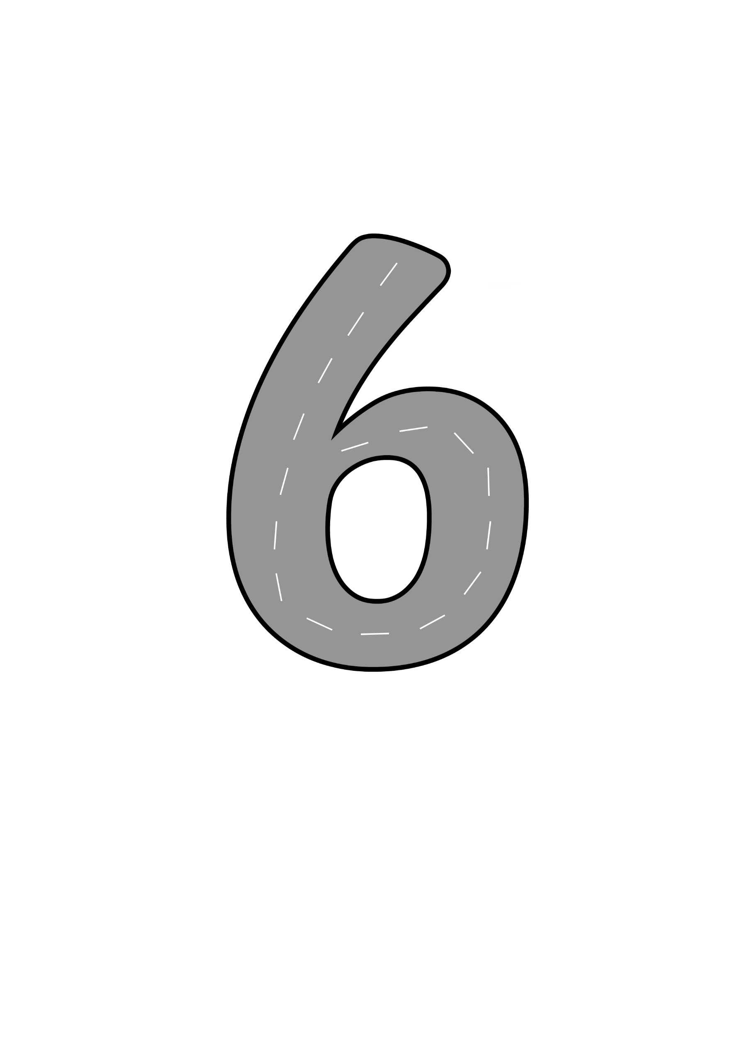

Next, Number Six set off along the road in the taxi. Look at the road that Number Six follows. As they drove along, Number Six sang a song...
Bend down low to pick up sticks. Now I’ve made a number six.

Slide 6
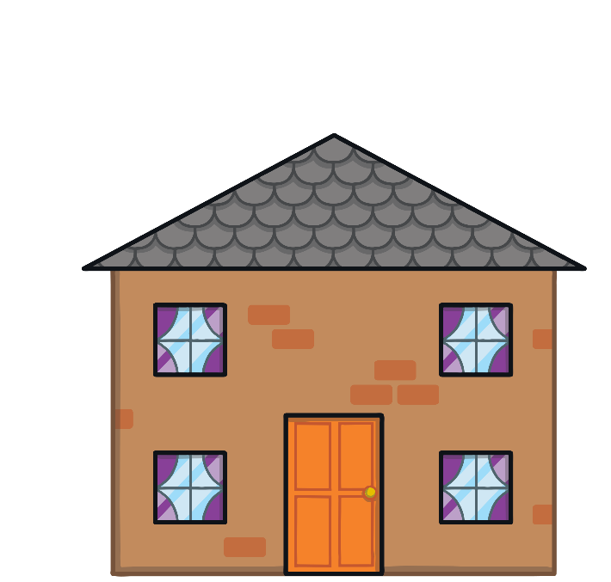



Number Six arrived at his friend’s house. He looked at the note his friend had given him. Number Six was in a such a fix! He didn’t know which house had 6 windows. Can you help him to find the correct house?
I live in the house with 6 windows.
Try again!
Try again!

Slide 7
Well done! You’ve found the right house. Can you count the windows to check?

Slide 8
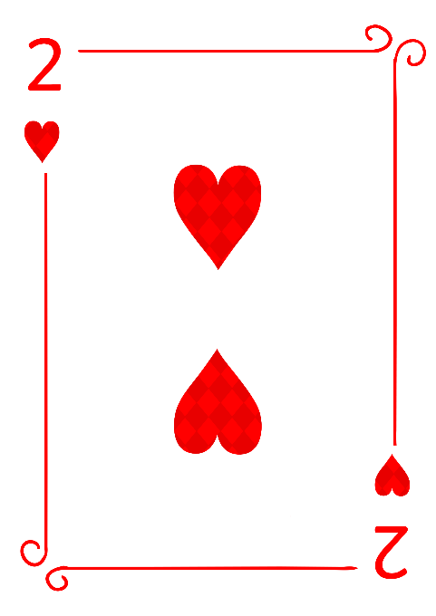
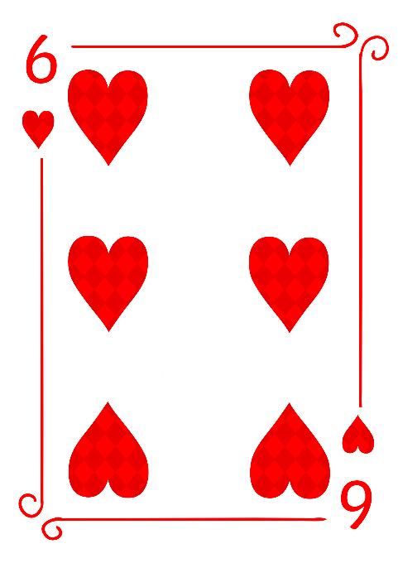

Number Six and his friend played a game of cards. Number Six needed to choose the 6 of hearts to win the game.
Try again!
I’m in such a fix! I don’t know which card is the 6 of hearts. Can you help me?

Slide 9
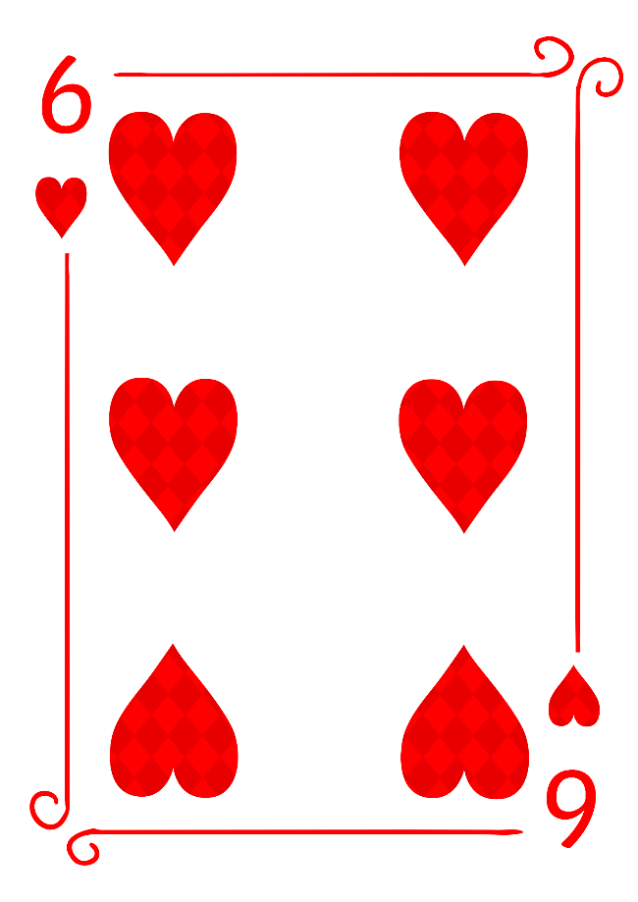
Well done! How did you know that was the 6 of hearts?

Slide 10



Number Six started to get hungry. He looked at the plates that his friend had laid out for lunch. Number Six needed the plate with 6 sausages but he was in such a fix! He didn’t know which plate to choose.
Try again!
Try again!
I’m in such a fix! Which plate is mine? Can you help me?

Slide 11


Thank you for helping me choose the right plate. I have 6 sausages. How did you work it out?

Slide 12
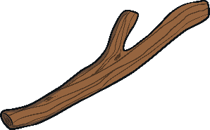



Then, Number Six and his friend went outside to play. They found some sticks and made some shapes. Number Six wanted to take a picture of the shape with 6 sticks. He was in such a fix, he didn’t know which shape to choose!
Try again!
Try again!
I’m in such a fix! Can you find the shape made with 6 sticks?

Slide 13

Well done, that’s my shape! Do you know what it is called? How many sides does it have?

Slide 14







Before he went home, Number Six painted a picture with his friend but they didn’t put their names on their pictures! Number Six was in such a fix, he couldn’t remember which picture was his. He used 6 colours.
I’m in such a fix! Can you help me find the picture that I painted?
Try again!

Slide 15







You’re right! That is my picture. Can you name the colours I used? How many colours are there?

Slide 16


It was night time when Number Six left his friend’s house. He looked up at the sky and counted the stars. He was in such a fix! Number Six couldn’t remember how many stars he counted.
I’m in such a fix! Can you help me count the stars? How many stars can you see?
There are 6 stars in the sky.

Slide 17















Thank you for all your help! Can you remember all the ways we saw number six?
6 pennies
6 windows
6 sausages
6 sticks
6 stars
6 colours

Slide 18
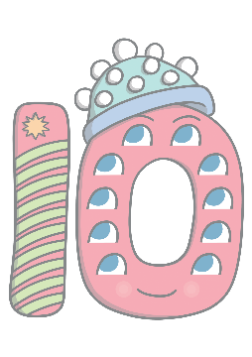





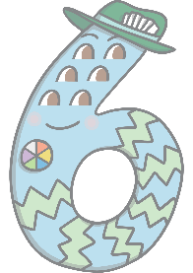
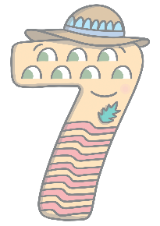
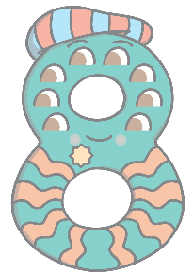


Can you find 6 on the number track?
1
2
3
4
5
6
7
8
9
10
Which number comes before 6? Which number comes after? Can you count along the number track from 1 to 10?

