Slide 1
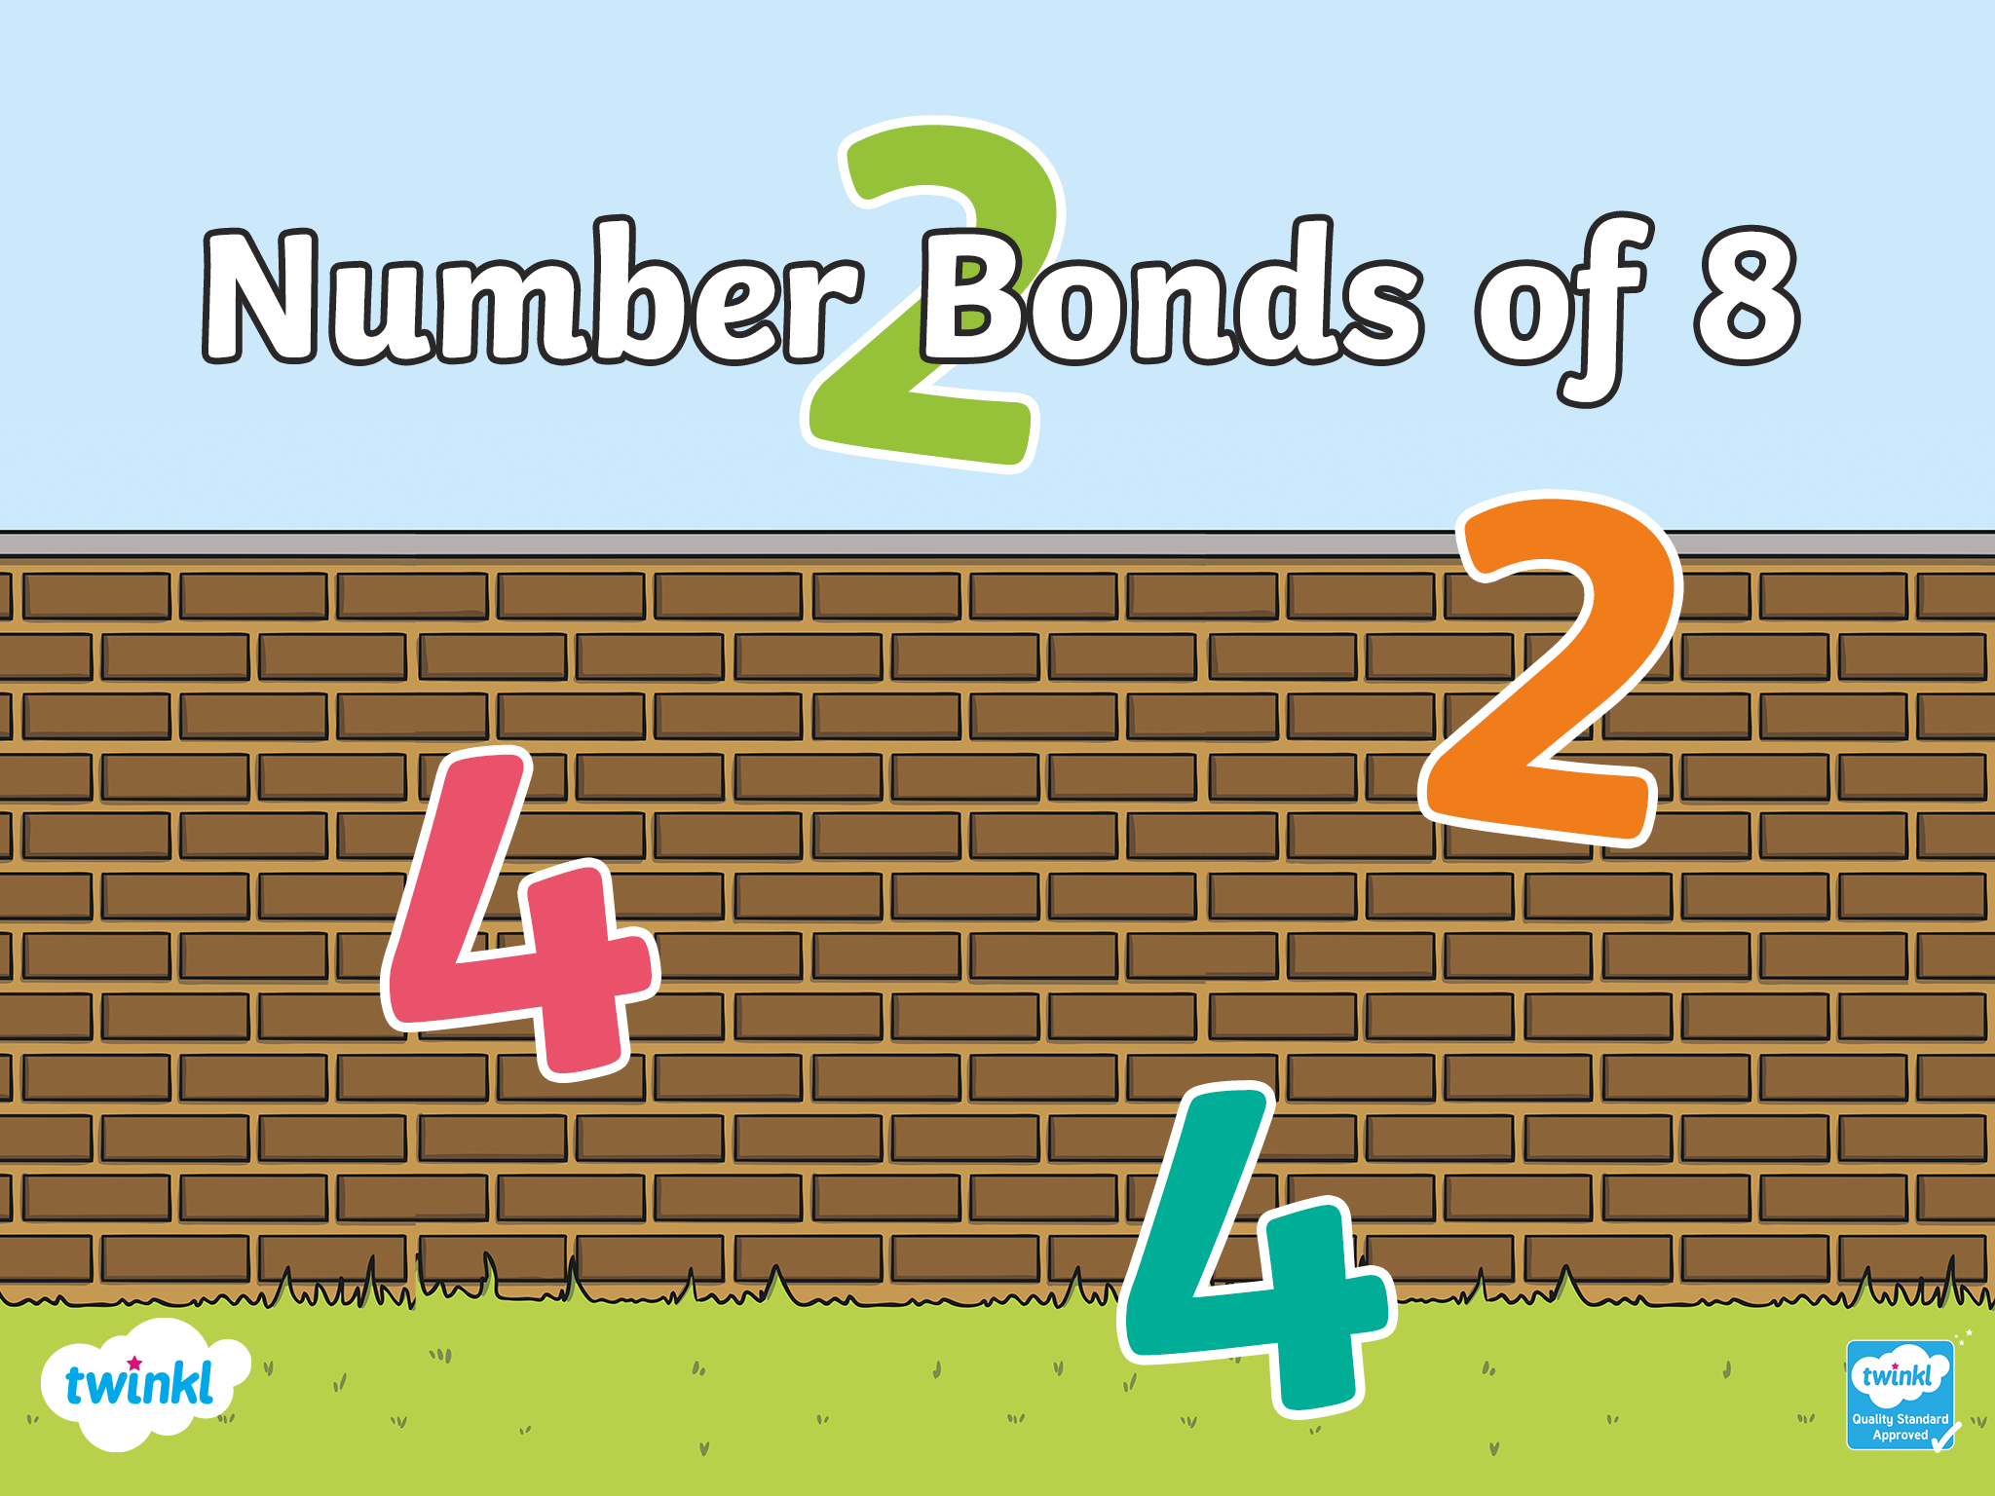

Slide 2
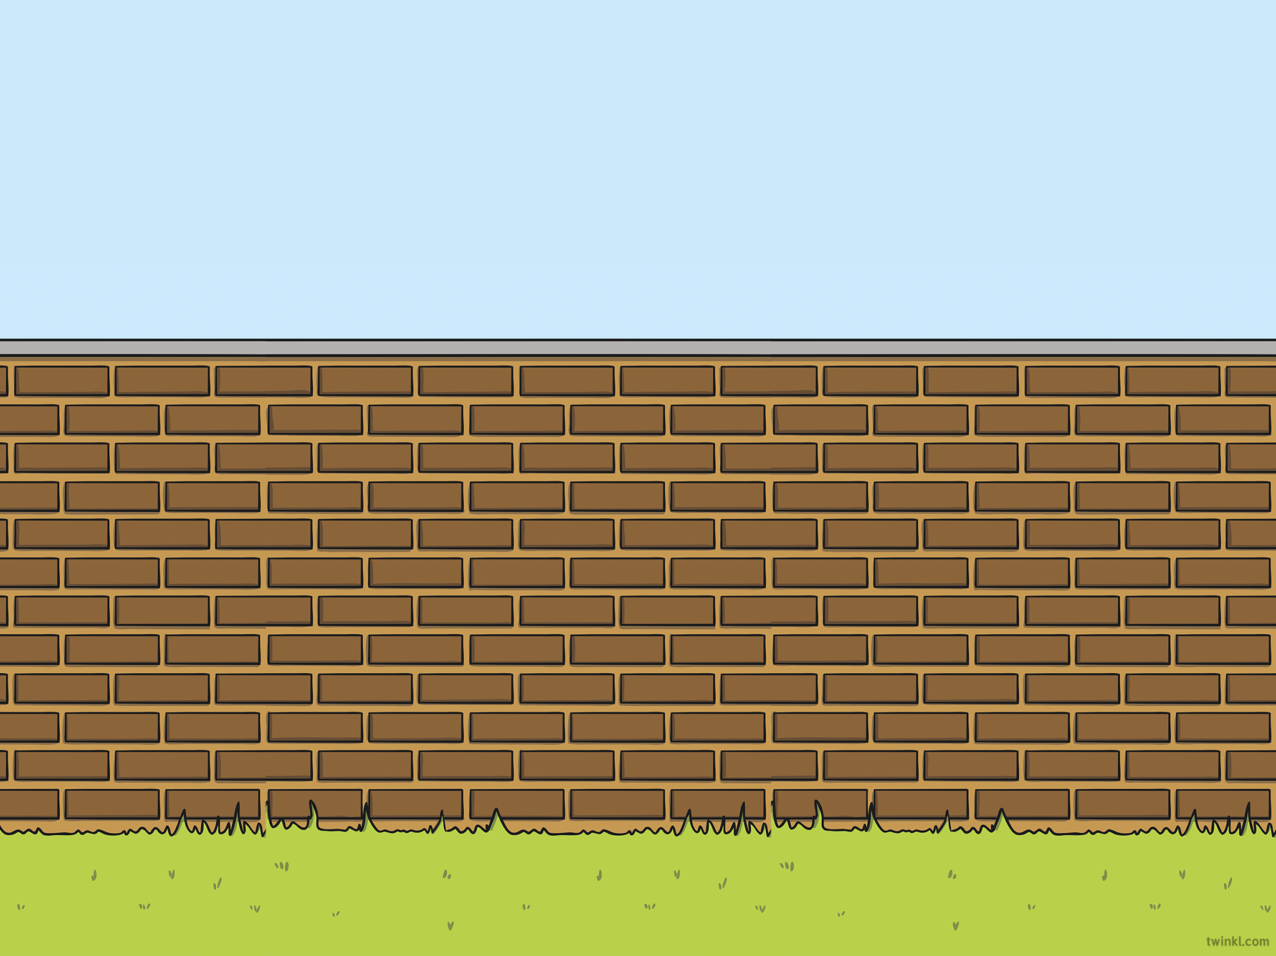
What Are Number Bonds of 8?
Numbers bonds of 8 are two numbers that make 8 when they are added together.
There are nine different ways of making 8!

Slide 3
Here Are Nine Different Ways of Making 8!
The number bond here is 8 + 0 = 8.
Look at the birds on the wall.
The wall has been split into two so we can show the number bonds.

Slide 4
What is the sum here?
0 + 8 = 8
Reveal answer

Slide 5
What is the sum here?
8 + 0 = 8
Reveal answer

Slide 6
What is the sum here?
7 + 1 = 8
Reveal answer

Slide 7
What is the sum here?
1 + 7 = 8
Reveal answer

Slide 8
What is the sum here?
6 + 2 = 8
Reveal answer

Slide 9
What is the sum here?
2 + 6 = 8
Reveal answer

Slide 10
What is the sum here?
5 + 3 = 8
Reveal answer

Slide 11
What is the sum here?
3 + 5 = 8
Reveal answer

Slide 12
What is the sum here?
4 + 4 = 8
What do you notice about this sum?
Reveal answer

Slide 13
What is the sum here?
It’s a double!
Reveal answer

Slide 14
Challenge
Can you remember all the number bonds of 8?
Work with a partner and write down the nine ways of making 8 on a whiteboard.

Slide 15
