Slide 2
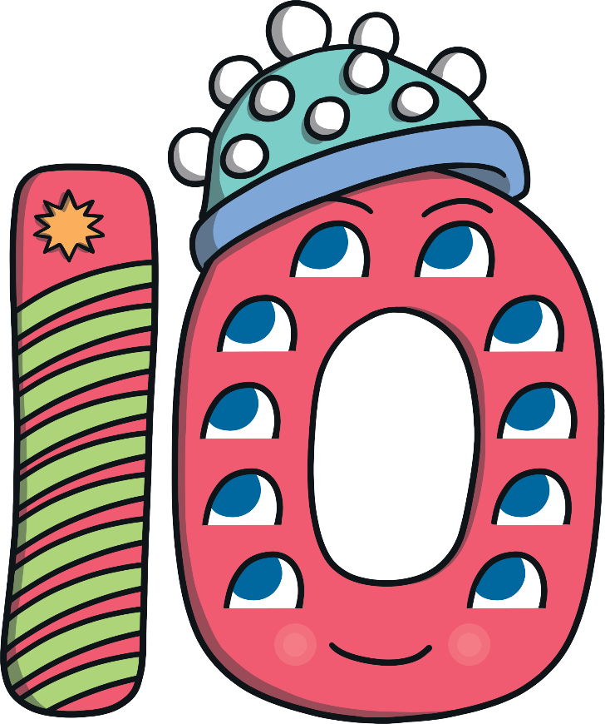
Meet Number Ten
Hello, I am Number Ten. Do you want to hear about what I did on my exciting camping adventure?
What do you notice about Number Ten? What does she have 10 of?

Slide 3
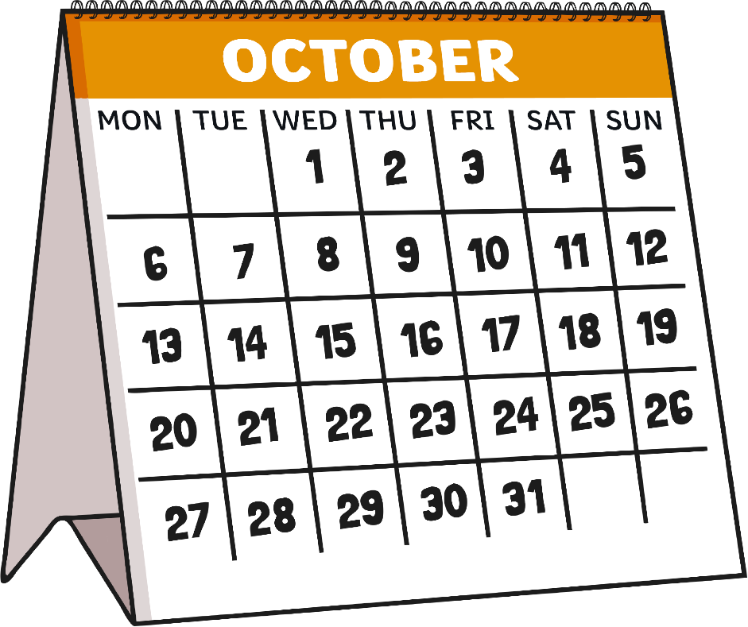
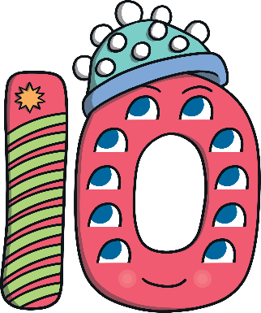
Number Ten was so excited about her camping adventure! She had been counting down to it for the last 10 days.
Number Ten was going camping on the 10th October.
I want to circle the date of my holiday on the calendar. Can you show me which date to choose?
Try again!
Well done!

Slide 4
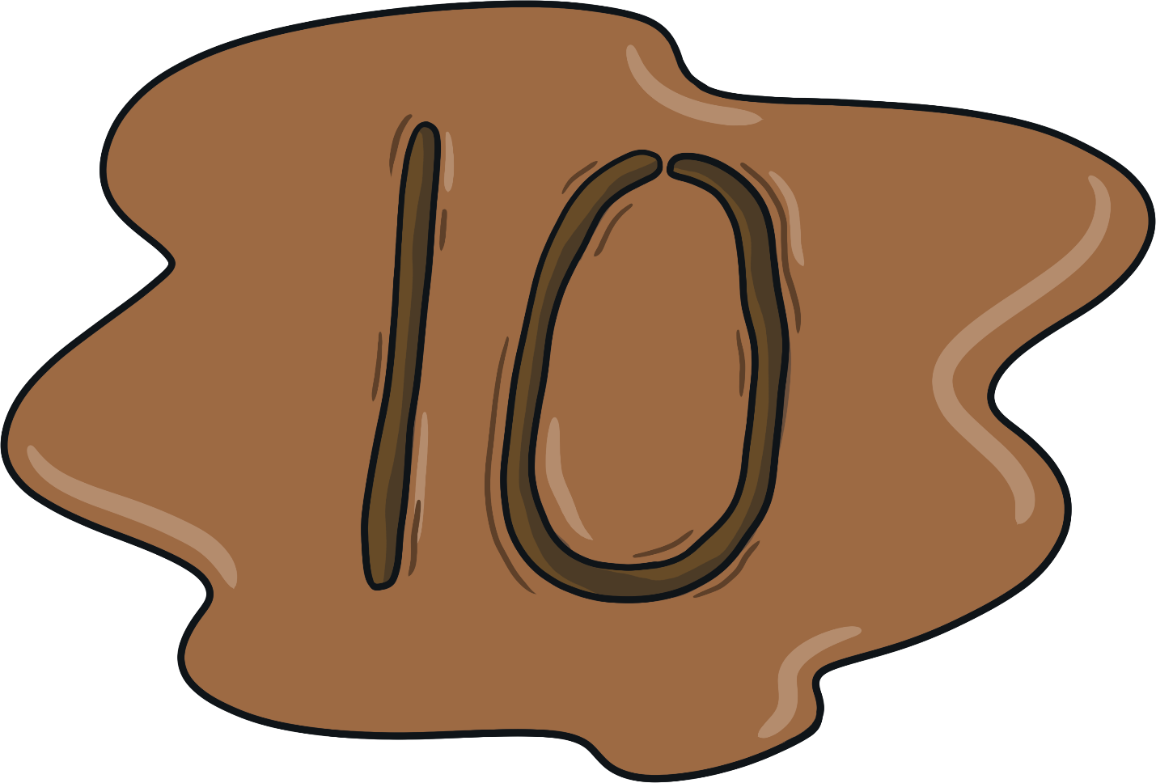
On the 10th October, Number Ten packed her bag and headed off on her bike to the camp site. On the way, she came across some mud. She loved drawing in the mud so she drew her favourite number. As she started writing in the mud, she sang a song…
Add a downward stroke, that’s my one. Add a zero, that’s my number ten done!
What do you think my favourite number is?

Slide 5
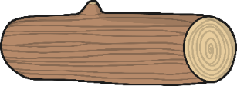
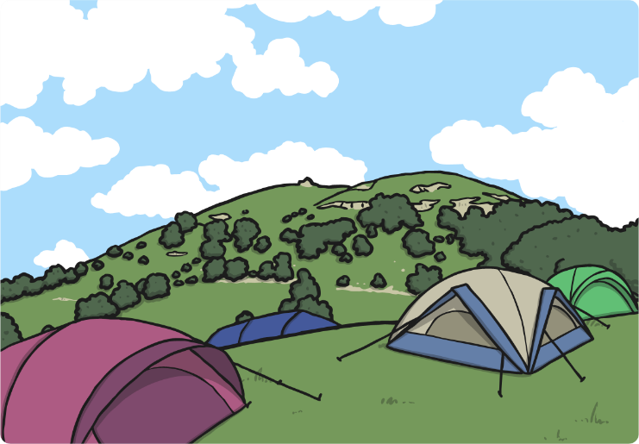
Number Ten arrived at the camp site. Her first job was to collect 10 logs to make the fire.
I’m not sure how to count to 10. Can you help me to collect the correct pile of logs?
Try again!
Try again!

Slide 6
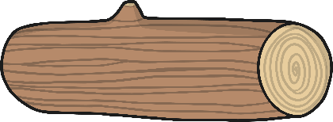
Well done!
1
2
3
4
5
6
7
8
9
10
Can you count the logs with me?

Slide 7
Number Ten then decided that she needed to build her den. She laid out all the equipment she needed.
I need 10 tent pegs to hold my tent together. Can you help me choose 10 pegs?
Try again!
Try again!
Well done!

Slide 8
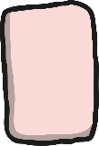
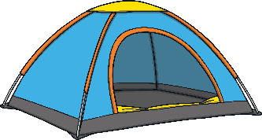
Once the den was complete, Number Ten decided to toast some marshmallows on the fire. She carefully placed some marshmallows onto two sticks.
Which two sticks do I need to toast to have 10 marshmallows? How can you check?
Try again!
Try again!

Slide 9
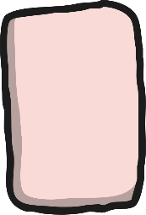
Well done!
5 + 5 = 10
What do you notice about the marshmallows? How many are on each stick?

Slide 10
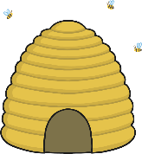
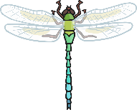
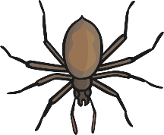
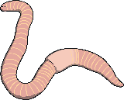
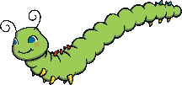
Number Ten decided to see what minibeasts she could find.
Can you help me find a minibeast that shows 10?

Slide 11
5 + 5 = 10
How does the ladybird show 10?

Slide 12
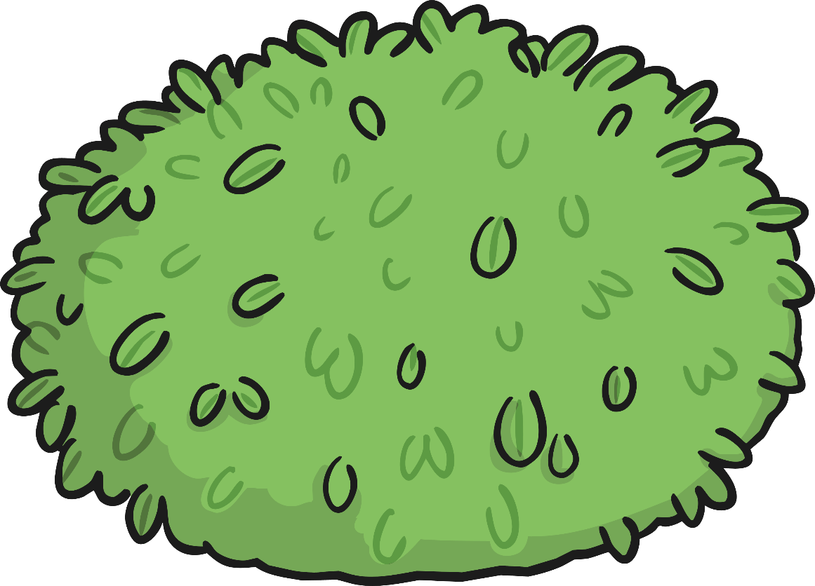
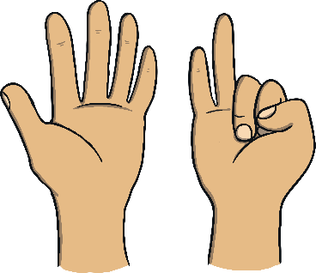
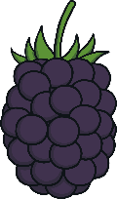
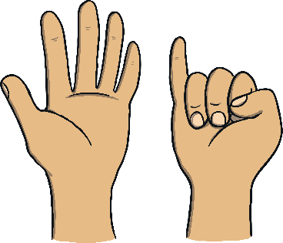
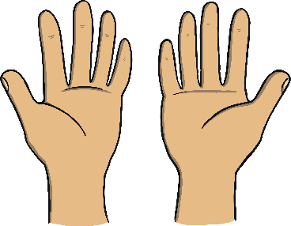
Number Ten decided to go blackberry picking. She looked at the blackberry bush.
I think there are 10 blackberries on the bush. Am I right? How can you check? Click the set of hands that shows the correct number of blackberries.
Try again!

Slide 13
Let’s count them to check!
1
2
6
7
3
8
4
5
9
10
Can you show me 10 on your fingers?

Slide 14
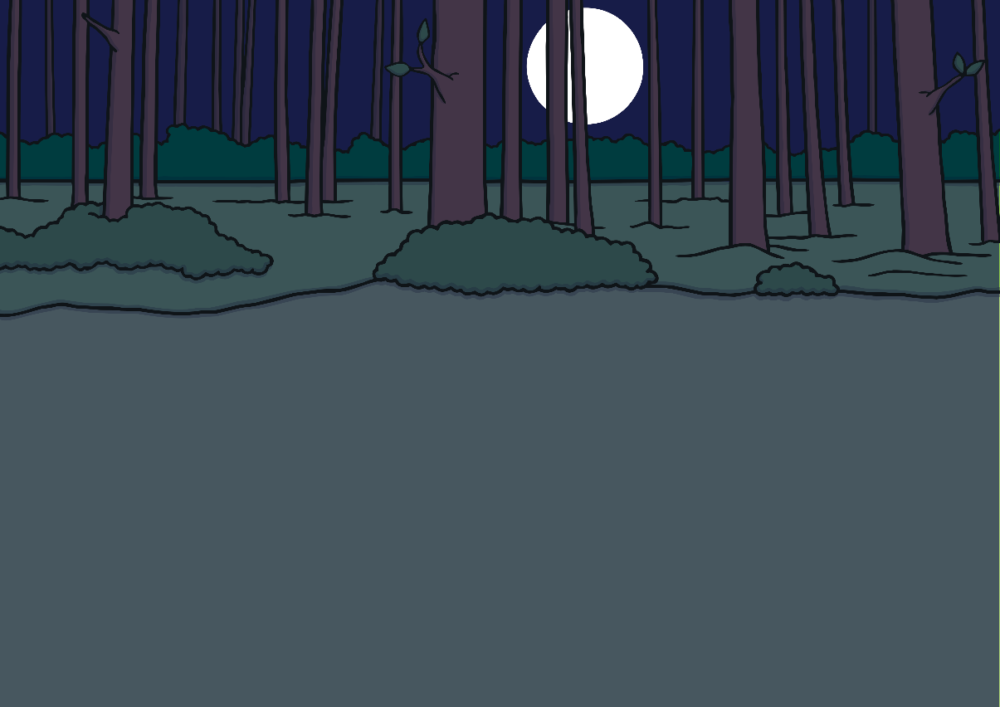
As night drew in, Number Ten sang herself to sleep. She sang a song all about herself and her friends.
Do you know the song ‘1, 2, 3, 4, 5, Once I Caught a Fish Alive’? Can you sing it with me?

Slide 15
Can you remember all of the ways that we saw 10 on my camping trip?
10th October
10 logs
10 tent pegs
10 marshmallows
10 spots
10 blackberries

Slide 16
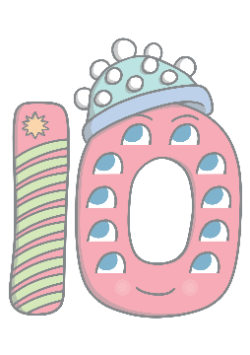
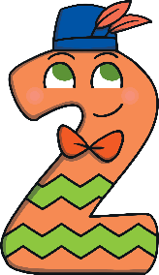
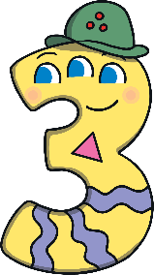
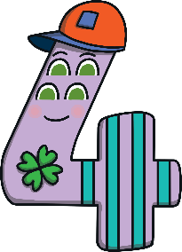
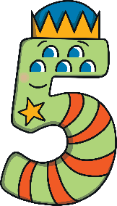
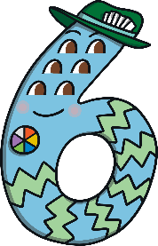
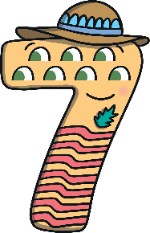
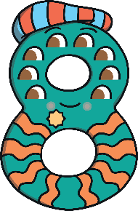
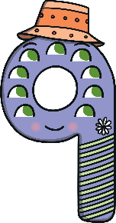
Can you find 10 on the number track? Click on Number Ten to move her onto the number track.
1
2
3
4
5
6
7
8
9
10
Which number comes before 10? Can you count along the number line from 1 to 10?

