Slide 1
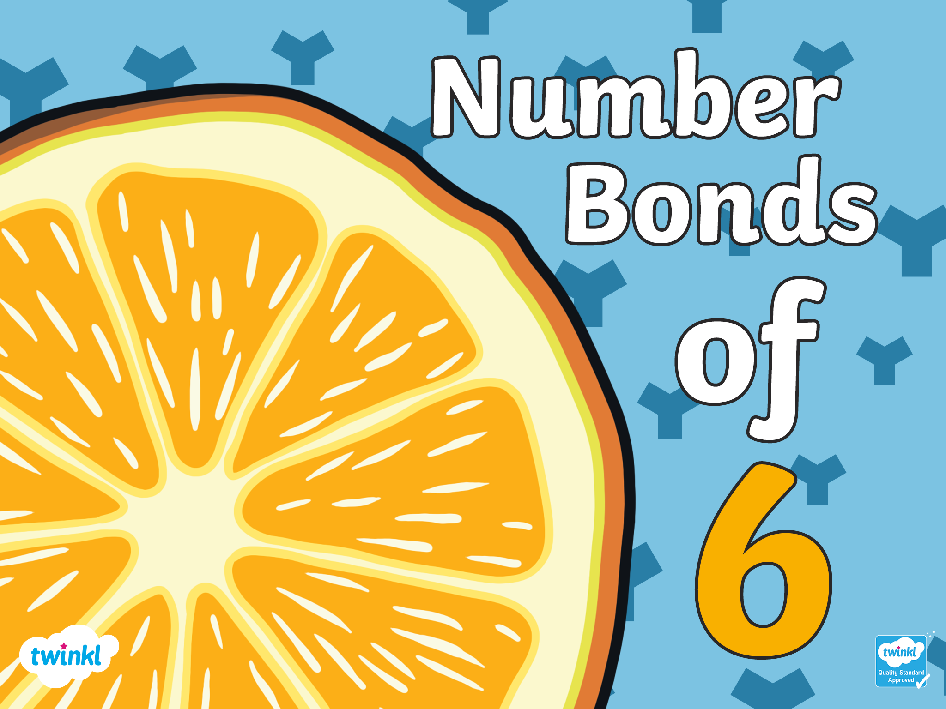

Slide 2
There are 7 ways to make 6!

Slide 3


6+0=6
There are 7 ways to make 6!

Slide 4

0+6=6
There are 7 ways to make 6!

Slide 5
5+1=6
There are 7 ways to make 6!

Slide 6
1+5=6
There are 7 ways to make 6!

Slide 7
4+2=6
There are 7 ways to make 6!

Slide 8
2+4=6
There are 7 ways to make 6!

Slide 9
3+3=6
There are 7 ways to make 6!

Slide 10
Challenge
With a partner, write down the ways of making 6. Remember there are 7 ways of making 6!
6 + 0 = 6
0 + 6 = 6
5 + 1 = 6
1 + 5 = 6
4 + 2 = 6
2 + 4 = 6
3 + 3 = 6
Click to reveal the answers

