Slide 1
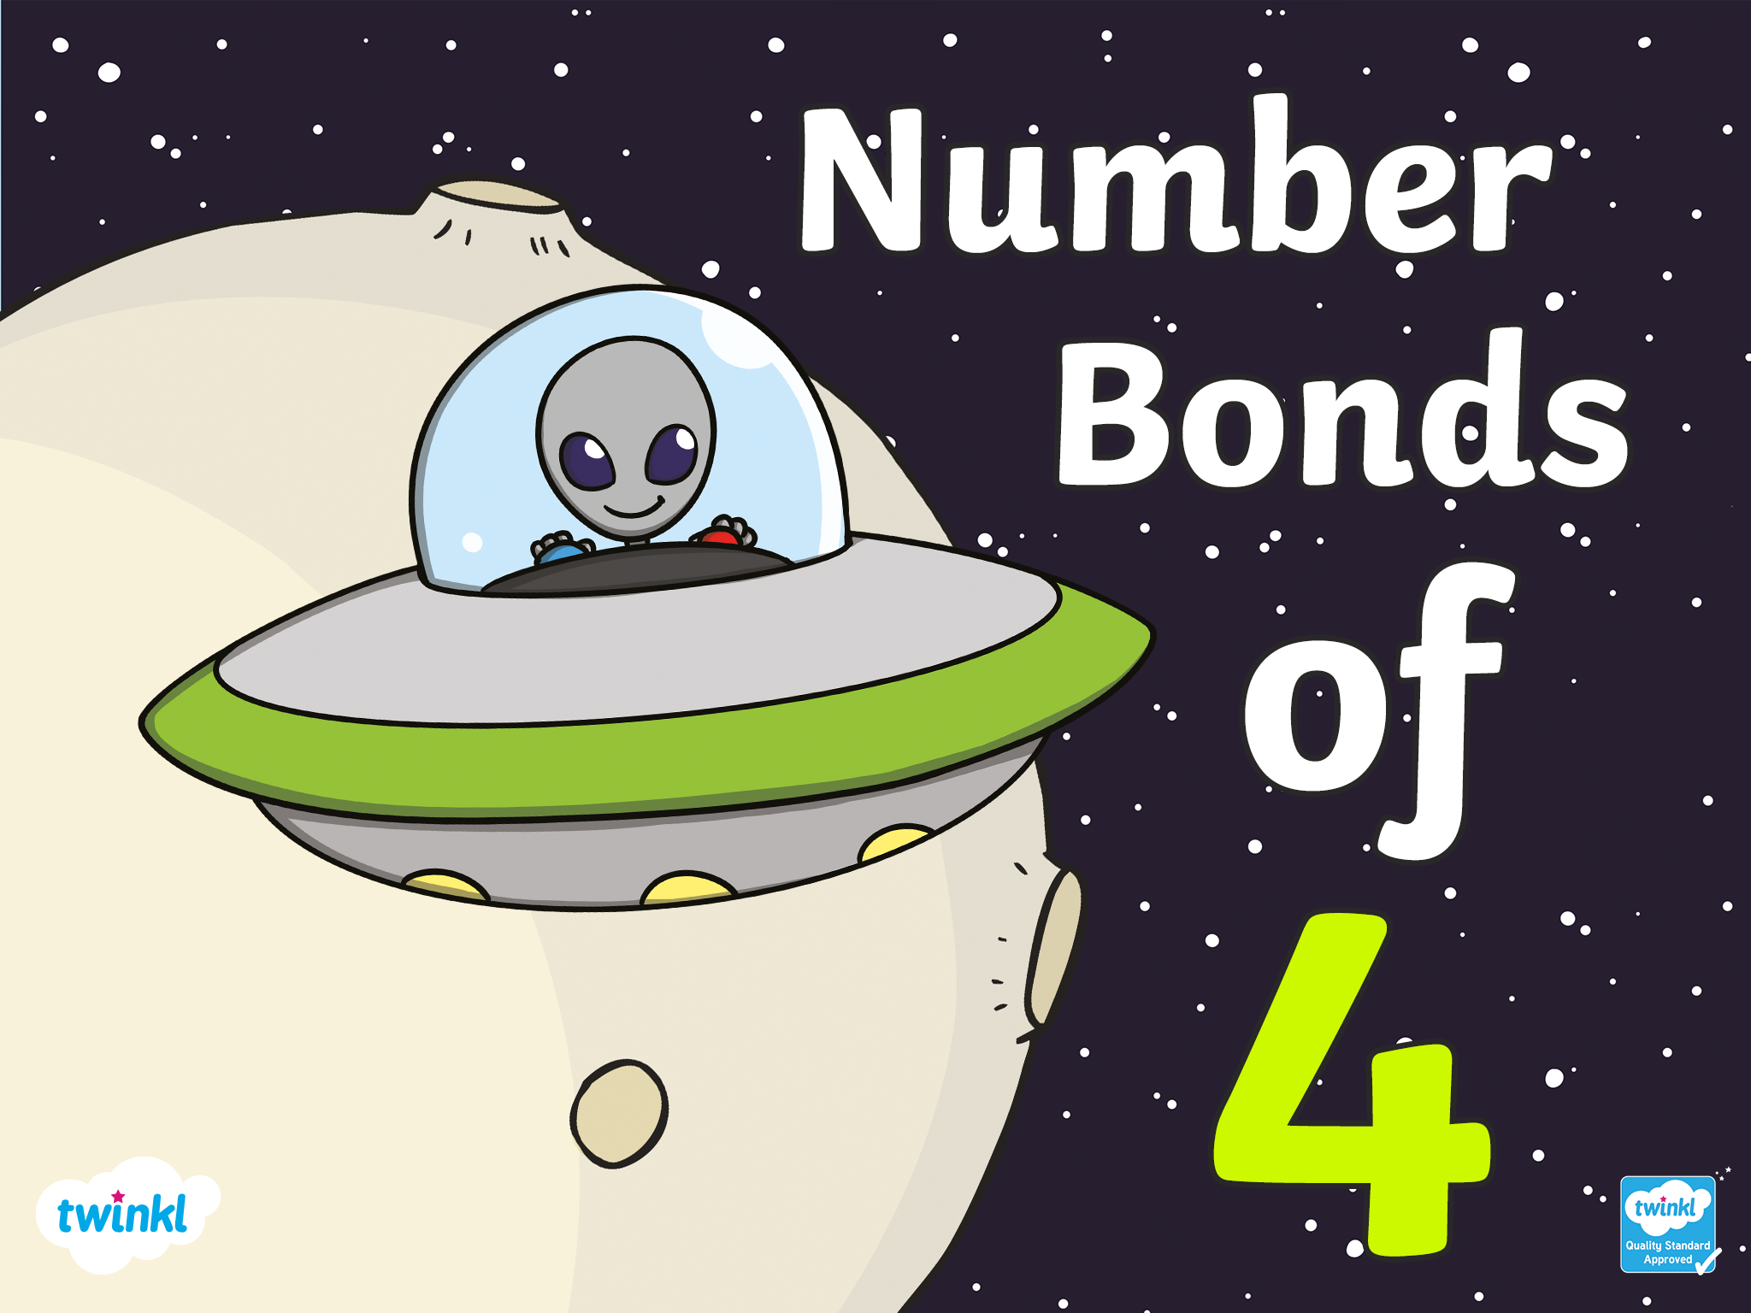

Slide 2
There are 5 ways to make 4!

Slide 3
4+0=4
There are 5 ways to make four!

Slide 4
0+4=4
There are 5 ways to make four!

Slide 5
3+1=4
There are 5 ways to make four!

Slide 6
1+3=4
There are 5 ways to make four!

Slide 7
2+2=4
There are 5 ways to make four!

Slide 8
Challenge
With a partner, use a whiteboard to write down as many ways as you can remember to make 4. Can you recall all 5 ways?
4 + 0 = 4
0 +4 = 4
1 + 3 = 4
3 + 1 = 4
2 + 2 = 4
Click to reveal the answers

