Slide 2
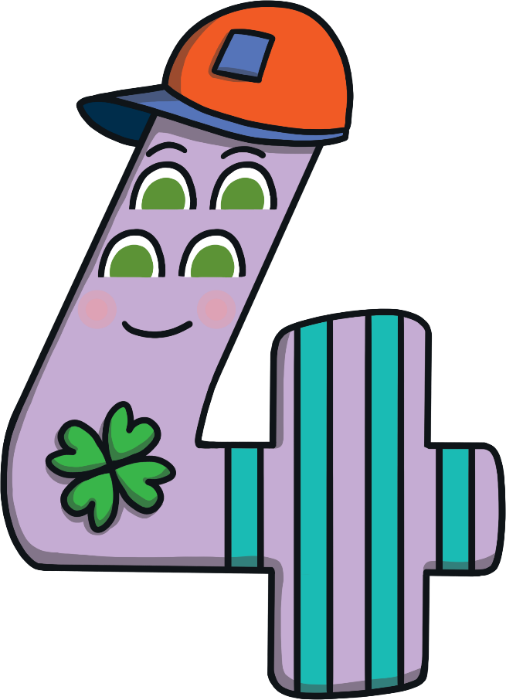
Meet Number Four
Hello, my name is Number Four. I love the number 4. Will you come on an adventure with me and see how many 4s you can see?
What do you notice about Number Four?

Slide 3
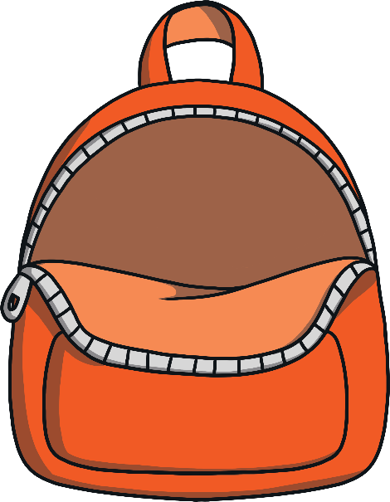
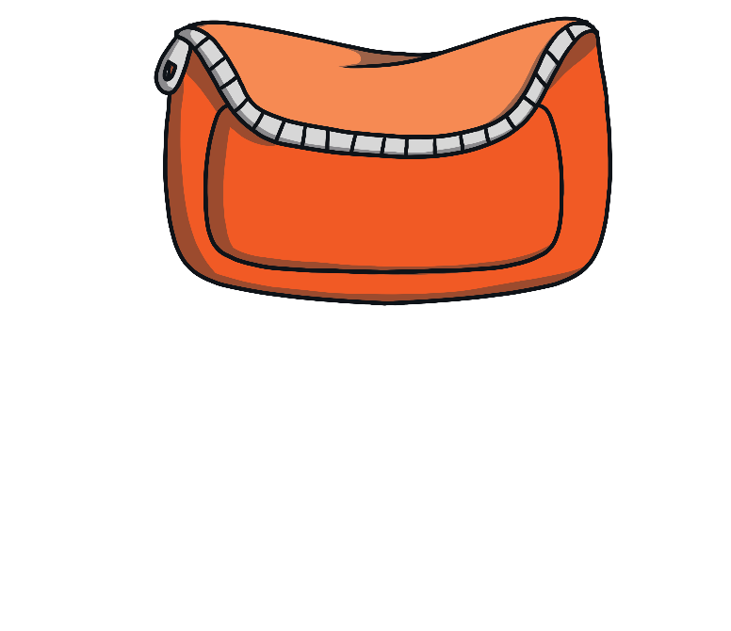
Number Four is going on an adventure to the store! Can you help to pack Number Four’s bag by clicking on each item?
a shopping list of 4 things to buy
number
4 ticket
a ticket for the number 4 bus
4 sweets
my purse with £4
Shopping List
a box of cakes
a bag of apples
some building bricks
a bunch of flowers

Slide 4
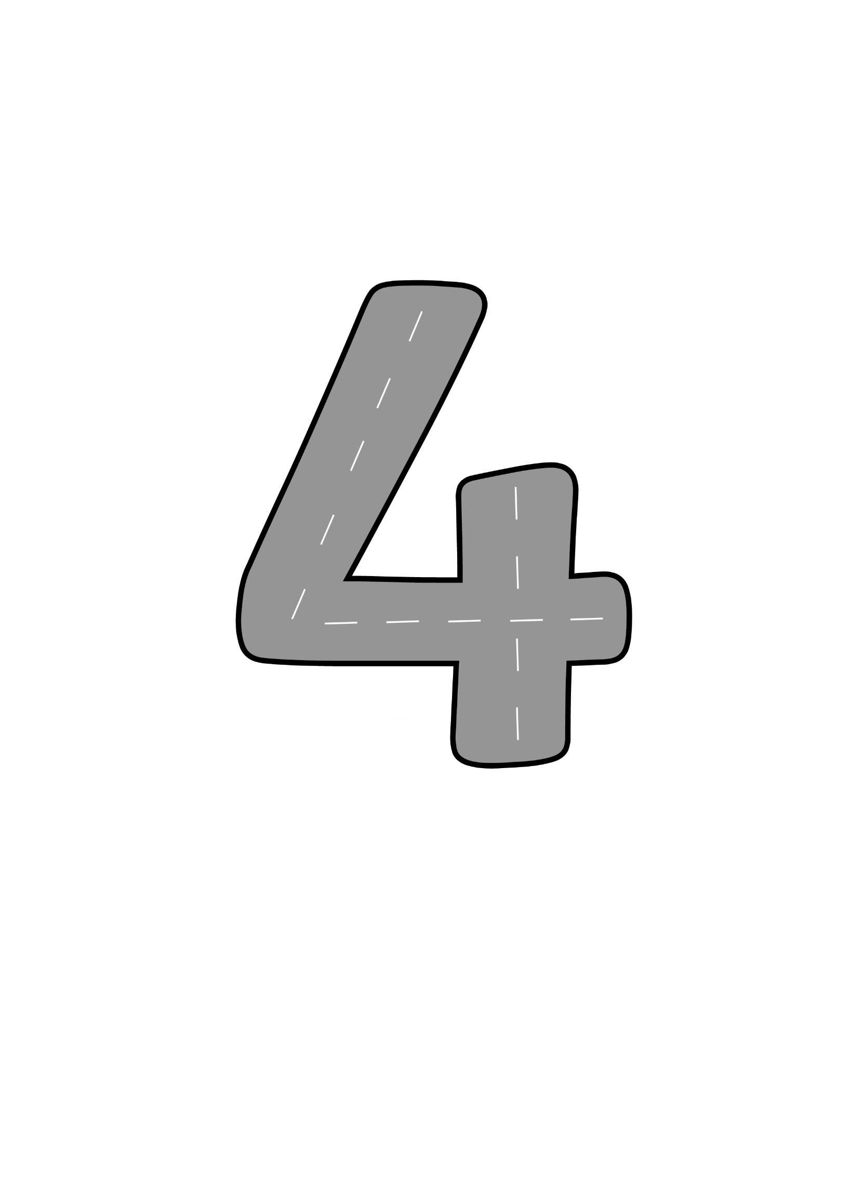
Number Four set off on his adventure. He hurried along the road to the bus stop. What do you notice about the road?
Down and across and down once more, now I’ve made the number four.

Slide 5
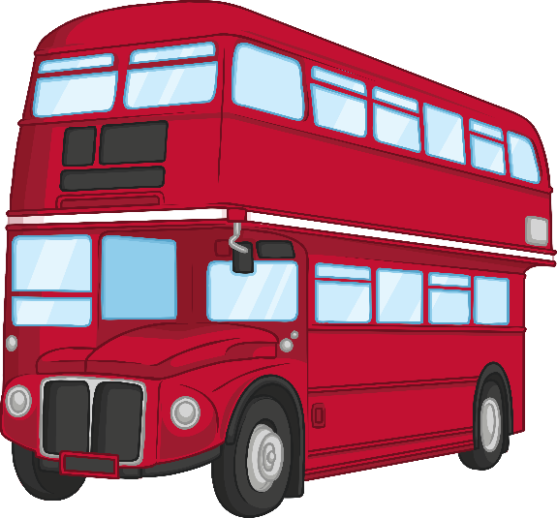
Number Four must catch the number 4 bus to get to the store. Can you help Number Four to get on the correct bus?
Number 4
Number 3
Number 2
Try again
Try again
Well done. This is the number 4 bus.
Which bus is number 4?

Slide 6
Let’s take a look at Number Four’s shopping list. How many things are on the list?
Shopping List
a box of cakes
a bag of apples
some building bricks
a bunch of flowers
Can you use your fingers to count how many items are on my list?

Slide 7
The first item on Number Four’s list, is a box of cakes. Which box contains 4 cakes?
Try again
Try again
Try again
Would it make a difference to the number of cakes if they were arranged in a different way?
Well done. This box contains 4 cakes.

Slide 8
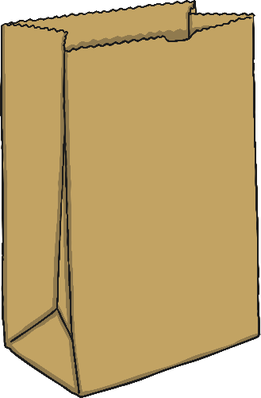
The second item on Number Four’s list, is a bag of apples. Can you find a bag of 4 apples?
Try again
Try again
Try again
Which bag do you think contains 4 apples? Can you tell without counting them?
Well done. There are 4 apples in this bag.

Slide 9
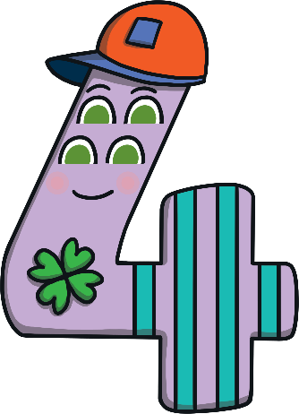
The third item on Number Four’s list, are some building bricks. Can you find a set of 4 bricks?
Try again
Try again
Try again
What do you notice about the shape of the four bricks? Could they be arranged in a different way?
Well done. There are 4 bricks in this set.

Slide 10
The fourth item on Number Four’s list is a bunch of flowers. Can you find a bunch of flowers of 4 different colours?
Try again
Try again
Try again
Well done. There are 4 flowers in this bunch.
Which bunch of flowers should I choose? Why?

Slide 11
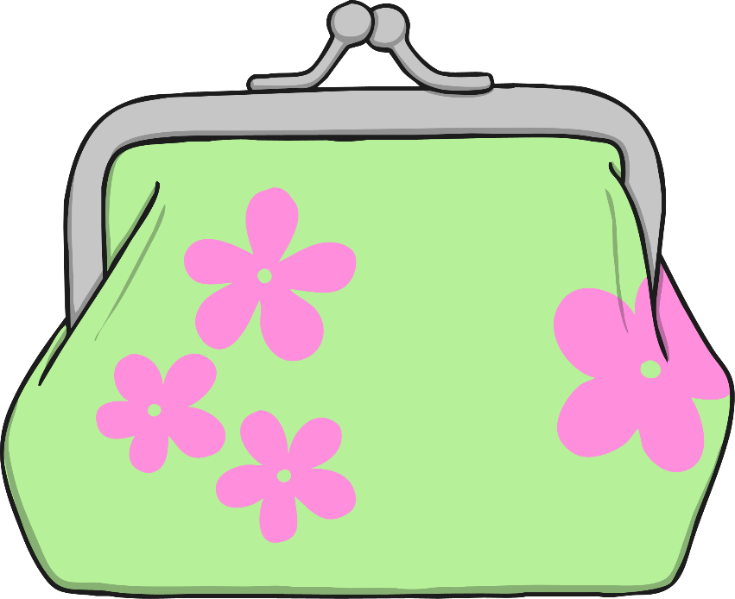
Can you help Number Four pay for their shopping? Can you find the purse that has 4 £1 coins inside?
Try again
Thank you. Now I can pay £4 for my shopping.
Can you use your fingers to show 4?

Slide 12
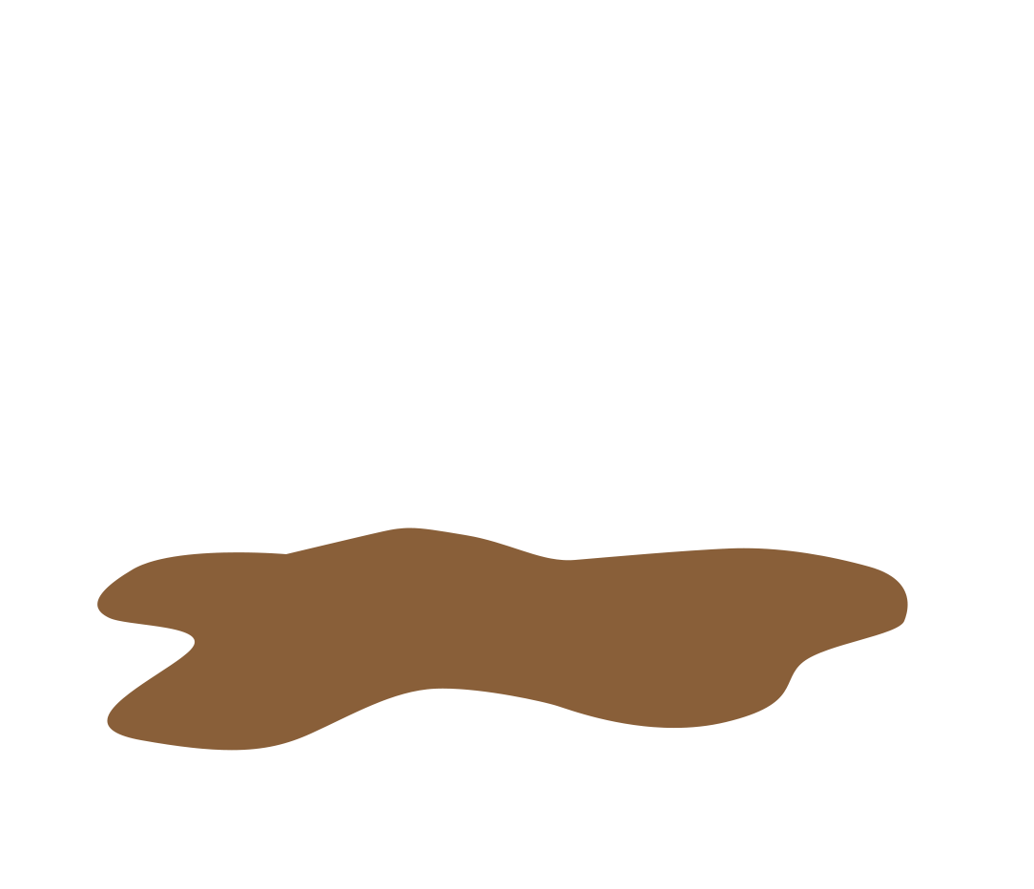
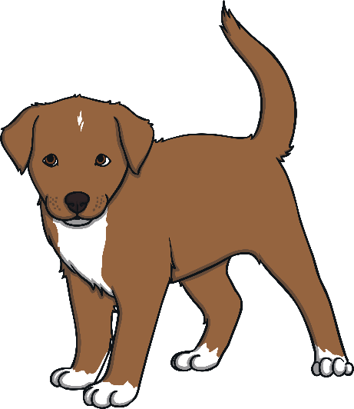
As Number Four headed back to the bus stop, he heard a noise. Click Number Four and listen carefully – what can you hear?
The puppy has muddy paws! How many muddy pawprints did puppy leave on me?
Click here to say “Hello!” to the puppy.

Slide 13
Number Four got back on the bus and headed home. Let’s look at all the things Number Four saw on their trip to the store.
Number 4
Number 4 bus
4 cakes
4 apples
4 bricks
4 flowers
4 muddy paws

Slide 14
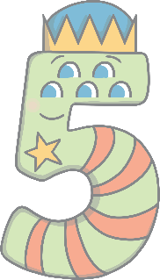
Can you find the number 4 on the number track?
1
2
3
4
5
Which number comes before number 4? Which number comes after number 4? Can you count along the number line from 1 to 5?
Click on Number Four to move them onto the number track.

