Slide 2
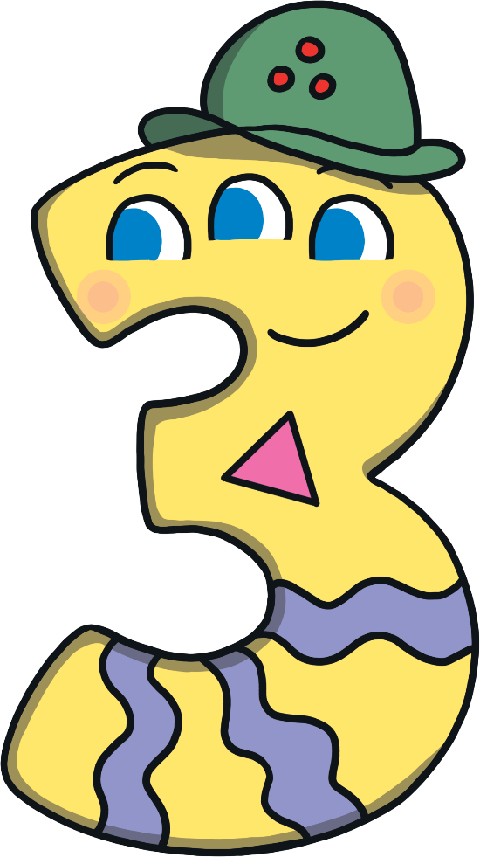
Meet Number Three
Hello, my name is Number Three and I love the number 3. Can you tell? Will you come on an adventure with me and find out all about number 3?
What do you notice about Number Three? Talk to a friend
about what you can see.

Slide 3
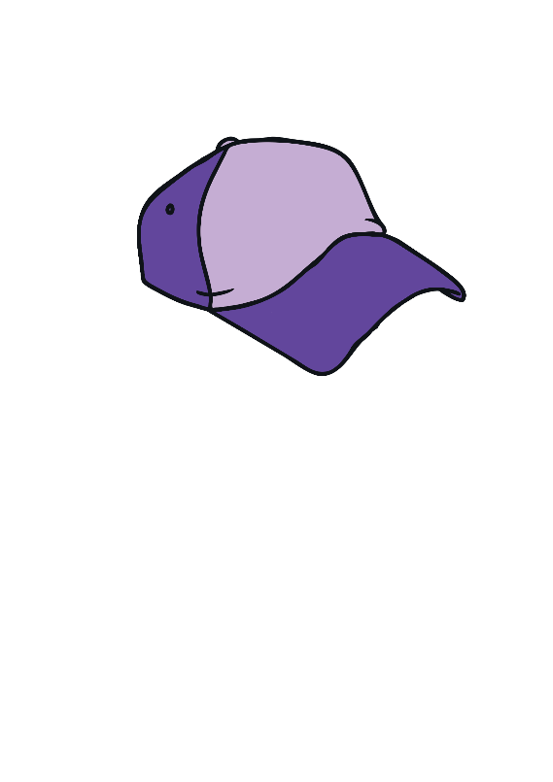
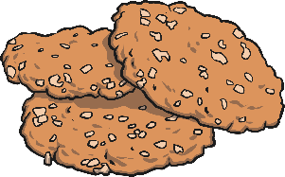
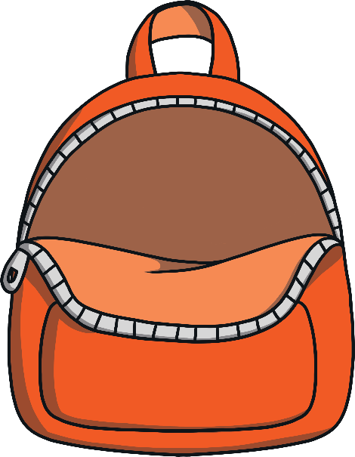
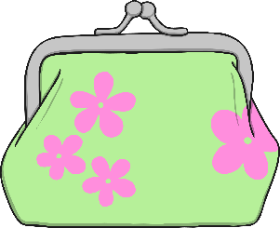
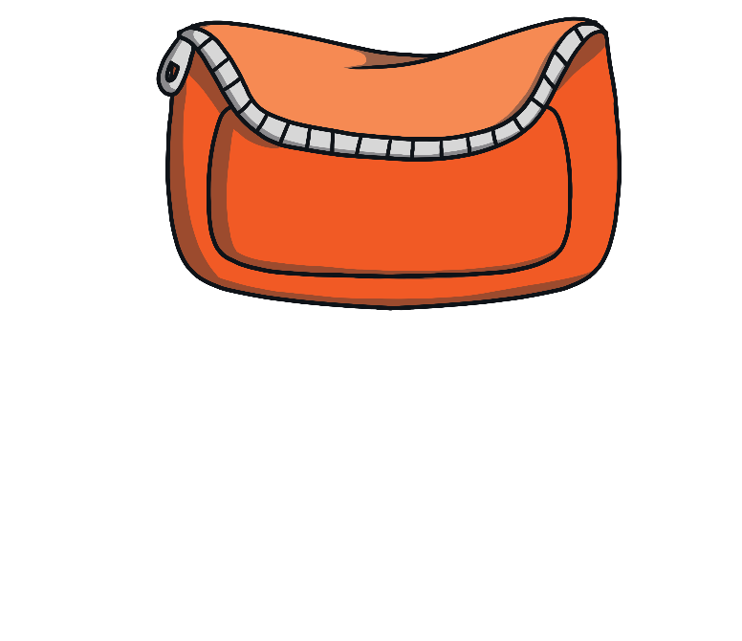
It was a beautiful day and Number Three decided to go out for a walk to the park. Can you help her to pack her bag?
3
my purse with £3
my number 3 sun hat
three biscuits

Slide 4
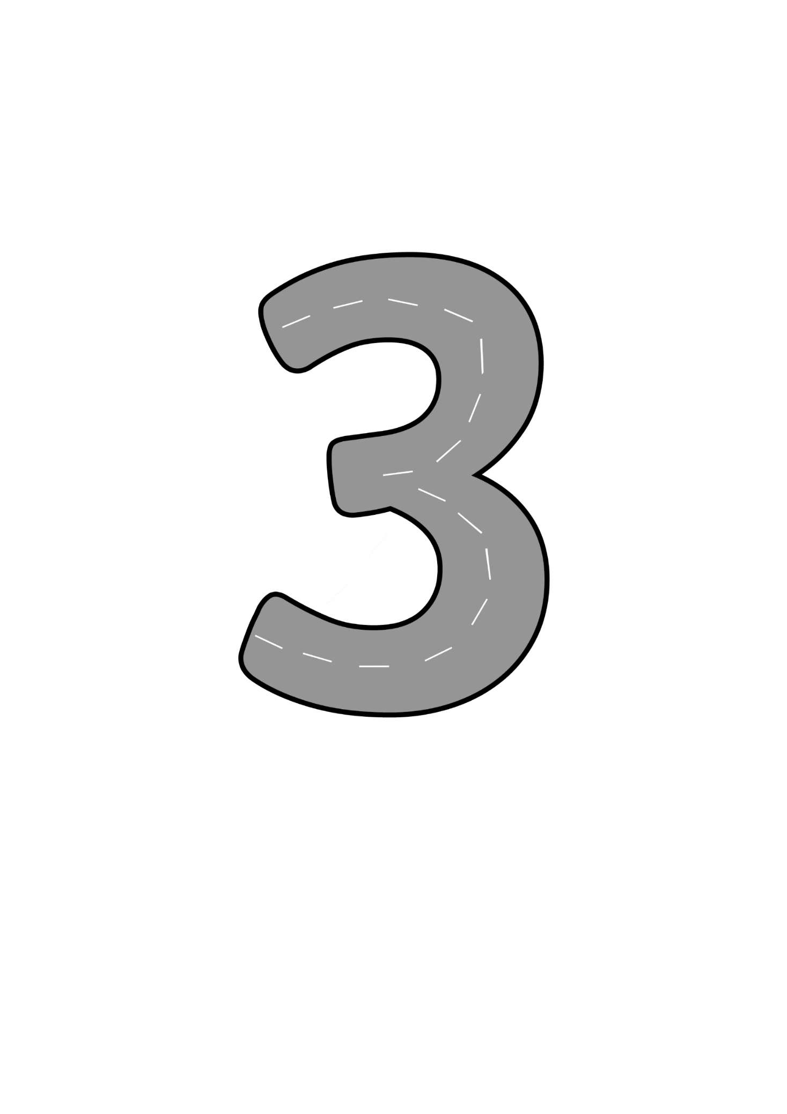
Number Three set off on her walk to the park. On the street outside her house were some trees. She slithered around them – look at the path she took as she slithered along! As Number Three slithered along, she sang a song.
Around the tree, around the tree, now I’ve made the number 3.
Can you use your finger to draw a number 3?

Slide 5
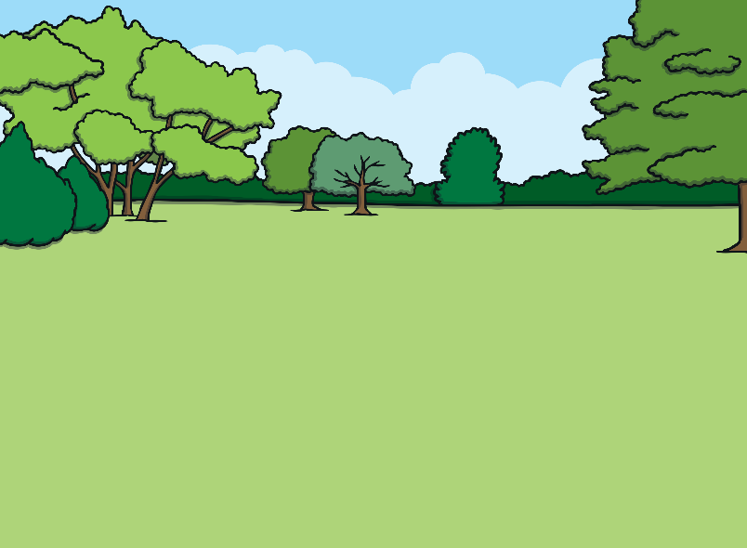
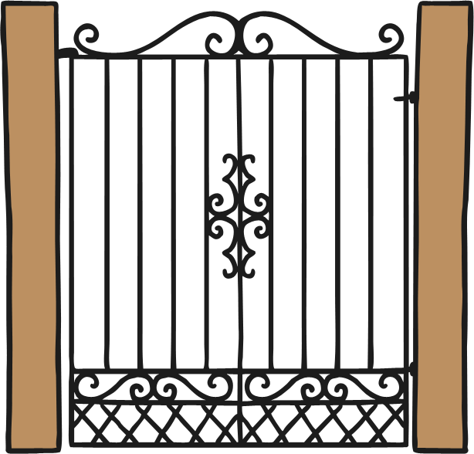
When Number Three got to the park entrance, she saw that there were different gates to choose from. Which gate do you think she chose? Why? Click on the gate that Number Three chose.
Try again
Try again
That’s right, this gate is decorated with 3 circles.

Slide 6
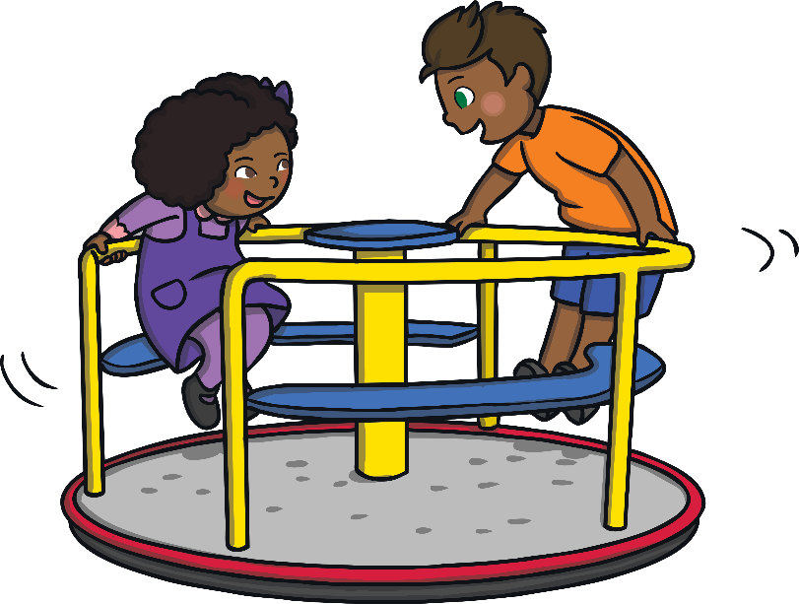
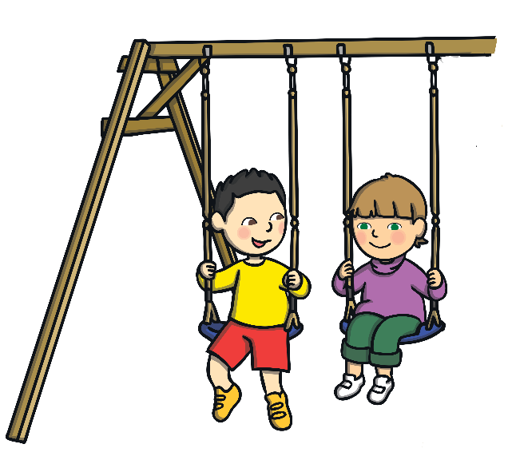
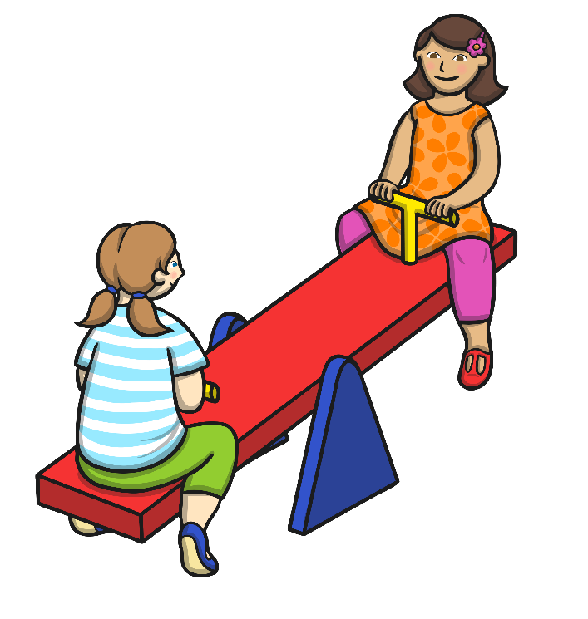
Number Three looked at all the play equipment at the park. Which equipment has 3 children playing on it?
Try again
Try again
Well done! There are 3 children on the swings. How did you find out?

Slide 7
After she had played on the equipment, Number Three decided to climb a tree. She found a tree with 3 apples growing on it and climbed that one. Which tree is the right one? How do you know?
Try again
Try again
Yes! This tree has 3 apples. Can you count how many apples are on the other two trees?

Slide 8
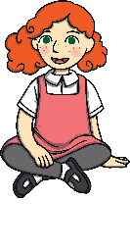
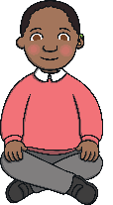
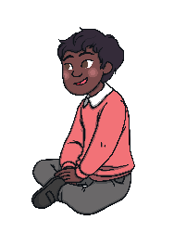
From the top of her tree, Number Three could see lots of people having picnics. Which family had 3 people in it?
Try again
Try again
Yes! There are 3 people in this family.

Slide 9
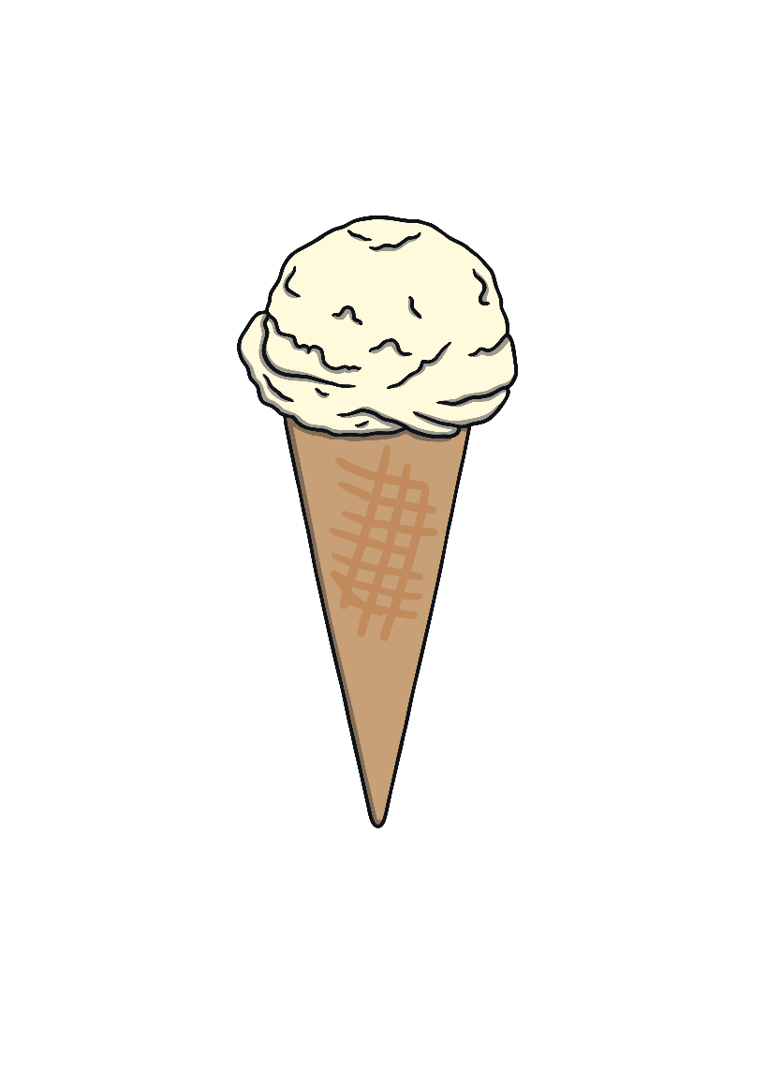
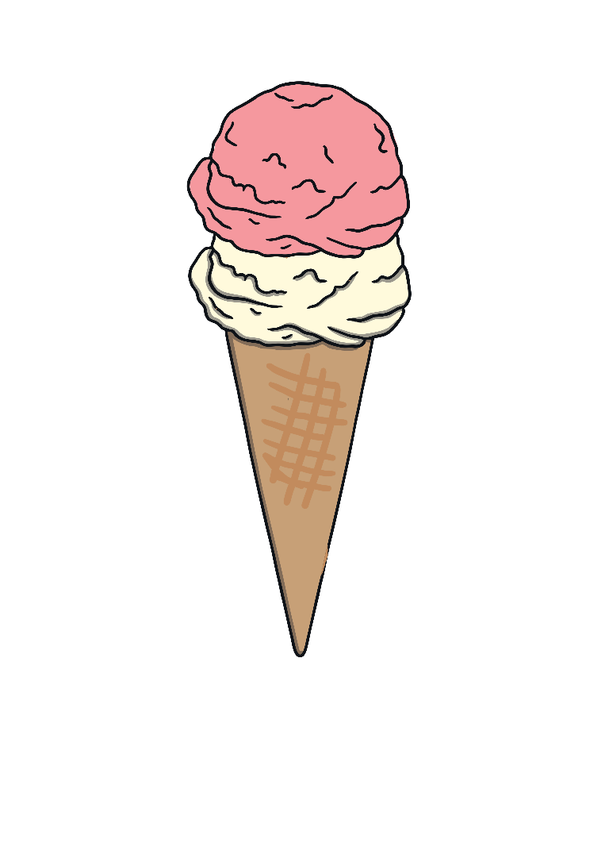
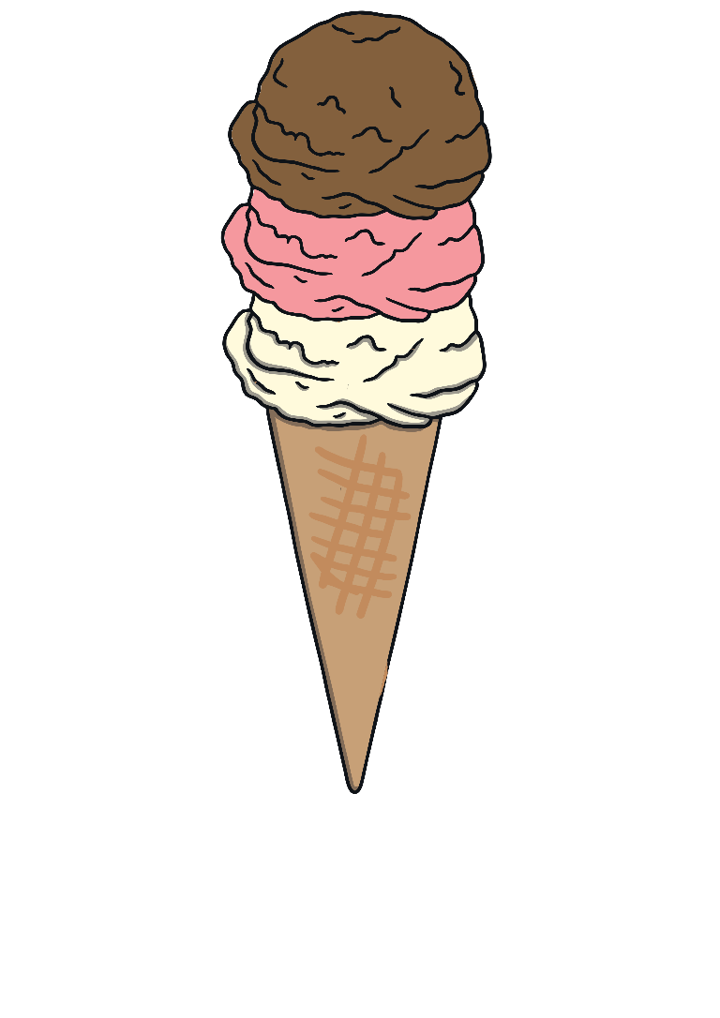
Number Three was very hot and tired after all that playing and climbing. She decided to buy an ice cream. She chose the ice cream with 3 different flavours. Which one is it?
Try again
Try again
That’s right. This ice cream has 3 flavours. Yum yum!

Slide 10
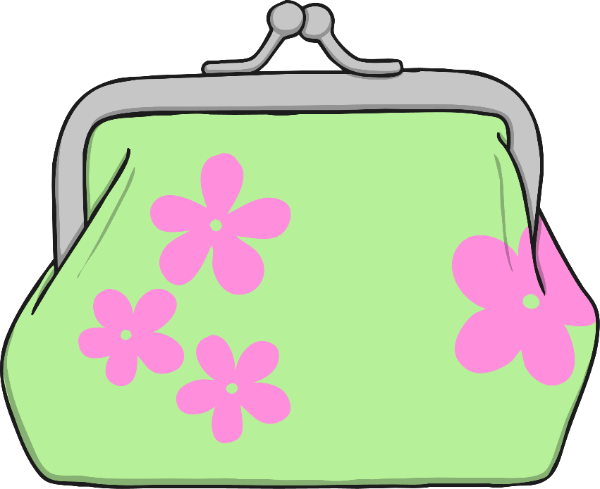
An ice cream costs £3. Which purse does Number Three need?
Try again
Well done! This purse has £3.

Slide 11
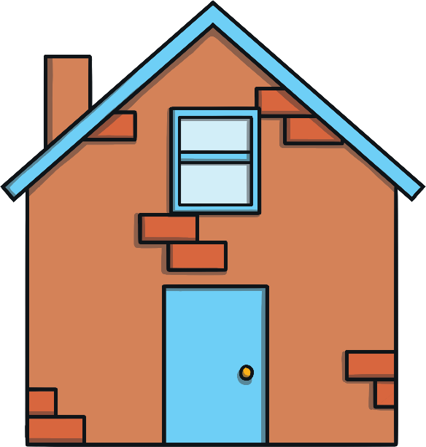
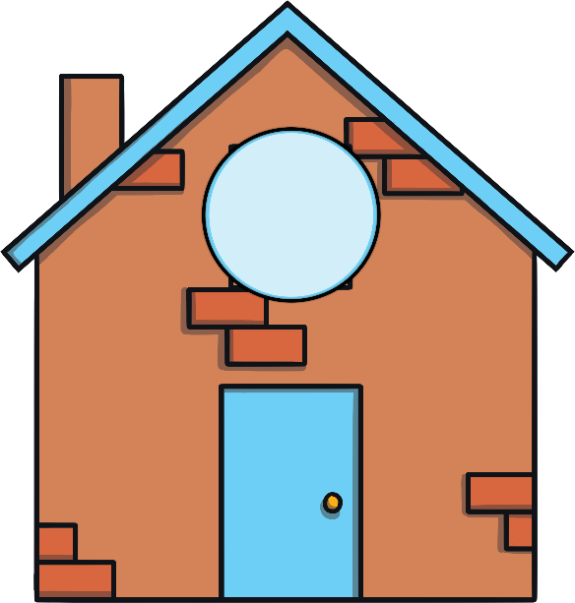
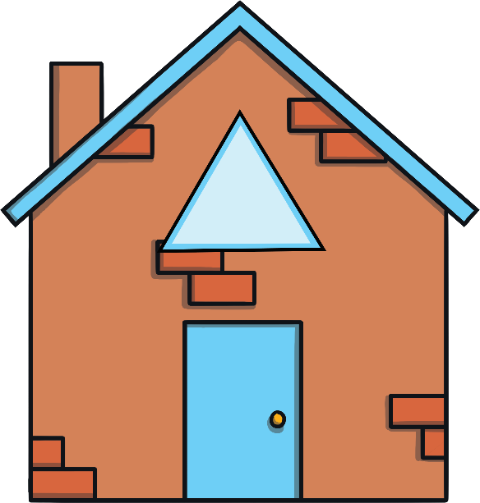
After a lovely afternoon at the park, Number Three decided to go home. This is Number Three’s street. Which house do you think belongs to Number Three? Why?
Try again
Try again
That’s right! I live at the house with the triangle window, because triangles have three sides and I love the number 3.

Slide 12
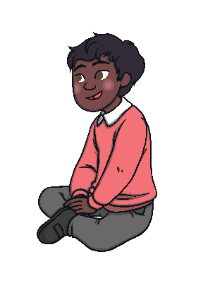
Number Three is safely back home. Let’s look at all the things she saw on her trip to the park.
A gate with 3 circles
3 children on the swings
A tree with 3 apples
3 people having a picnic
An ice cream with 3 flavours

Slide 13
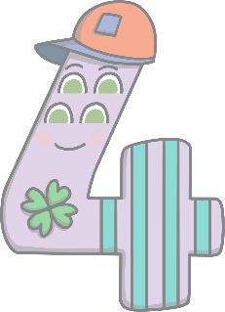
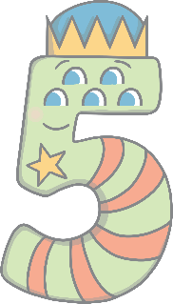
Can you find the number 3 on the number track? Click on Number Three to move her onto the number track.
1
2
3
4
5
Which number comes before number 3? Which number comes after number 3? Can you count along the number line from 1 to 5?

