Slide 1
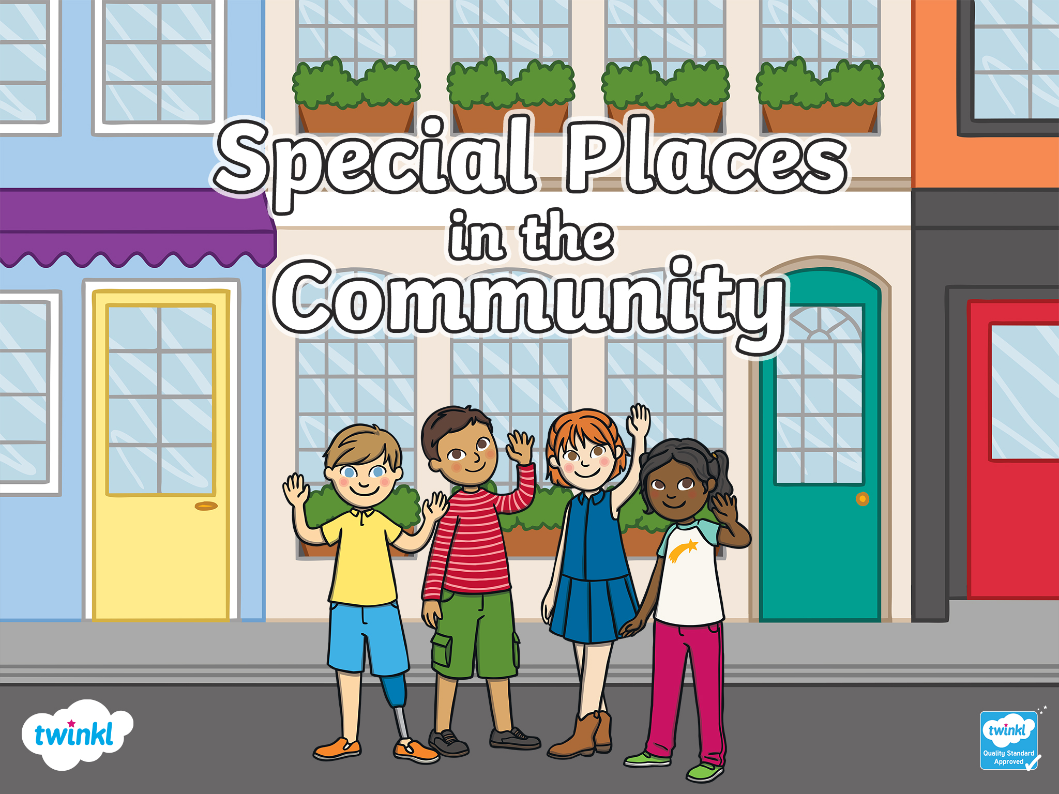

Slide 2


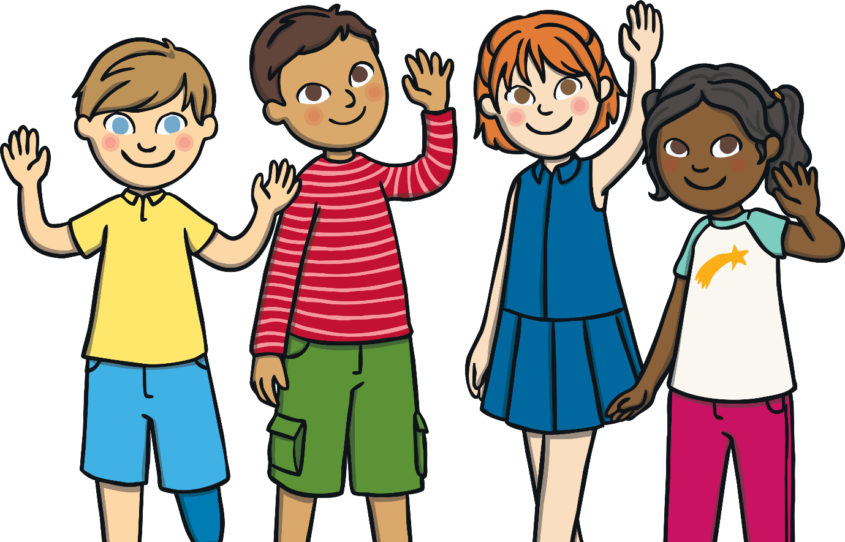

Hello! Do you want to learn more about the special places in our community? Let’s talk about why they are special.
next

Slide 3








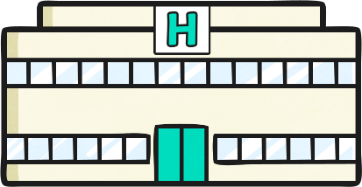


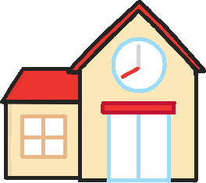
Special Places
woodland
museum
places of worship
park
beach
playground
library
hospital
school
allotments
Click on a place to explore!

Slide 4

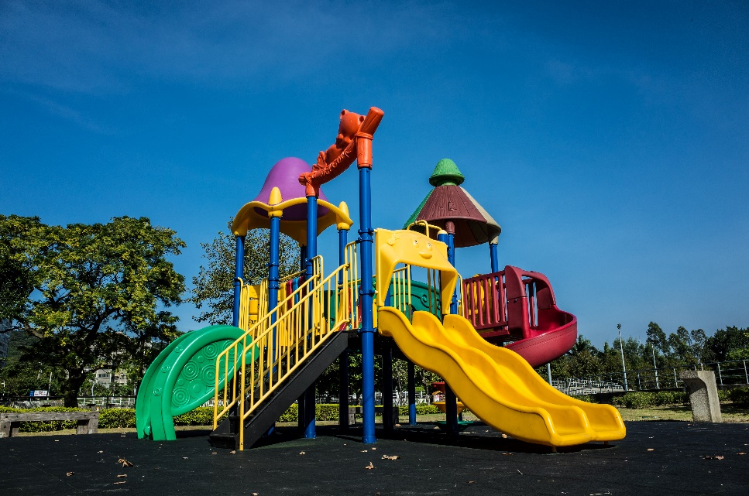

Playground
Playgrounds often have lots of different things to play on, such as slides, swings and climbing frames. Why do you think playgrounds are special places?

Slide 5

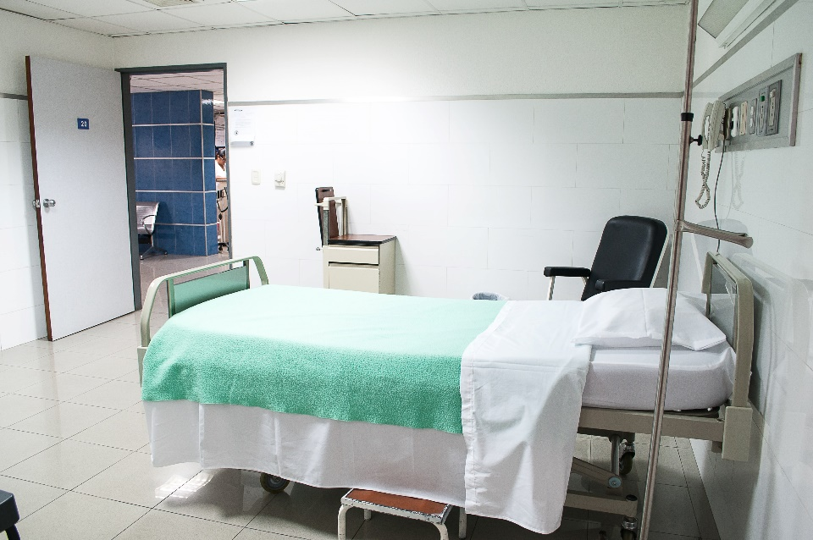
Hospital
For some people, a hospital is a special place because it’s where their brother or sister was born. Can you think of any other reasons why a hospital could be a special place in the community?

Slide 6
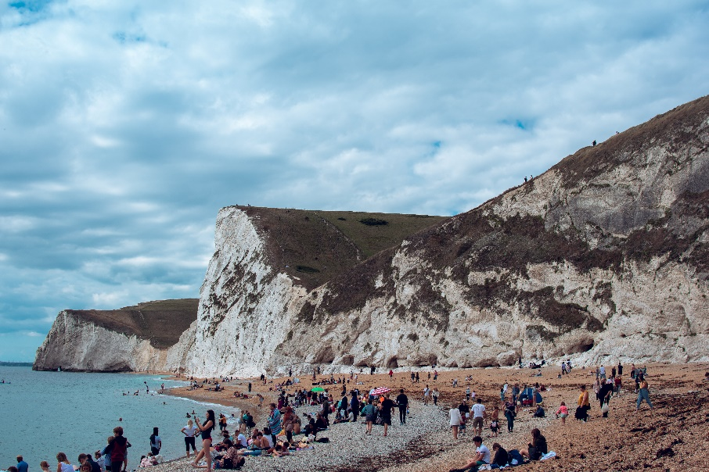
Beach
Some people live near the beach, which means they can often go and visit it. This makes it a special place for their community. At the beach, you can walk, swim, relax and have lots of fun. A beach also has lots of plants and creatures that live there, such as crabs, starfish and jellyfish.
Have you ever been to a beach? What did you do when you were there?

Slide 7
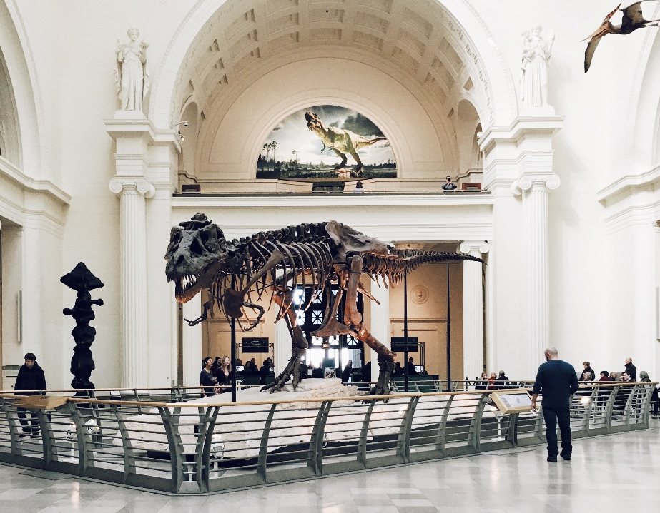
Museum
Some communities have museums. It can be a special place because you can find out what your local area was like in the past. Does your community have a museum? Have you ever visited one?

Slide 8
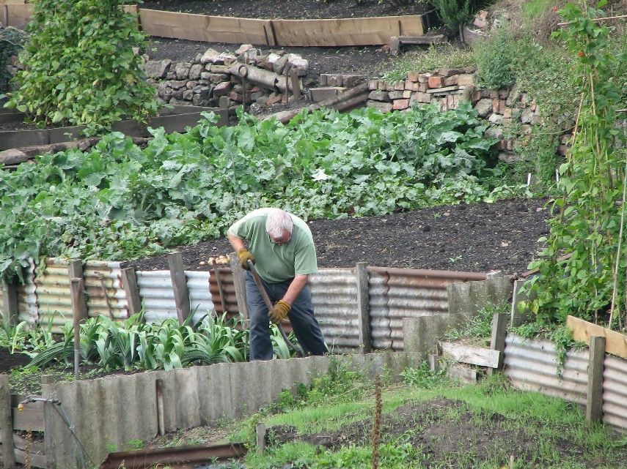
Allotments
Some communities have allotments. These are special places where you can enjoy gardening in the fresh air and grow food to eat. Some of the food grown here can be shared with other people in the community. Does your community have any gardens or allotments?

Slide 9
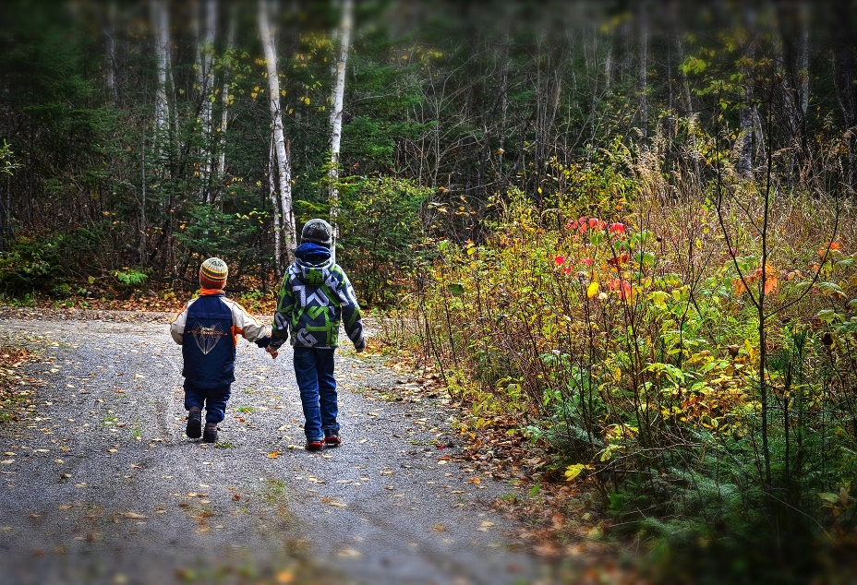
Woodland
Some communities have woodland areas, which they take care of and protect. Woodland areas are special natural places because they have different trees and plants.
Many creatures also like to live in woodland areas, such as squirrels, rabbits, deer and owls. I wonder whether you will see any...

Slide 10
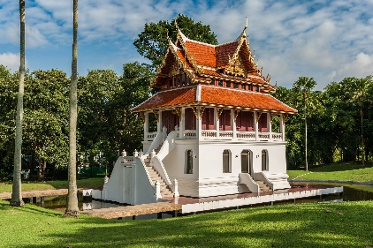
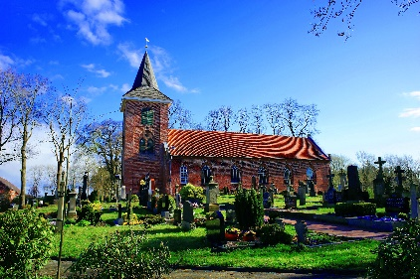
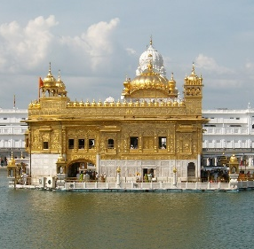
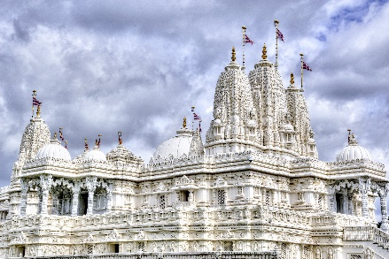
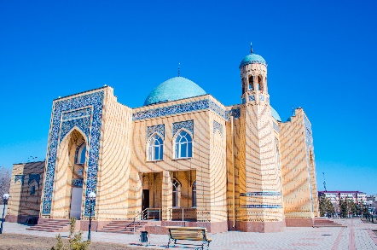
Places of Worship
For some people, their place of worship is a very special place. In a place of worship, people go to pray, be still and reflect. There can be many different places of worship in a community. Have you seen any of these in your community?
Buddhist temple
church
gurdwara
Hindu temple
mosque

Slide 11
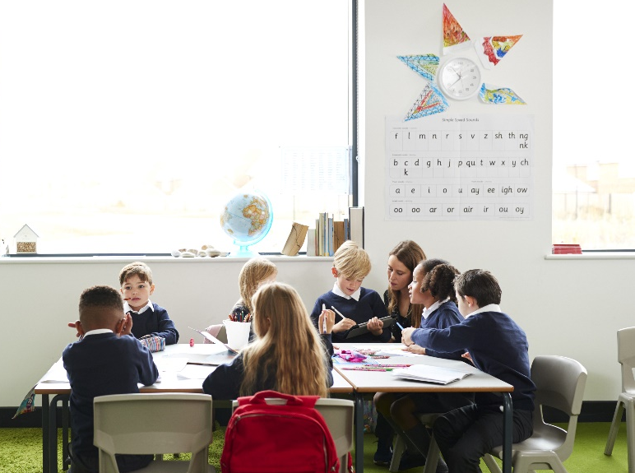
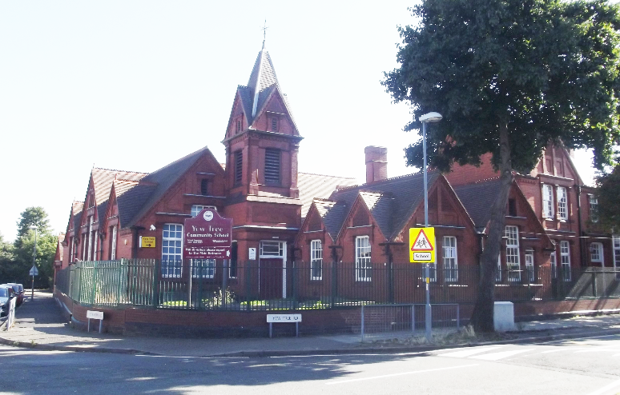
School
Schools are special places in communities because they are a place where children can learn, play and have fun with friends.
What makes your school special to you?

Slide 12
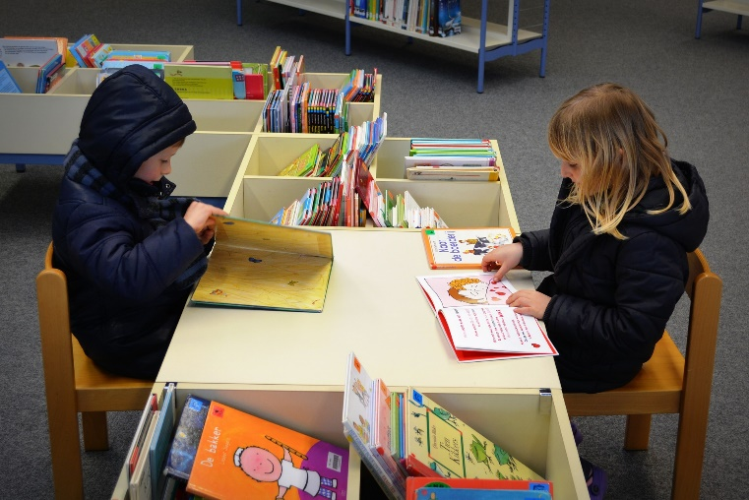
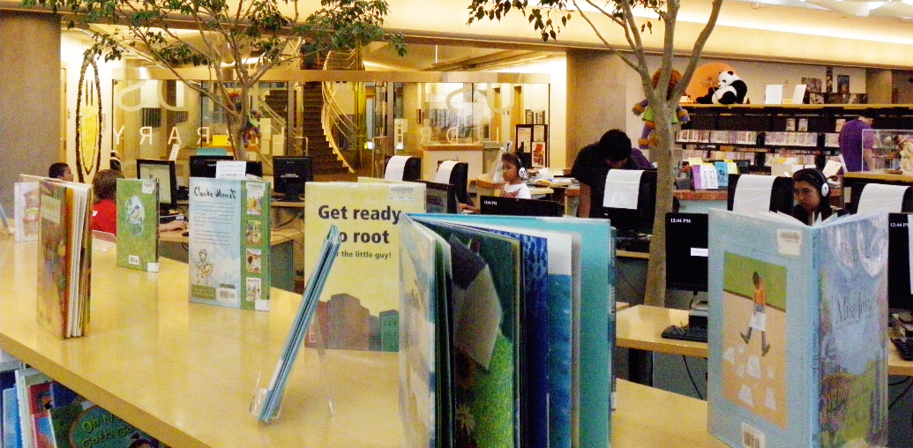
Library
You can visit the library to borrow some new special books to read. Why do you think a library is a special place in the community?

Slide 13
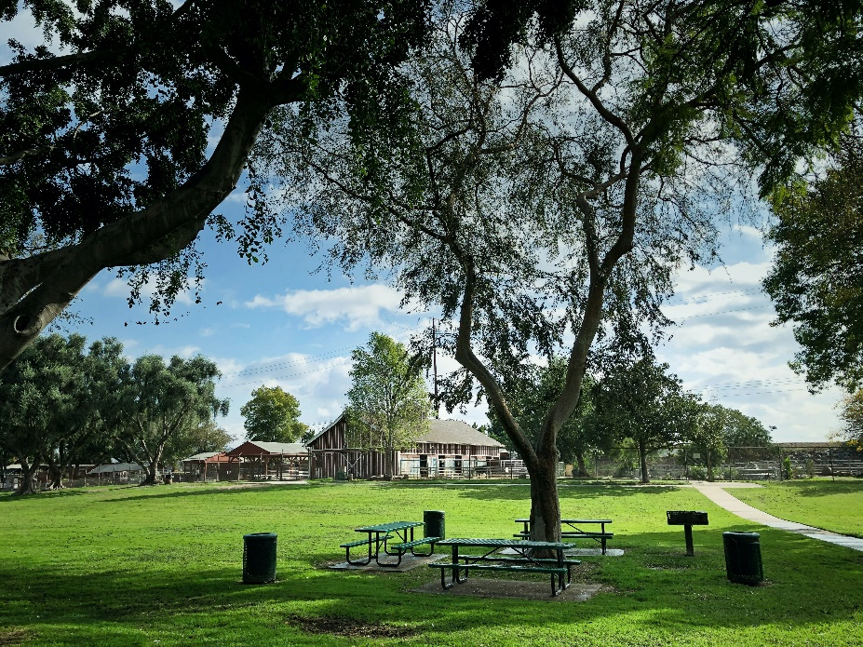
Park
Parks are special places because you can play, run, walk, have picnics and enjoy being in nature. Sometimes, a park may even have a pond! What would you like to do at a park?

Slide 14
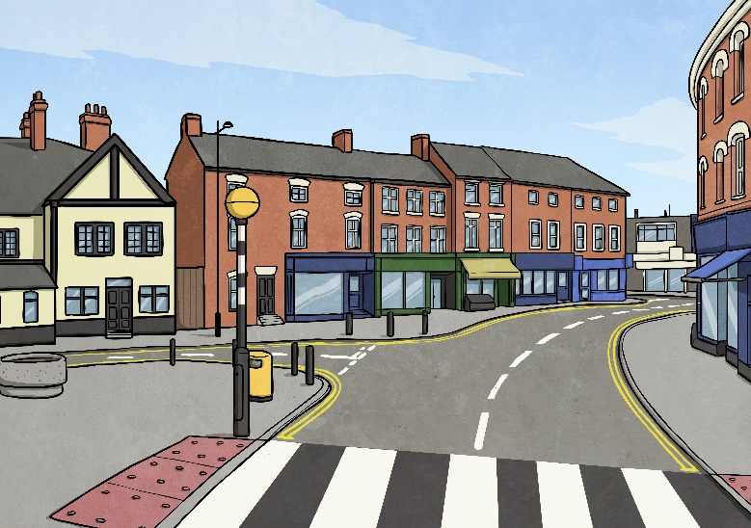
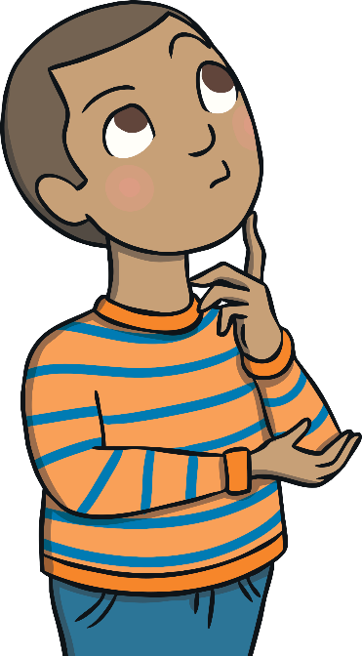
Think About…
What places are special in your community?
Why are they special to you?

Slide 15


